Slide 1
Getting started on your device
Notes:
Websites / pages to have open prior to session start:
https://www.lloydsbankacademy.co.uk/learn-for-life - Academy site - for Individuals
https://deviceguides.vodafone.co.uk/lenovo/tab-m10-plus-3rd-gen-android-13/getting-started/insert-sim/ (step-by-step graphics to show how to insert the SIM card into the device)
https://support.vodafone.co.uk/SIM-eSIM/SIM - this is Vodafone’s general support page for SIMs
https://download.lenovo.com/consumer/mobiles_pub/tab_m9_ug_en.pdf - this is the user guide for the Lenovo M9 tablet
https://images-eu.ssl-images-amazon.com/images/I/91jtERixEmS.pdf - this is user guide for the ZTE MiFi device
https://www.ncsc.gov.uk/collection/top-tips-for-staying-secure-online - referenced by our Fraud team – all our ‘top tips’ in the session are derived from the NCSC’s content
https://stopthinkfraud.campaign.gov.uk/protect-yourself-from-fraud/protecting-against-online-fraud/turn-on-2-step-verification-2sv/ - how to turn on 2sv for various email, social media and other accounts
Capture participant numbers once everyone has arrived
(These should be sent to your Liverpool City Region contact after the session)

Slide 2
Welcome
Notes:
Facilitator note:
Introduce yourself – state your role today and how you plan to help them
Let them know this is a safe space to ask questions
Encourage them to ask about words or phrases they are unclear on
Today's session will last around 90 minutes (if delivering the full session)

Slide 3
Lloyds Bank Academy
Supporting customers and communities to improve capability
www.lloydsbankacademy.com
Notes:
First, a little about the Lloyds Academy and what it does.
Lloyds Academy work with local and UK-wide partners to help reach people and communities we would not otherwise be able to. We work with charities like Crisis, housing associations, anti-poverty groups, prison services and organisations who work with refugees. You don’t need to be a Lloyds bank customer to access our resources or training sessions.
Lloyds Academy has a wealth of resources that you can tap into – so, aside from face-to-face and virtual sessions, we’ve got a bunch of online lessons that anyone can access from our website. We focus on three broad areas:
Online essentials – This covers all aspects of digital, from getting started with a device through to more specific lessons like how to use Excel and context-specific topics like how to access Universal Credit online
Working life – which covers both employability topics like working on CVs and interview preps through to lessons and videos on things like collaboration and productivity tools, how to use email and so on
Money management –The aim here is to increase people’s confidence and show them how they can start to control their own finances

Slide 4
Today we want to help you:
Set up your device
Connect to the internet
Get started with email
Keep safe online
Notes:
Talk through the on-slide content:
Here’s what I’d like you to take away / know by the end of the session:
You’ll have set up your device so you can take it away with you and start using it safely
We’ll also make sure that you know how to connect your device to the internet, using your free SIM
We’ll help you get set up with an email account too
We will look at some tips to help you to keep safe

Slide 5
Setting up your device
Unbox
Start MiFi
Insert SIM
Power on
Setup
Internet
Secure
Notes:
(See Get Started hands-on script in Facilitator Guide for detailed step-by-step instructions)
Talk through what we’re going to cover in this hands-on part of the session:
Talk around the device, charger and any other items in the box (tool for inserting the SIM, Quick Start Guide and Safety info / warranty​)
Demonstrate the MiFi Device (more on the next slide)
Insert the SIM card (detailed images on next slide)​
Power on (including talk around the charger) – plug in the charger ASK: what percentage power does it say?​
Setup and Personalisation / accessibility: language and vision settings as these are presented on initial power up (plus talk around the fact that the device will remember these, but you can change them any time)​
Connect to the network (talk about Wi-Fi – as they will need to know how to connect to their home Wi-Fi if appropriate, though note that during the training session they will be using their SIM card (mobile network))​

Slide 6
Your MiFi Device
Top
Internet with SIM card
Battery powered
Front
Bottom
Notes:
(See Get Started hands-on script – Your MiFi Device step in Facilitator Guide)
This is a pocket size MiFi device, used for connecting to the internet using your SIM card. It is battery powered, the battery life this can go up to 8 hours on a full charge, depending on usage that can fluctuate a bit. The device will require charging using the cable provided. The device is unlocked, you can add whatever SIM card you need.
At the top of the device, you will find the charging port.
On the front, right of the screen there are four LED lights, they monitor the basics things with the device. The one at the top that will monitor the battery health of the device. Green Light means Battery level is high to medium. Red Light means Battery level is low, please charge. Next there is the Wi-Fi status. Blue light means Wi-Fi is on. Light off means Wi-Fi is off. The third light is for unread text messages. Fourth Light will monitor the mobile reception strength like you notice on your phone, Blue light means 4G faster internet connected and Green light means a slower 3G internet connection.
At the bottom side of the device, you will find the power button on the opposite side to the power button you will find SIM card holder. We will look at this together shortly. The middle button for your reference is the WPS button, it lets you connect to the device without using the Wi-Fi name and password for the device but in this group environment we recommend not to use this as people may end up connecting to other people's devices so recommended NOT to press the WPS button!
On the back of the device, you can find your Wi-Fi name which is referred to as “WiFi SSID:” The password for your Wi-Fi is referred to as “WiFi Key:”. This is how you connect your tablet to your MiFi to enable you to use the internet.
TRAINER NOTE
​
As mentioned above The middle button at the bottom side of the device is the WPS button, it lets you connect to the device without using the Wi-Fi name and password for the device but in this group environment we recommend not to use this as people may end up connecting to other people's devices creating stress and confusion, so recommended Not to press the WPS button!

Slide 7
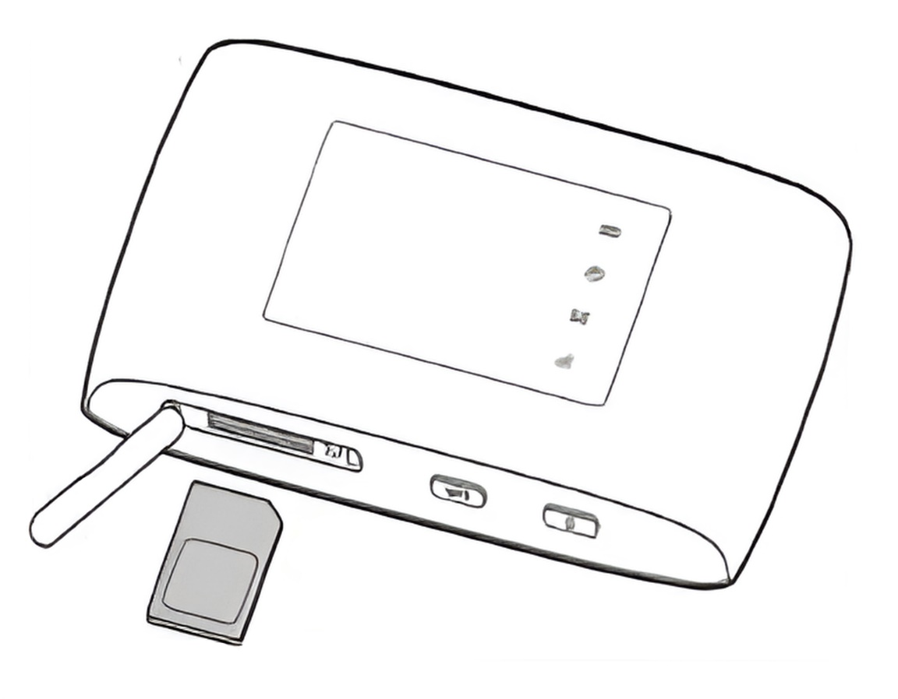
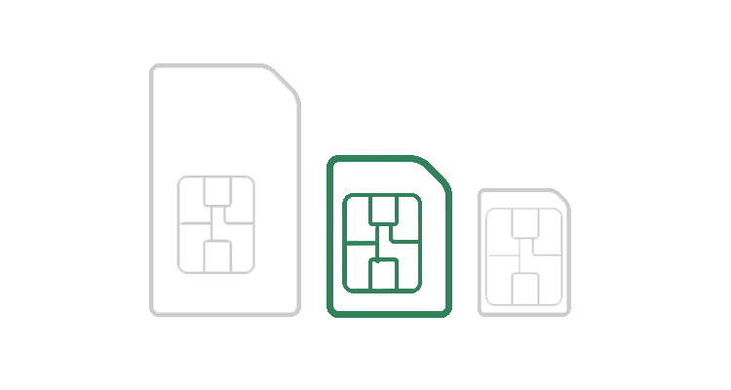
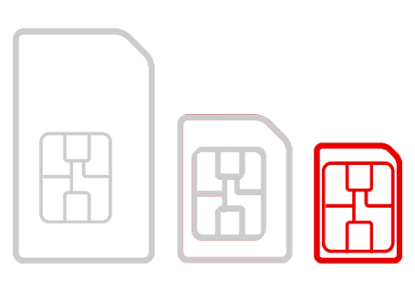
Inserting your SIM
Micro SIM
Notes:
(See Get Started hands-on script - Insert SIM step in Facilitator Guide)
Visuals are here to help the learners if they find it useful – let them know if this isn’t helpful, not to worry and that we will come round and help them with this as required​.
Give out SIM cards and MiFi device if not already done so​
Ask if anyone knows what these are / has used a SIM Card (e.g. with their phones)​
Explain this MiFi device allows you to connect to the internet with a SIM card
TRAINER NOTE - Before they start this part of the hands-on session, make sure their devices are powered OFF​.
​
Micro SIM - Explain what a SIM card is, what they have (40Gb data per month for 6 months). They may have some knowledge e.g. if they have a mobile phone. Show SIM card in its packaging, including the Mobile number. Remove and show the different SIM sizes (standard, micro and nano)​
Remove and make sure to choose the correct SIM sizes (Micro-SIM for the MiFi device)​
As the image on the right shows, on the bottom side of the device you have 2 buttons and a SIM card reader latch that you open. Remove the SIM cover and insert your Micro SIM card. Once the SIM card is inserted securely close the cover
On the Back of the device, you will find your Wi-Fi name (WiFi SSID) and Your Wi-Fi Password (WiFi Key). When prompted to connect to the internet use this information

Slide 8
Internet
Wi-Fi
Mobile data
Data allowance
Notes:
(See Get Started hands-on script – Internet step in the Facilitator Guide)
This slide may enable some discussions and questions. Here are the main talking points to share:
Wireless network – This is also known as 'Wi-Fi' and is a way for your computer to connect to the internet without using wires or cables. Does anyone have internet at home? You can connect this device to your home network for example - you will need the password. You can also connect to public Wi-Fi networks
Mobile data – This enables your device to get online when you're not connected to Wi-Fi. Your MiFi device connects you to the internet using SIM card which is your mobile data.
Data allowance – If you aren't connected to Wi-Fi, using the internet on your smartphone or table uses mobile data, which is measured in megabytes (MB) and gigabytes (GB). Most phone and tablet contracts have monthly allowances for data usage. Once you use up your allowance, you might get charged for additional usage, or you might not be able to use mobile data until your allowance renews the next month
Ask: Can you remember your Data Allowance? 40GB

Slide 9
Typical data usage
Movie 4.5 GB
Music 720 MB
Radio 600 MB
Internet 180 MB
Notes:
TRAINER NOTE – Some attendees may not understand what we mean by Megabytes and Gigabytes. Explain that this is how we measure internet use. Just like you measure weights with Grams and Kilograms.
This slide shows typical Internet data usage (these are average data and not exact) we have the following examples:
An average 90-minute Movie - 4.5GB of Data (1 Gigabyte = 1000 MB)
Streaming Music online for 10 hours 720MB of Data
Listening to Digital Radio for 10 hours 600MB of Data
Surfing the Internet for 3 hours 180 MB
So it’s good to keep track of this if you are using mobile data.
Average data usage for a 90-minute movie on your popular streaming platform is 4.5GB. So that means you could get around 8 movies out of your monthly data allowance, depending on their length. But if you streamed all those movies, you may not have much data left over for other things.
How to set your Data Usage – learners may want to do this with you:
Settings > Search for ‘data warning and limit’ or go to Network and Internet > Internet > Vodafone setting > Data warning and Limit here you can switch on ‘Data warning’ that tells you are reaching your data limit for the month. You can also set Data Limit so that you don’t use more than what you have paid for each month. This is around the 40Gb per month for 6 months provision – show the SIM card information provided.

Slide 10
Keep yourself safe online
Take care with public Wi-Fi
Check websites are secure
Take Five message
Stop
Challenge
Protect
Notes:
TRAINER NOTE – Stress the importance of applying these principles while learners are using their devices remotely
Be careful with public Wi-Fi – Public Wi-Fi can be tempting but risky. Scammers might set up their own "free Wi-Fi" to access your device. If you use public Wi-Fi, avoid logging into sensitive accounts, like your bank
Take care visiting websites – Make sure you're on secure websites, especially those from those you trust. Look for a padlock icon and "https" in the web address. Check for spelling and grammar errors on the site.
Remember the Take Five Message:
Stop – Take a moment to think before taking any action regarding your finances or personal details
Challenge – Question requests that seem too good to be true. Criminals often rush or panic you
Protect – Contact your bank if you suspect a scam and report it to Action Fraud
Staying safe online is about being careful and staying informed. Don't rush into sharing personal information, and always double-check if something seems unusual

Slide 11
Screen unlock options
Face recognition
Pattern
PIN
Password
Notes:
(See Get Started hands-on script – Secure step in the Facilitator Guide)
First, talk through / check understanding of the term ‘screen lock’ and what this does / why you should set it up as part of keeping your device and data safe​.
​
Face recognition – To set this up, you first need to create one of the other options. Do this as part of the setup
Pattern unlock – This is a security feature commonly used on some phones. It allows you to set a unique pattern by connecting dots on the screen. To unlock your phone, you need to recreate this pattern
PIN Unlock – To unlock your phone you simply type in a numeric pin code
Password – Choosing this option you can type a password to unlock your phone. Password can be a combination of numbers, letters and symbols. We’ll talk more about what makes a strong password in a little while

Slide 12
Keep your device safe
Lock your device
Keep it up-to-date
Create strong passwords
Use a password manager
Guidance taken from https://www.ncsc.gov.uk/collection/top-tips-for-staying-secure-online
Notes:
30 mins - Staying safe while using your device
TRAINER NOTE – No need to demo these, just talk through and signpost, where appropriate, further sources of advice/info.
Suggested script:
As with all your belongings, you will need to keep your device safe. There are plenty of ways to do this, beyond just keeping it with you or locked away when you are not using it.
We’ve mentioned locking and unlocking your device – who can remember the different options to unlock? (facial recognition, patterns, PINs and passwords) Also mention the screen lock options through Settings > Display > Lock display (allows you to change the timeout duration, switch on ‘double-tap to lock’ etc).
Another way to keep it safe is to make sure all the apps and the software on your device are always up-to-date. That means applying updates when you’re prompted to do so. This software helps to fix, improve and secure your device. So, these updates include the latest security fixes as well as improvements and new features, so it’s important to apply them as soon as possible. The best way to do this is set these updates to automatically install. On your tablet, you can do this by going into Settings > System > System Update and tapping the three dots at the top right of the System Update screen.
You may occasionally see a prompt to update your device. If you do, don’t ignore it. And make sure you are only downloading and installing these updates from trusted sources.
It’s important that when you’re creating passwords – to access your device or any app or website that needs it – that you pick one that is not easily guessed. Protect your accounts by using strong and unique passwords. Don't reuse them. Scammers can easily guess weak passwords. So how to come up with a strong password? Start by picking three random words, then join them all together. Change some letters from lower case to capitals, and swap others for numbers, to make it harder to guess.
Never share your passwords or use the same password for multiple things. If you have trouble remembering your passwords, consider using a password manager, which can create strong passwords and store them safely for you. Now you have a Google account for instance, you may find that when you access websites that request a password, Google will offer to suggest a strong password and store this for you.

Slide 13
Find your way around
3-button navigation
Gesture navigation
Notes:
(See Get Started hands-on script – Complete setup step in the Facilitator Guide) Use this slide for the Lenovo M9 tablets
Part of setup is setting preferred navigation mode​
​
Default is ‘3-button navigation’ – as shown here, the 3 buttons show on the navigation bar at the bottom of the screen:​
​
Triangle = Go back (returns to previous menu or exits an app​
Circle = Home (returns to home screen)​
Square = Switch apps – shows a list of open apps and switches between them​
Can switch to gesture navigation during setup or later (hands-on script suggests all learners leave this as 3-button during setup to ensure consistency and for ease of training – they can change this later if required) Gesture navigation-specific gestures:​
Swipe up from bottom – Return to Home screen​
Swipe up from bottom and hold – View open apps​
Swipe from left / right – Switch to previous page​
Swipe from left or right at bottom – Switch between open apps​
​
Mention also basic gestures (available regardless of navigation mode)​:
Tap – Select or open an item​
Press and hold – For frequently used app functions and customising the Home screen​
Swipe – Up to see list of all apps; down for Notifications; down twice for Quick settings​
Hold and drag – To move apps etc​
Spread and pinch – To zoom in and out​
​

Slide 14
Find your way around
3-button navigation
Gesture navigation
|||
<
|||
<
|||
<
Notes:
(See Get Started hands-on script – Complete setup step in the Facilitator Guide) Use this slide for the Samsung Galaxy Tab A9 tablets
Part of setup is setting preferred navigation mode​
​
Default is ‘3-button navigation’ – as shown here, the 3 buttons show on the navigation bar at the bottom of the screen:​
​
Back = (Triangle) Go back, returns to previous menu or exits an app​
Home = (Square) Returns to home screen​
Recent = (Three horizontal Lines) shows a list of open apps and switches between them​
Can switch to gesture navigation during setup or later (hands-on script suggests all learners leave this as 3-button during setup to ensure consistency and for ease of training – they can change this later if required) Gesture navigation-specific gestures:​
Swipe up from bottom – Return to Home screen​
Swipe up from bottom and hold – View open apps​
Swipe from left / right – Switch to previous page​
Swipe from left or right at bottom – Switch between open apps​
​
Mention also basic gestures (available regardless of navigation mode)​:
Tap – Select or open an item​
Press and hold – For frequently used app functions and customising the Home screen​
Swipe – Up to see list of all apps; down for Notifications; down twice for Quick settings​
Hold and drag – To move apps etc​
Spread and pinch – To zoom in and out​
​

Slide 15
Apps
Apps and the Home screen
Try it out: the Camera app
Notes:
(See Get Started hands-on script – Navigation and apps step in the Facilitator Guide)
Apps help you to use your device. You can use different types of apps like the Camera to take pictures, games apps, online banking apps, talk to family and more.
Apps and the Home screen – Let the participants feel comfortable with the device and show the apps situated on the home screen and other screens, swipe up to see list of all apps that are installed on the device
​Camera App​ – On the home screen you will see an icon that looks like a Camera
Tap this icon
​Click the Camera app, this will open the app to allow you to take pictures
You can then click the big button to take a picture, you can also take videos by choosing the video option
TRAINER NOTE: We have noted that the App named "Duo" (Google Duo app) icon looks similar to the Camera Icon so be aware of this and go around the room to make sure everyone is in the correct camera app. Allow participants to take pictures use the video and feel more comfortable.

Slide 16
Emails
To keep in touch with family and friends
Needed for online accounts like:
Online shopping
Online Banking
Streaming Services
Notes:
10-15 mins hands-on session
(See Reach Out hands-on script for step-by-step instructions – up to and including Start using Gmail step in Facilitator Guide)
Email is a great way to keep in touch with friends and family and is much quicker and cheaper than sending a card or letter in the post. You can write to people online, send pictures and even upload short videos to an email. Having an email address is also useful in other ways. It means you can do everyday tasks like shopping and banking online. It’s also now the main way companies and organisations keep in touch with customers. Email is definitely a handy thing to have as it will keep you connected with the wider world.​
We’re going to work through how to set up a Gmail email account. You may already have a Google account and know the email address and password. If that’s the case, you can use that email address. If you can’t remember the password, would like another email account or just don’t have one yet, then this next activity is for you.
TRAINER NOTE: If any learner would like to know more about setting up another email account, this can be done as a separate 1-to-1 after the session.
Mention:
You can access email on various devices, like phones, tablets, laptops, or computers
Most devices have built-in email apps, and you can also download email apps from app stores or browsers

Slide 17
You get an email
You don’t know the sender.
They’re asking for personal information.
What do you do?
Reply with information
Ignore the email
Report it
Check using contact details you trust
Notes:
Let's test your instincts in a common online scenario. Imagine you receive an email from an unknown sender asking for your personal information. What would you do in this situation?
Reply with information
Ignore the email
Report it
Check with the sender using contact details you trust
Take a moment to choose your answer
TRAINER NOTE – The correct responses here are C. Report it and D. Check with the sender using contact details you trust
C. Report it: If you ever receive an email that seems suspicious or requests personal information, report it. If you have received an email which you’re not quite sure about, forward it to report@phishing.gov.uk
D - Check with the sender using contact details you trust: If you know the person that the message is supposed to have been sent by, it’s a good idea to check with them directly and make sure they sent it. If the message comes from a business or organisation, you can find their contact details by searching online – don’t trust the contact details in the email. You can then explain the email you have received and check they are aware of it
Follow-up discussion:
Now, let's discuss why these are the right choices. These kinds of emails are attempts to trick people into sharing sensitive information. Reporting them helps prevent others from falling for these types of traps. Checking using another channel that you know, and trust can give you an extra line of safety before responding to or interacting with the email. Online safety is a shared responsibility, and being aware of these situations will help you to navigate the digital world securely.

Slide 18
Downloading apps
Find Play Store
Search Google Lens
Install Google Lens
Notes:
(See Reach Out hands-on script for step-by-step instructions – from Access Play Store app step in Facilitator Guide)
Having a Google account means you’ve got access to more than just Gmail. You can also use things like the Google Play Store app. This is where you can get more apps on your device, so we’re going to look at how to use the Play store to get a new app – we’ve picked the Google Lens app as it can be quite a useful one to have. Google Lens uses your camera to do lots of wonderful things like, translate words, identify plants, use QR codes and so much more.
​
​ Adding apps to your device​ – You can add other apps that may be useful for you. You can add apps like, emails, games, banking, and more. The "Play Store" has a library of apps from which you can choose the ones to download and use on your device ​
Let's download Google Lens app now.

Slide 19
Keep your data safe
When you start to use your device
Using apps and websites:
What are you sharing?
Think before you buy
Back up your valuables
If you’re no longer using the device:
Remove the device from online accounts
‘Factory reset’
Guidance taken from https://www.ncsc.gov.uk/collection/top-tips-for-staying-secure-online
Notes:
Suggested script:
When you start to use your device – Can you remember information you gave out when you first logged into your device? (Looking for: name, contact details, date of birth plus username/email address and password /PIN / pattern info) This data is held and remembered on your device, and it’s the first piece of personal data that is stored there
Using apps and websites – Now think about data you share or enter when you’re setting up and using the different apps and websites. This may be similar to when you first logged into your device, plus it may include other information, depending on the type of app or site
What kind of content would you share on a social media site for example? (Looking for: photos, videos, maybe location info etc). Talk about how this information might be used by others and the need to be careful about what you post and who might see it – e.g. holiday snaps that tell people you’re not at home all week
How about when you’re buying something online – what information do you need to give out to the online shop/seller? (Looking for payment info including credit / debit card details, as well as your name and billing plus delivery address) Again, talk about how this information may be used and the importance of checking / researching the seller before giving payment information out. Make sure you only buy from trusted sellers – and only give the details that are absolutely needed to complete the sale. If you’re not sure about a seller, if you can’t see a padlock icon on their website or if they want payment through a direct bank transfer, don’t go ahead with the purchase
If you are buying or selling items on social media such as Facebook Marketplace, just like in real life buying something from someone unknown or a guy down the pub, be careful. Things to think about when buying on social media, someone may ask you to put down a deposit or send payment in advance to secure your Item. It could be possible that they'll take off with your money and give you nothing in return. Never agree to pay for an item before you receive it. If the seller continues pressuring you or implies it's urgent that you pay in advance, it's possible it could be a scam and best to be safe. Beware of anything that's for sale for a fraction of the proper retail price. It could be that the item listing non-working electronics or counterfeit designer clothing. Or may take you away from the platform to take your money. So best to be safe
Back up your valuables– this includes all your precious photos and videos, as well as important contacts and documents – anything that is of value to you. If you’re not sure whether something needs backing up, just ask ‘would it be a problem if I lost this?’. Backups mean that even if your device is lost or stolen, you’ll still be able to access your data. Backing up just means taking a copy of all your important information and keeping this copy somewhere safe
That ‘somewhere safe’ may be on the internet – using what we call ‘cloud’ storage. This is online storage, available to you on your devices through your Google accounts. You’ll get a certain amount of cloud storage space included for free with your Google account, and you can buy more if you need it. Then if you need to access your backed up data – for instance if your device is broken or you’re getting a new one – you can log into your Google account from elsewhere to retrieve your data
The other type of ‘somewhere safe’ is a separate physical device. This can be a useful option if you don’t have cloud storage, or if you have a lot of data to back up
TRAINER NOTE – This article gives more detail on the Google backups: https://support.google.com/android/answer/2819582?hl=en
If you’re no longer using the device – if you are preparing to pass your device on, you’ll need to clear out all your personal data. We recommend you do two things here:
First, remove that device from any online accounts you have, for instance your Google account. Google has a simple feature to remove a single device, or even ‘remove all devices’ so that if you – or anyone else – tries to log into your account from that device, they’ll need to enter the login details, including password
Secondly, clear down all the data that’s stored on the device itself, by doing a ‘Factory reset’. This literally means resetting the device back to what it looked like when it came out of the factory. Make sure that before you do this, you’ve backed up any data that you’re likely to need elsewhere. To do a factory reset on your tablet, go to Settings > System > Reset options > Erase all data (factory reset) then tap ‘Erase all data’

Slide 20
More ideas to stay safe
Enable 2-factor authentication
Use / install security software
Don’t share personal information
Check your social media profile and privacy settings
Guidance taken from https://www.ncsc.gov.uk/collection/top-tips-for-staying-secure-online
Notes:
Suggested script:
Two-factor authentication (2FA) - also called multi-factor authentication (MFA) and 2-step verification (2SV) adds an extra layer of security to your accounts. This might involve a text being sent to your phone with a code you use, a fingerprint or face scan or an app. It's a great way to keep your accounts extra safe. If you want to know more about this, there's a gov.uk site to help you, which includes how to go about setting this up: https://stopthinkfraud.campaign.gov.uk/protect-yourself-from-fraud/protecting-against-online-fraud/turn-on-2-step-verification-2sv/
Antivirus and security software help keep your devices safe. There’s built-in security software for your devices (including Google Play Protect plus Android built-in security protection tools). You can also get separate software for your laptop or PC – some are free, others you pay for, though they may offer a free trial. It’s a good idea to ask around and do your research when you’re thinking of getting this, to make sure anything you get doesn’t conflict with that device’s built-in software. Phones and tablets don’t need antivirus software, just make sure that when you install or download apps, you do this from your official app store. Plus, don’t forget to update these apps when a new version is available, to keep their own security features up-to-date
Don’t share personal information – this applies to all your devices, including your phone. Sadly, not everyone has good intentions online, so it’s good to always be protective of your personal information – even around family members and friends. Think of this information as private to you, and always think twice when someone is asking for things like date of birth, address or other contact details or banking details
Check your social media profile and privacy settings – while these apps are a great way to share with friends and family, you need to think about who else might be viewing these. So, when setting up your social media – and every so often after this – do check your public profile. This will show you what everyone can see. Then you can tweak or change who you want to see this, through your privacy settings. You may not want everyone to see photos of your children for instance. And those holiday snaps tell people that you’re not at home this week, too

Slide 21
You meet someone online
They ask for your personal information.
What do you do?
Share my information
Say no. Don’t share
Ask why they need it
Seek advice
Notes:
Let's explore another scenario related to online interactions. You've been chatting with someone online. They ask for your personal information, including your full name, address, and phone number. What would you do in this situation?
Share my personal information with them
Say no and not share any personal information
Ask them why they need this information
Seek advice from someone I trust
Take a moment to choose your answer.
TRAINER NOTE – The correct responses here are:
B. Say no and not share any personal information – Take care and be cautious when sharing personal details online, especially with someone you've just met. Your privacy is important, and sharing information like this can pose risks
D. Seek advice from someone I trust –Seeking advice adds an extra layer of security. If you're unsure about the situation, talking it though with someone you trust provides valuable insights
Discuss the answers and share tips based on the responses.
Emphasise the importance of protecting personal information online and the potential risks of sharing such details with strangers.
Let's discuss why these are the recommended choices:
You need to protect your personal information online
Saying no to sharing sensitive details helps protect your privacy and security
Seeking advice helps you make sure that you make informed decisions. It also highlights the importance of involving people you trust in your online interactions

Slide 22
What to do if something happens
Contact Action Fraud:
0300 123 2040 actionfraud.police.uk
Tell your bank - Call 159
Change your passwords
Scan your device
Notes:
If you encounter a problem online, quick action is key. Here's what to do:
Contact authorities – If you suspect a scam, report it to Action Fraud on 0300 123 2040 or online at Action Fraud. In Scotland, you can contact Police Scotland on 101
Gather evidence – Keep any screenshots or any relevant data related to the incident together. This evidence can be really helpful for reporting and potential investigations
TRAINER NOTE – This is a good opportunity to demo how to take a screenshot on their device: press and hold the volume down and power buttons together. Show how the screenshot is then displayed bottom left of screen, and that you can go into it, edit if required (e.g. to crop) then tap the tick/check icon to save it. Then show in the Photos app the new album called Screenshots, with your saved screenshot there.
Tell your bank – If your bank account is affected, contact your bank immediately. They can secure your accounts and investigate. 159 is a new, secure number that contacts you directly to your bank if you think you’re being scammed
Change your passwords – If you think someone might have your password, change it right away. Make sure your new passwords are strong and unique for each account.
Scan your device – Run an antivirus and malware scan on your devices to make sure your data is safe
Taking these steps quickly can make a big difference. Stay alert, seek help, and take action if you encounter a problem.

Slide 23
What you’ve done today
Set up your device
Connected to the Internet
Got started with email
Learnt how to keep safe online
Notes:
Recap what they've done so far. Let them know that we have an extra hour available now if anyone would like 1:1 support

Slide 24
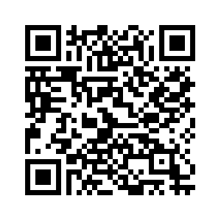
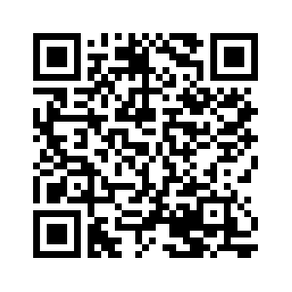
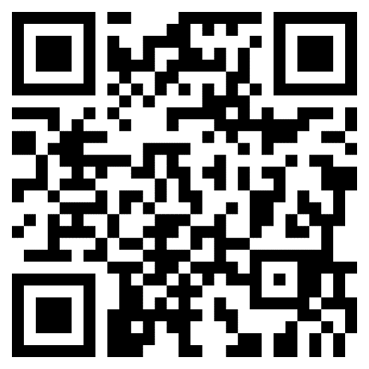
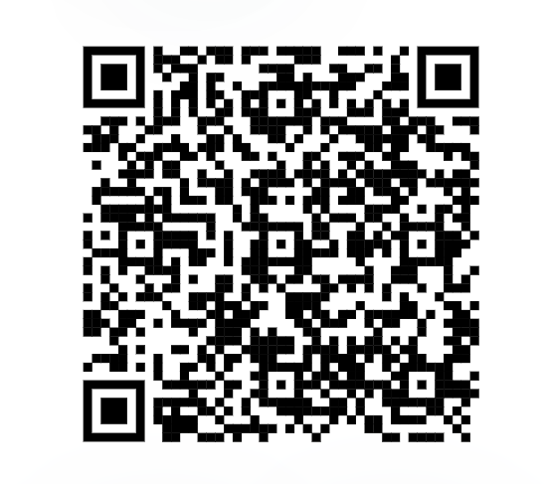
What’s next?
Notes:
10 mins - Recap, onward journey and signposting
Signpost related content on the Academy website https://www.lloydsbankacademy.co.uk/learn-for-life/get-started-online/
Encourage them to search for this site. Alternatively, they could use their device or phone cameras to scan the QR code here. This is where we can now use the downloaded app, Google Lens. find the Google Lens app on your device and use it to scan this code. As you point your camera at the QR code, you’ll see a frame around the code and a prompt to open the website it links to, using your web browser.
There’s also a QR code for the Vodaphone site, for any questions around SIMS (e.g. how to top up after their 6 months): https://support.vodafone.co.uk/SIM-eSIM/SIM
There’s the Digital Helpline number: a free dedicated service offering 1:1 help with digital needs. Available to anyone 18 or over and who live in UK / Channel Islands – you don’t need to be a Lloyds Bank customer. Mon-Fri 9am-5pm, quote ‘Digital Inclusion Initiative’
You can use the QR code to link to the user guide for your tablets - contains everything we’ve been through in the ‘setting up your device’ part of this session as well as other useful info in an easy-to-read format https://download.lenovo.com/consumer/mobiles_pub/tab_m9_ug_en.pdf Lenovo M9 tablet
You can use the QR code to access the user guide for the ZTE MiFi device which explains all the features available https://images-eu.ssl-images-amazon.com/images/I/91jtERixEmS.pdf

Slide 25
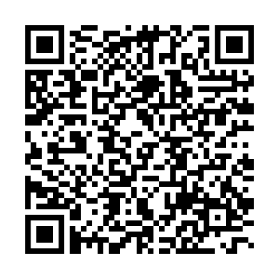
Feedback
Please give us feedback!
Use your device to scan the QR code
Or type in the URL
www.bit.ly/DIIfeedback
Notes:
Final activity: accessing and completing the feedback survey
So, for your last activity today before you go, we’d like you to access the feedback survey for this session. You can see a QR code here – so find the Google Lens app on your device and use it to scan this code. As you point your camera at the QR code, you’ll see a frame around the code and a prompt to open the website it links to, using your web browser. Once you’ve tapped this, you’ll see a short form to fill in.
Alternatively, type the URL into your web browser.

