Slide 1
Banking Essentials Workshop
Presentation

Slide 2
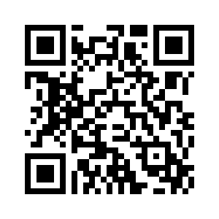
Pre-session survey
Notes:
Encourage learners to scan the QR code here and complete our short pre-session survey around levels of confidence in the session’s topics today, plus what they would like to get out of the session

Slide 3
Welcome

Slide 4

Introductions
Your facilitator today is:
Please introduce yourself to the group
What do you want to get from this workshop?
Notes:
Introductions
Introduce yourself – state your role today and how you plan to help them
Let them know this is a safe space to ask questions about money​
Encourage them to ask about terms or practices they are unclear on
Learner intros– if it’s a larger group, then ask them to introduce themselves to the person on their right.
In their intros, ask them to name one thing they'd personally like to get from the workshop.

Slide 5
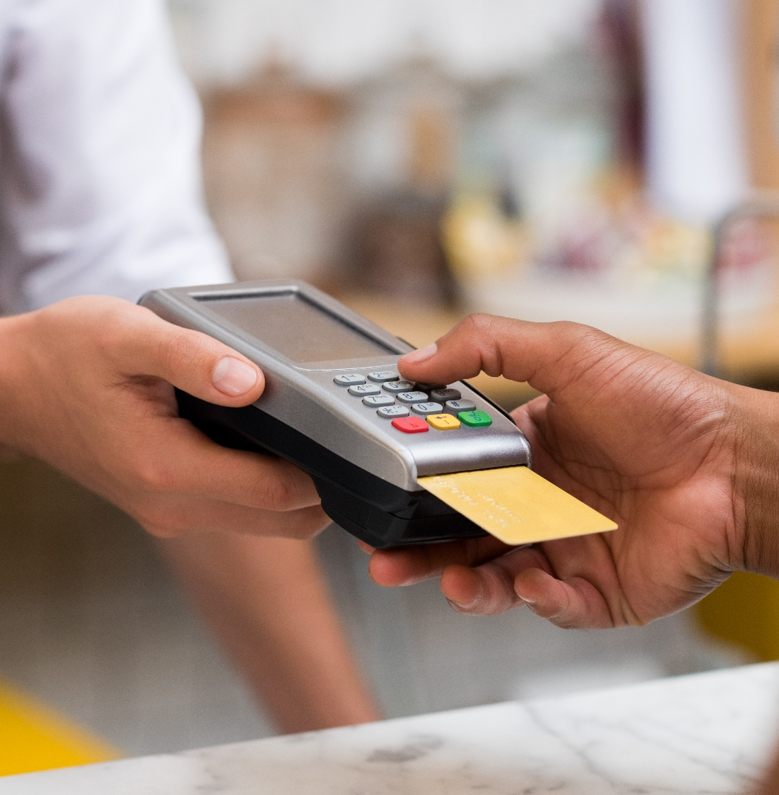
Objectives
By the end of this workshop, you should be able to:
Explain the difference between a basic bank account and a current account
Plan how to open a bank account
Name parts of a bank statement
Manage a bank account
Use your bank card safely
Notes:
Talk through the on-slide content:
This workshop aims to help you understand how to open and manage a bank account.
Here’s what I’d like you to take away / know by the end of the session
(Read through the objectives)

Slide 6

Today’s session
Health and safety briefing
Agenda
Welcome
Bank account types
Opening a bank account
Understanding bank statements
Managing your bank account
Debit cards
Disclaimer: Everything that is discussed today is for guidance and is not financial advice. Any websites, tools etc. are examples of what's available.
Notes:
Today’s session
Run through basic health and safety (fire exits, trip hazards etc).
Run through the agenda.
Read out the disclaimer:
Everything that is discussed today is for guidance and is not financial advice. Any websites, tools etc. are examples of what's available
Hand out the workbook and explain it's for the learners to make notes as we go through the workshop and has some useful links to further information.

Slide 7
Bank account types
Notes:
Bank account types
So, first we’re going to look at the different types of bank account.
And by the end of this section, you should be able to:
explain the difference between a basic bank account and a current account.

Slide 8

Bank account types, explained
Basic bank account
Current bank account
Notes:
Bank account types
There are lots of different types of bank accounts which can make it very confusing when you're not sure which is the best one for you.
We're going to focus today on the two common types of accounts – a basic bank account and a current bank account.
There’s information in your workbook about where to find out more about bank account types if you want to explore this further.

Slide 9
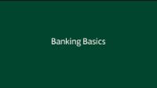
Banking Basics
Notes:
*** NOTE THIS SLIDE IS HIDDEN BY DEFAULT. TO SHOW IT, GO TO ‘SLIDE SHOW’ TAB THEN SELECT ‘UNHIDE SLIDE’ ***
PLAY BANKING BASICS ANIMATED VIDEO IF APPROPRIATE

Slide 10
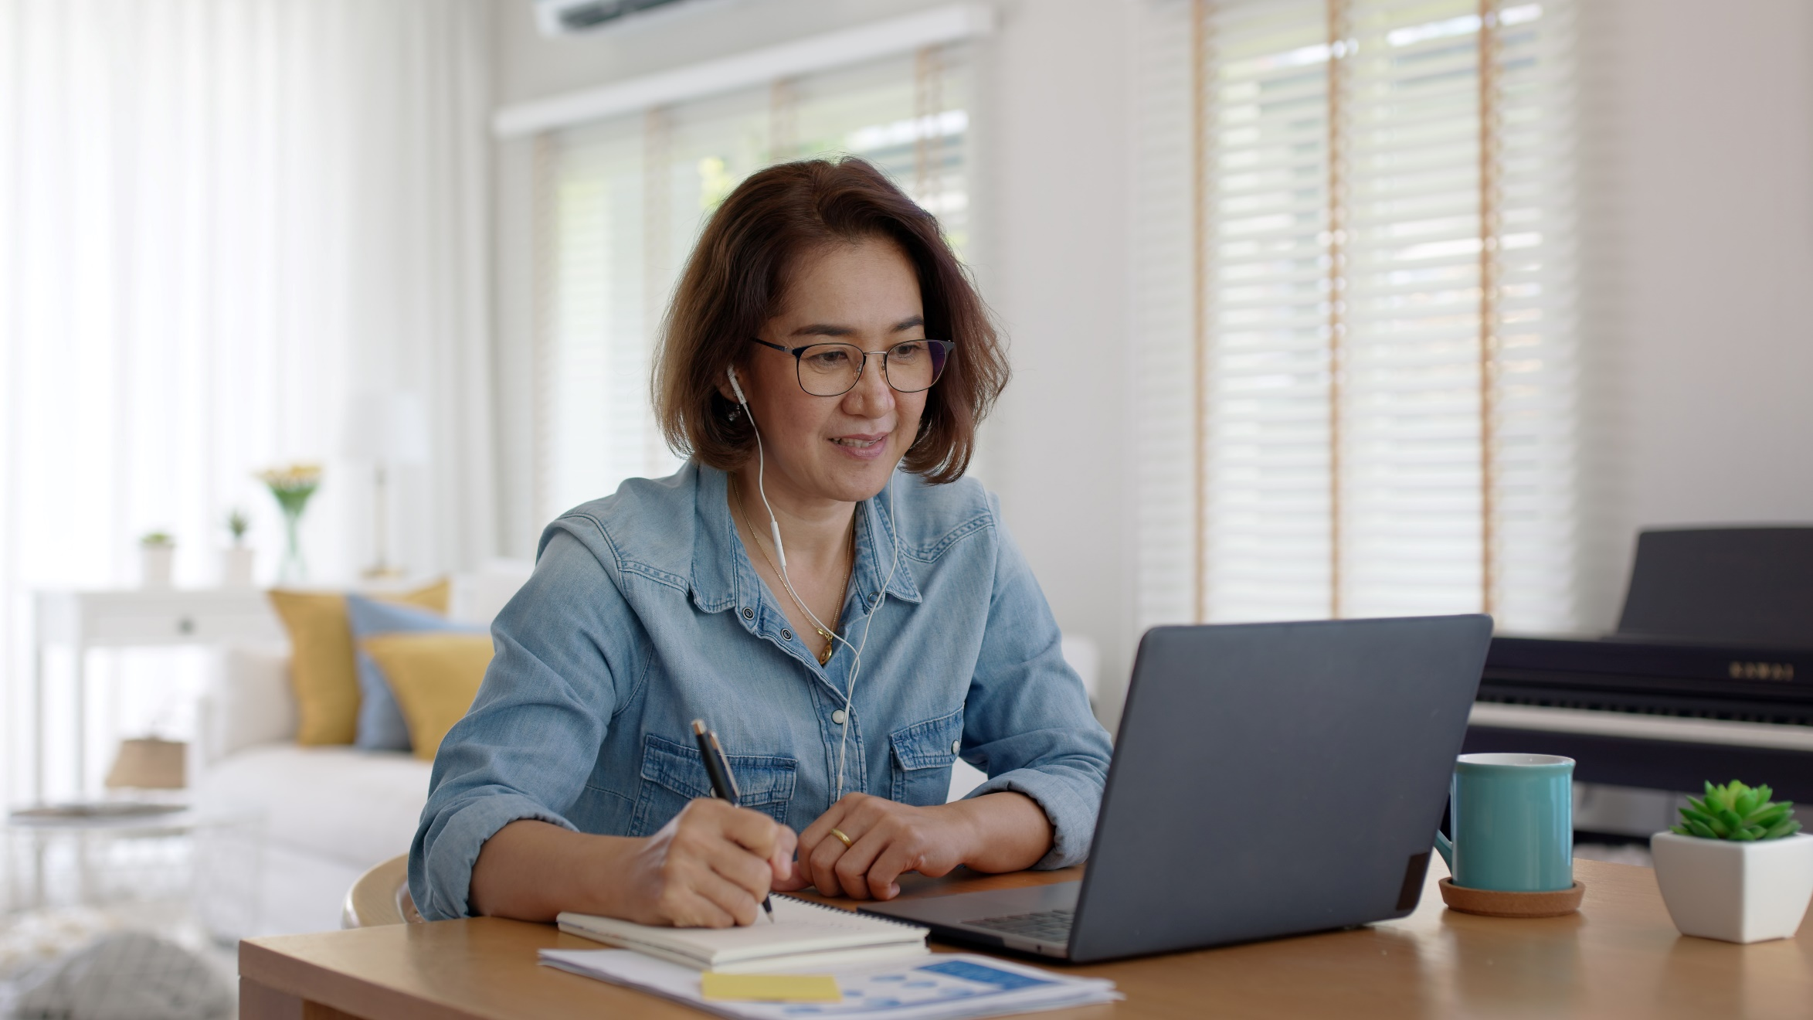
Sheila
Sheila wants to apply for a bank account and has heard from a friend that the type of account she needs is called a current account
What is a ‘current account’?
Notes:
Ask:
Sheila wants to apply for a bank account and has heard from a friend that the type of account she needs is called a current account. Does anyone know what we mean by a 'current' account?
Pause – for any suggestions. If delivering online, you may need to allow a bit extra time here, if people are typing their answer rather than speaking.
Explain:
This account is the most common type of bank account to help you manage your money on a day-to-day basis.
If you have a current account, you can also apply for an overdraft, which is a way you can borrow money in the short-term.
We’ll talk about overdrafts in a little while, but you can also find out more about overdrafts in the Banking Essentials learning on the website – the link is in your workbook.

Slide 11

Sheila’s experience
Sheila applied for a current account but has been told by the bank that she doesn't qualify for one because she has no credit history
The bank recommends that she applies for a basic account instead
What is a basic bank account?
Notes:
Ask:
Sheila applied for a current account but has been told by the bank that she doesn't qualify for one because she has no credit history.
The bank recommends that she applies for a basic account instead.
What is a basic bank account?
Pause – for any suggestions.
Explain:
Basic bank accounts are for people who don't already have a bank account or don't qualify for a standard current account as they have low or no credit history.
Basic bank accounts give you the essentials you need for everyday banking whilst you build up your credit score allowing you to get a current account in the future.

Slide 12
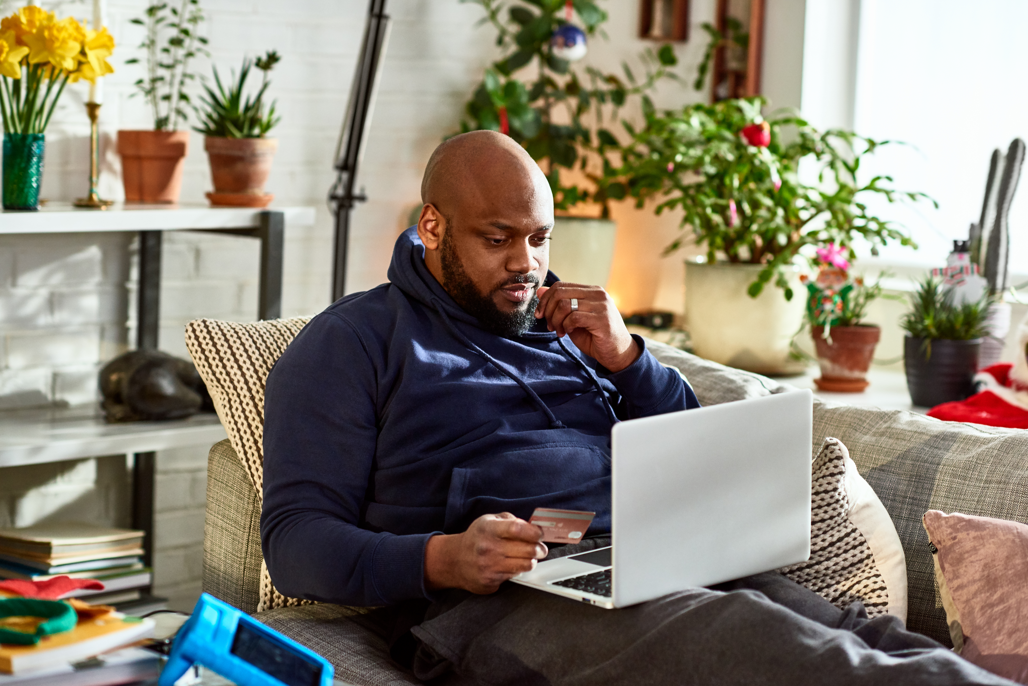
Credit scores and credit history
Helps banks decide how much to lend
Approval for credit cards, loans and mortgages
Your score comes from:
  Credit history
  Your address
  Public records about debts
  Money links with other people
  Search history
Notes:
OK, let’s talk about credit history.
Ask:
Does anyone know what a ‘credit score’ is?
Explain:
This is something that tells banks and other money lenders how reliable you are at borrowing and repaying money
They then use this score to decide how much they can lend you
They look up this score when you apply for things like credit cards, bank loans and mortgages
Credit agencies work out your score by looking at:
Credit history – to see if you’ve repaid credit on time before. This shows you can manage your money well
Your address (and how long you’ve lived there) – they find this from the Electoral Register. They can also see if your home has been repossessed in the past because you haven’t kept up the mortgage payments
Public records – these include things like official records showing if you’ve gone bankrupt or had court judgements around debt
Money links with others – For example,if you have applied for credit together with someone else, or have a joint mortgage
Search history – this shows if any credit agencies have checked your score in the past year. Lots of credit checks in a short period of time might show that you’ve been applying for a lot of credit during that time. This can lower your score so it’s one to be aware of
You can sign up to one of the credit reference agencies to see what your score is, for free

Slide 13

Find your credit score
  Experian – moneysavingexpert.com/creditclub
  Equifax – www.clearscore.com
  TransUnion – www.creditkarma.co.uk
Notes:
So now you know what a credit score is, let’s see how you can use it
First, you can contact the credit reference agency to find out what your score is, and get a report, for free. There are 3 main agencies:
Experian
Equifax, and
TransUnion.
You can contact them by post or using the related website. They might ask if you want to sign up for a paid-for subscription, but you don’t need to do this – just ask for your free report

Slide 14

Building up your credit score
Do:
  Use a bank account
  Stay within your limits
  Keep up with repayments
  Check you’re on the electoral roll
Don’t:
  Apply for credit too many times
  Pay late – or not at all
  Be tempted by ‘payday loans’
Notes:
Now you have an idea of what these agencies use to work out your credit score, let’s look at what you can do to make it as high as possible:
The best way to do this is simply to get a bank account. Once you’ve had this for a while, it tells the credit agencies that you can manage your money. In particular, if you have things like Direct Debits set up (we’ll look at these in a little while) it also shows you’re paying your bills
If you have a bank account with an overdraft (more on this later) or a credit card with a borrowing limit, always be aware of this limit and keep your borrowing under the limit. Going over sends a message to prospective lenders that you can’t manage your debts and loans
If you keep up with repayments on bills and other borrowing, your score will go up as it shows that you’re reliable about managing your money. If you miss these, or don’t pay on time, it may go down.
The credit reference agencies use the electoral register to check your address. So make sure you’re on this register, and that they’ve got your current address. If your address doesn’t match what’s on the register, your credit score can go down. If you don’t have a permanent address and aren’t on the electoral register, just make sure all the other info about you in your credit report is up to date. And if you’re linked with someone else at this address – or elsewhere – don’t forget that when their credit score goes up or down, it can affect yours too
If you apply for credit with lots of lenders in a short space of time, the banks tend to think you may be overstretching yourself, so it may be riskier for them to offer you credit or a loan, too. Again, they’re thinking of repayments. This is just when you’ve applied for and got credit from other lenders. If you’ve applied and been refused many times, this is not going to look good either
Don’t be tempted to skip a payment, or pay (for instance, your credit card bill) late – even by a few days. If you keep doing this, it will show up on your credit history that you’re not so good at paying on time
In general, any credit that you take out, as long as you repay it on time, will boost your credit rating. The only exception to this is what we call ‘payday loans’ – often these short term loans are only offered and taken as a last resort, by people who haven’t been able to get credit elsewhere. These types of loans tend to have extremely high interest rates, and many mainstream lenders are put off if they see you’ve taken out one of these recently. There are often alternatives to these, and it pays to use other options
Facilitator note:
If anyone wants to know more about credit scores, point them to the Borrowing Basics learning on the Lloyds Academy website

Slide 15
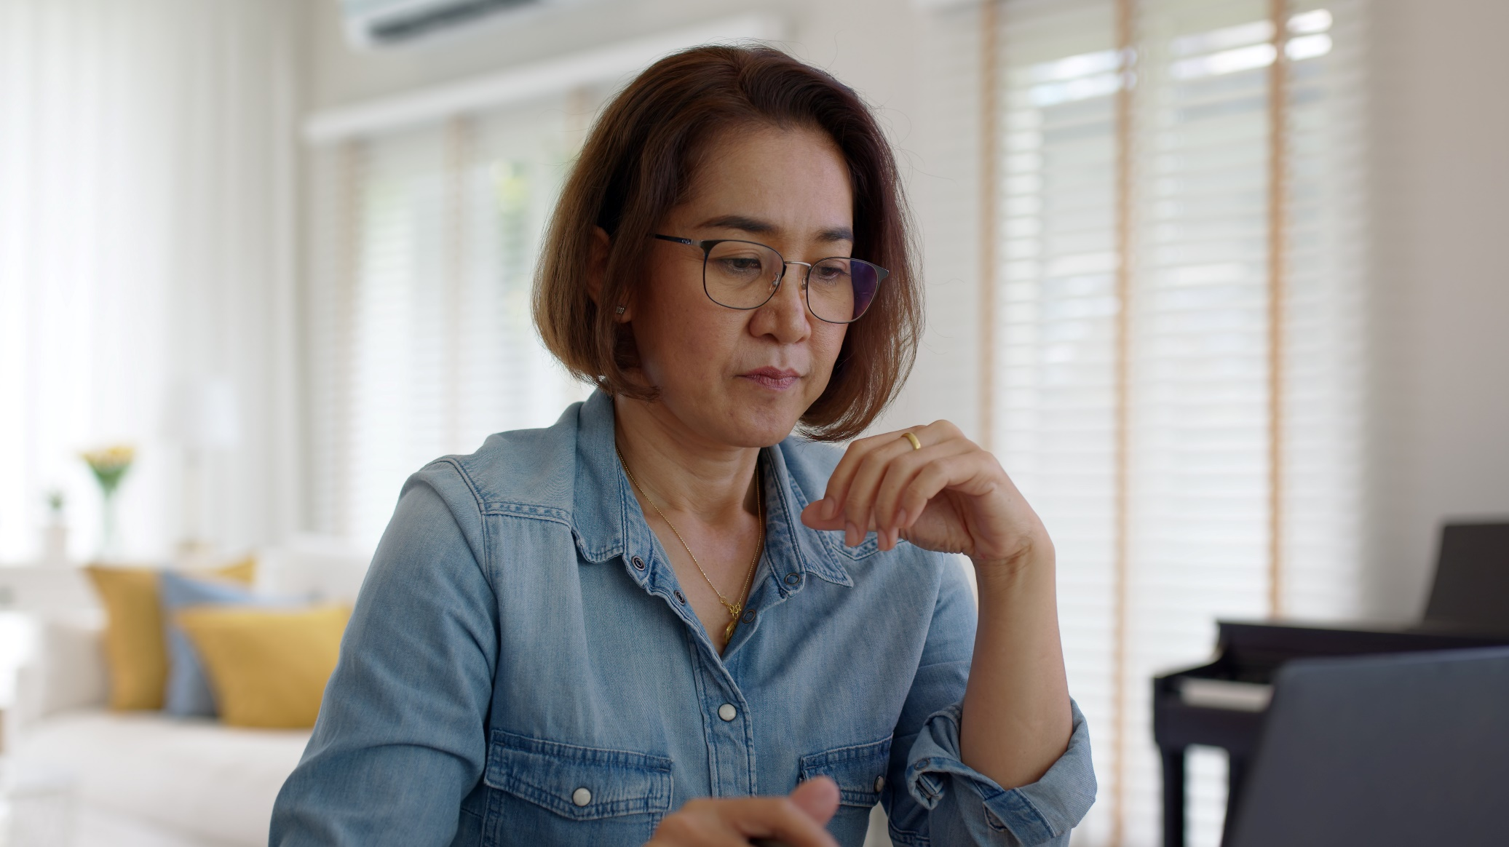
Activity: Bank account features
Look at the list of bank account features – work out which features are available if you have a basic account, and which ones you need to have a current account to access
Notes:
Introduce the activity:
In your workbook is a series of features available with the two bank account types – it’s on page 5
Tick each feature to show it's available with both types of account or just with a current account.
We'll discuss these features and how they can help you as we go through the workshop.

Slide 16
Bank account features explained
Feature | Current only | Both types
Ability to have wages, Universal Credit and other funds paid into the account |  | 
Ability to pay bills by direct debit |  | 
Access to overdraft facilities | 
Access to ATMs in the LINK network |  | 
Ability to pay in or take out money over the counter at a bank branch or Post Office |  | 
Notes:
When they have finished the activity, run through the answers with the group. AS SHOWN ON THIS SLIDE.

Slide 17
How to open a bank account
Notes:
Now we’ve looked at different types of bank account, let’s take a look at how you would open one.
And by the end of this next section, you should be able to:
plan how to open a bank account.

Slide 18

Sam
Sam’s planning a trip to his local bank, to open an account
The bank has told him that he’ll need to bring some ID to show them proof of his name and address
He’ll need something with his photo on it and something else that shows his address
What documents do you think he could take?
Notes:
Explain:
Meet Sam. He’s going to visit his local bank to open an account.
The bank has told Sam that to open a bank account he will need to take along some identification to show the bank proof of his name and address.
As with most banks, Sam will need to take one item with his photo on it and one or two items showing his address.
Ask:
What types of things do you think Sam could take?
Discuss:
Discuss with the class what type of items Sam could take with him to prove his name and address.
If necessary, prompt by asking things like: what might Sam have with his photo on it? And what kind of official letters might he get which show his address?
For face-to-face sessions, you could write up their suggestions on a flipchart / whiteboard if available
Alternatively, learners may prefer to jot down their ideas in their Workbook – direct them to page 6.
FULL LIST OF ITEMS IS ON THE NEXT SLIDE

Slide 19
Types of ID and Proof of Address
Photo ID (proof of name)
Driving licence
Passport
EU ID
HMRC Tax Notification
Blue disabled drivers pass
Benefits entitlement letter
UK Armed Forces ID Card
Home Office Immigration Status Document accompanied by proof of right to reside
Home Office Application Registration Card
Biometric residence permit (BRP)
Proof of address
Council tax bill
EU/EEA photo driving licence
Benefits entitlement letter
HMRC Tax Notification
Utility bill
Bank, building society or UK credit union statement
UK, EU/EEA mortgage statement
Current UK provisional driver’s licence
UK credit card statement
Tenancy agreement issued by a solicitor, housing association, local council or reputable letting agency
Notes:
Pick some items from the list on the slide.
Take a mix of those that the group have suggested, plus a few that they haven’t guessed.
If a group chooses something which would be unacceptable to open an account, discuss with the group why that would not be applicable.
If someone attending doesn't have any of the items of ID on the list then reassure them that there are charities and some local authorities who can help them – YOU MAY WANT TO GOOGLE ‘FINANCIAL LITERACY CHARITIES’ IN YOUR AREA, AND PICK A COUPLE OF EXAMPLES IN CASE ANYONE WANTS TO KNOW MORE – E.G. CITIZENS ADVICE, OR THE citizencard scheme: Not For Profit - CitizenCard
Trainer note: All banks have their own new account opening guidelines on acceptable ID and these can vary between each. As part of your pre-lesson preparation consider what ID would be relevant for your audience and pitch the delivery of this content accordingly. If support and guidance on the relevant ID is required, speak to your lesson co-ordinator beforehand.

Slide 20
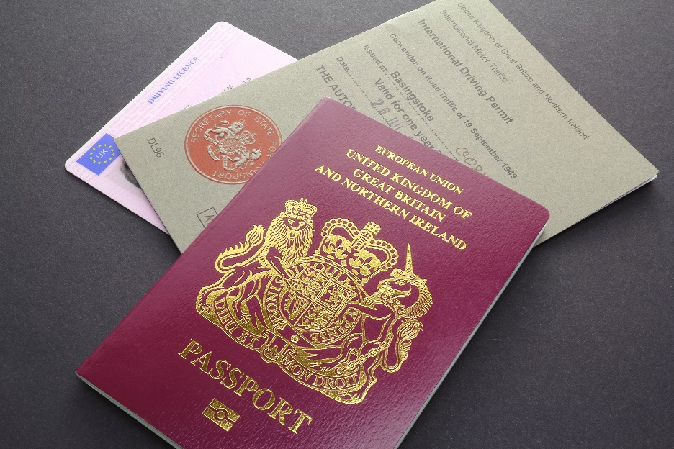
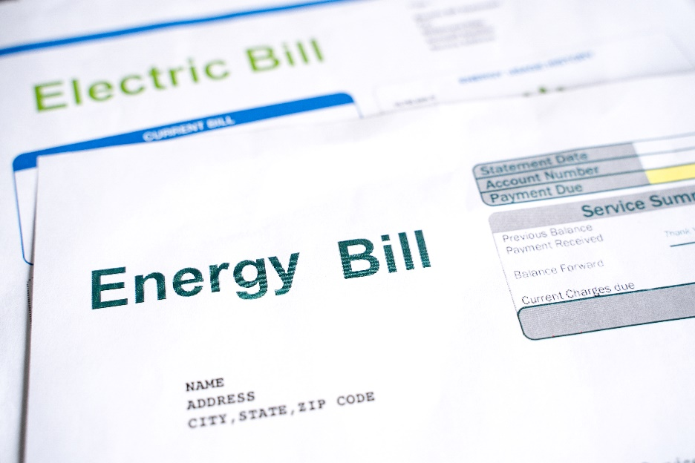
Proof of ID
Notes:
Explain:
Sam takes his passport (as proof of ID ) and his Electric bill (as proof of address) with him to the bank, to open his account.
The staff in the bank walk Sam through what he needs to do – in this case, Sam is asked to complete an application form.
There are charities that can help you through the process, especially if you're having difficulty because you don't have proof of identity or address.
Once Sam has been accepted, the bank will send him details of his account number and sort code, together with a bank card (we'll talk more about his later). He’ll need this information to send or receive money so it's important to keep it safe.

Slide 21

‘Carer’ or ‘Trusted Person’ cards
You can give someone you trust access to your money
They have their own card and PIN
They can only use this to take out cash or spend in shops – and there are limits
They can’t see all your account details
You have control of the card
For more info: moneyhelper.org.uk
Notes:
Explain:
There may be a time – maybe due to illness or disability - where you rely on friends or family to help with shopping, paying the bills or taking out cash.
If you need help looking after your money, or if you want to support someone else in this way, some banks now offer ‘carer’ or ‘trusted person’ cards. This is how they work:
The trusted person gets their own card and PIN. The card number is different from yours, but it’s usually linked to your account
They can use this card in shops or to take out cash. They won’t be able to use it for online or over-the-phone payments, or to send money or pay someone outside the UK. Different banks set different limits – so this might be no more than £100 a week cash withdrawals and / or purchases
They won’t be able to see your account balance or other details
You have control of the card – you can keep a track of how it’s being used and you can cancel it at any time
Trainer note:
If people want to know more about this, the moneyhelper site has a useful page: Carer's Card Accounts (moneyhelper.org.uk)
Banks that offer this kind of option include Lloyds, Bank of Scotland, Halifax, Starling and Santander
PAUSE HERE AND CHECK HOW THE LEARNERS ARE FEELING – SO YOU CAN ADJUST THE TRAINING AS NEEDED

Slide 22
Understanding bank statements
Notes:
So Sam now has a bank account. And every so often, the bank will send him a statement. In this next section, we’ll see what a bank statement looks like, and the kind of information it shows you.
And at the end of this section, you should be able to:
Explain the different parts of a bank statement

Slide 23
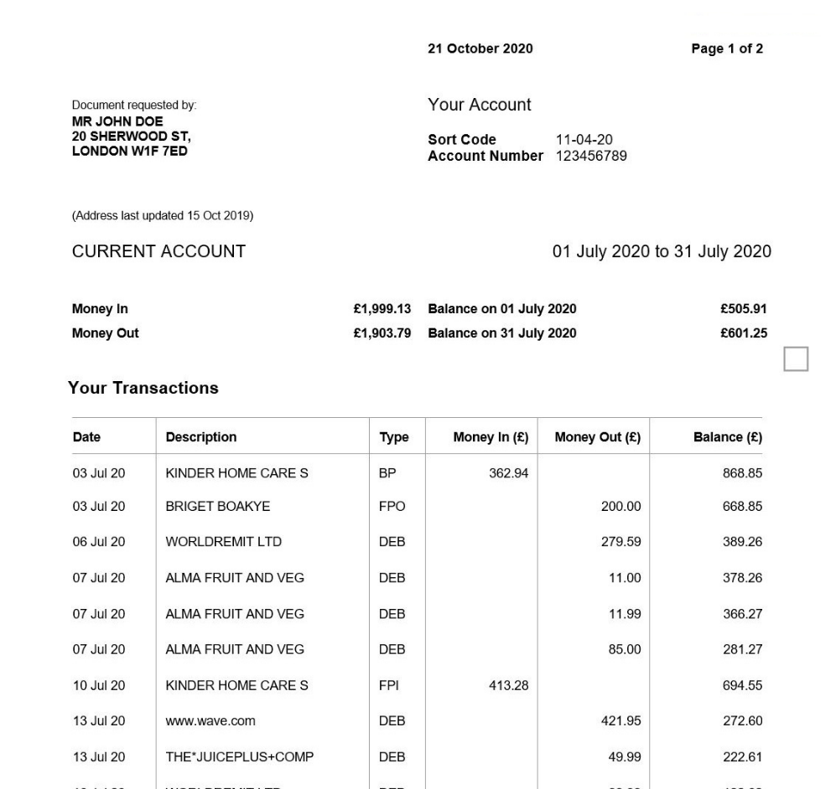
Copy of a bank statement
Personal details
MR SAM DOE 20 SHERWOOD ST LONDON W1F 7ED
Account No details
Statement date range
Account balance
Outgoing money
Incoming money
Notes:
Explain:
Sam has just received his first bank statement. Here it is – you can also see it on page 8 of your workbook
Walk them through the following points on the statement:
Information about the bank - not currently visible on this example, but mention that the bank’s name and logo are likely to be on the top of the statement
Personal and account ID details –your full name and your address on the left, and the bank account number and sort code on the right
The period of time covered by your bank statement - so you know the list of transactions is just what’s gone through between these dates
The Balance –how much money is in your account (as of the later date in the date range)
Money In, - this is all the money coming into your account. So this might include cash deposits, cheques, money transfers sent to you, refunds and interest earned
Money Out - all the money coming out of your account. So that might include any spending, transfers that you've sent, cash machine withdrawals, automatic payments and bank fees
PREPARE FOR NEXT SLIDE - Explain:
Sam can also check information about his bank balance online.

Slide 24

Online banking
What are the risks of Sam sharing his password?
Notes:
Explain:
So, Sam is keen to check his bank balance online.
The first time he does this, he will be asked to set up a secure password and details, so that the bank can make sure it's really him. He must then enter these details each time he logs in.
Sam knows that he should never share this password with anyone else.
Some banks may have the option for you to set up something called a biometric password when you access your bank details from your mobile phone. This is usually in the form of your fingerprint. And this creates a secure way to log onto your account.
Ask:
What are the risks of Sam sharing his password?
If necessary, prompt with:
What could happen if someone else knew his password? What could they do?
Look for:
Security – with this information someone could log into his account and have access to his money.

Slide 25
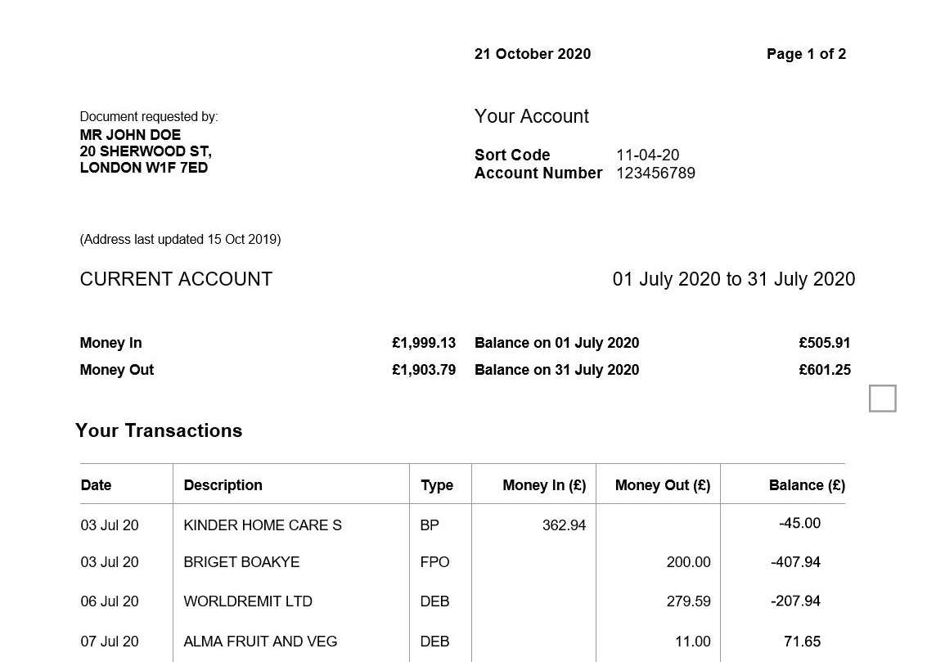
Sally’s bank statement
MS SALLY DOE 20 SHERWOOD ST LONDON W1F 7ED
Notes:
Let’s look at Sally’s bank statement now.
Ask:
If you look at the balance, you’ll notice it is negative – it has a minus sign beside it. What does this mean?
Look for:
If the account balance is negative, (in this example -£45) it means this person has more money going out than coming into their account.
Explain:
When this happens, it is called an overdraft.
An arranged overdraft can act as a short-term safety net. It’s when you’ve arranged with your bank that you can borrow money up to an agreed limit through your bank account – this is called your overdraft limit.
An unarranged overdraft is when you have had more money come out of your account than the limit you had agreed with your bank first.
When you go into an overdraft, the bank will charge you a fee; this is a small fee if the overdraft was pre-arranged, but can be much more if you go overdrawn without first getting the bank's approval.

Slide 26
Managing your bank account
Notes:
So now we’ll take a look at how you can manage your bank account. We’ll look at different ways you can arrange for money to go into and out of your account.
If needed, mention: As we work through these different ways, don’t forget there’s space in your workbooks if you want to take notes – and if you want me to pause while you do this, just let me know. The main thing is that you’re comfortable with what we’re working through.
Then read out the objective:
And by the end of this section, you should be able to:
manage a bank account.

Slide 27

Payments
Make and receive payments online
Move money from your other accounts
Make payments into your account
Some banks let you use your local Post Office to make payments too
Notes:
Explain:
You can easily make and receive payments to and from your bank account, online.
You can move money from your other accounts, and with some banks, you can also pay in cheques through your mobile banking app.
You can also make payments into your account in person, by going to your local branch, or by using one of the cash machines (which allow payments) at your bank. Not all cash machines accept payments, but some do.
And some banks will also let you use your local post office to make payments into your account.

Slide 28

Direct debits
You agree that a company can take money from your account on an agreed date, every month
They must let you know of any changes to the date or amount
You can cancel at any time, but make sure you give them enough notice
The Direct Debit Guarantee protects you if there’s an error
Notes:
***NOTE – THIS SLIDE IS ANIMATED. CLICK FOR EACH BULLETED ITEM TO APPEAR ***
Explain:
So we’ve talked about deposits and withdrawals – now let's look at some of the other things you might see in your account.
Ask:
Have you heard of direct debits? A lot of companies like you to set these up, to make regular payments to them, like your gas or electricity bill.
Explain (HERE’S THE ANIMATED BIT):
A direct debit involves you giving a company permission to take money from your bank account on an agreed date. So you might agree that the gas company can take money out for your gas bill on the 1st of every month for instance.
Then once you've set them up, these payments will be taken monthly by the company.
The company will need to let you know about any changes to the date or amount to be taken. This is stated in the direct debit guarantee.
And you can cancel a direct debit at any time, however, check with your bank or building society you have given them enough notice. Generally, banks and building societies require at least a day's notice before the direct debit is due to be paid. As well as cancelling the direct debit at the bank, you should also contact the service provider advising them you are cancelling the contract, otherwise you may be liable for additional payments and fess.
The Direct Debit Guarantee protects you if there is an error in the payment of your Direct Debit, for example if a payment is taken on the incorrect date or the wrong amount is collected.
Discuss:
Get the group to discuss which companies might want them to set up a direct debit and how this can benefit them by helping to pay bills. They might like to jot down a few ideas in their workbook – guide them to Page 11.

Slide 29

Standing Orders
You can set up a regular payment to any person or company
You control:
the amount
when they are paid
how long they are paid for
Notes:
Explain:
Standing Orders are a bit like Direct Debits, but you control the amount, when they are paid, and how long for.
For example, you might want to set up a regular payment to a family member. You’ll need to put in some details.
Using a standing order means that you don't have to remember to pay them each time.
Once you set someone up as a payee - that just means that they’re a person you are paying money to - you won't need to enter their details again if you want to set up a different payment for them in the future.
You could also set up a standing order into one of your own accounts – for example, if you want to pay a certain amount into your savings account each month.
Discuss:
Encourage the class to discuss whether standing orders will be useful for them and what type of things they could use them for. They might like to jot down a few ideas in their workbook - again, they’ll find space for this on Page 11.

Slide 30
Activity: Direct Debits vs Standing Orders
 | Direct Debit | Standing Order
Set up by the company
Set up by you
You can cancel the payment at any time
You are in control
The company must tell you of any changes in advance
Notes:
So let’s recap the differences between Direct Debits and Standing Orders with an activity. You’ll find this in your workbook
Trainer note: THINK THIS IS ON PAGE 10 BUT PLEASE CHECK
Activity:
In your workbook, there’s a grid with the two types of payments shown at the top and different features shown down the side.
Put a tick under each payment type to correspond with the features that could be available.
Remember some features might apply to both.
Trainer note:
When they have finished, run through the answers with the group.
The answers are shown on the next slide

Slide 31
Activity: Direct Debits vs Standing Orders
 | Direct Debit | Standing Order
Set up by the company | 
Set up by you |  | 
You can cancel the payment at any time |  | 
You are in control |  | 
The company must tell you of any changes in advance | 
Notes:
ANSWERS TO THEIR EXERCISE – talk through

Slide 32
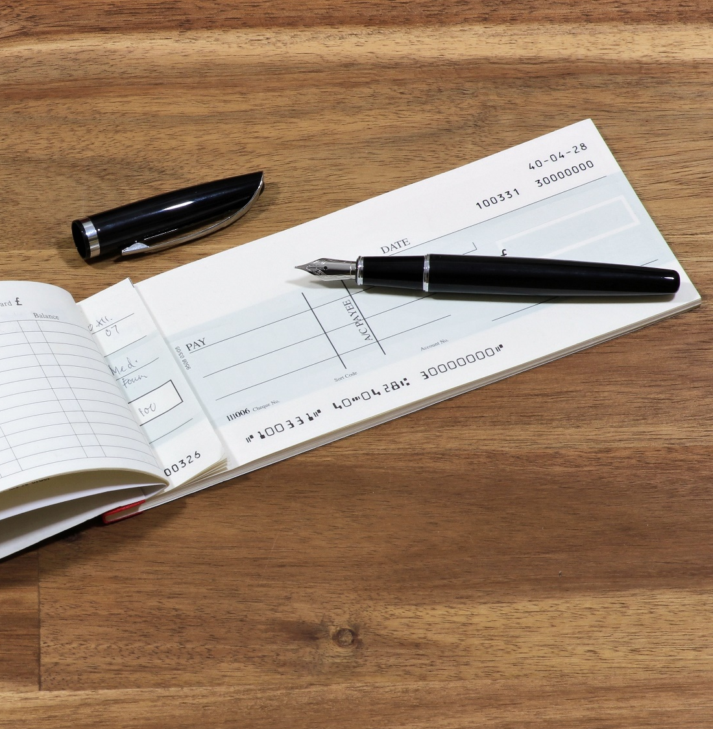
Cheques
Sam has received a cheque through the post
Have you recently used or received a cheque?
Notes:
Trainer note:
This section is optional depending on your learners, you can choose to skip this section or just run through it at a high level if you think it will confuse them.
Ask:
Sam has received a cheque through the post. Have any of you come across a cheque?
Explain:
A cheque is a paper form used to give money from one person or business to another.
Most banks no longer give these out when you open a new bank account, so if you need one, you may need to ask for it.
If you get a cheque from someone, you can take it to a bank and redeem it for the amount of money stated on it. The bank then processes the cheque, taking that amount from the account of the person who gave you the cheque. And you will usually see the amount appear in your bank account within a few days.
You can pay cheques in at your bank and at the Post Office.
Some UK banks now also let you pay cheques in using your mobile banking app by taking photos of them.

Slide 33
Where you can pay in a cheque
Your bank branch
Immediate Deposit Machine (IDM)
Building society branch
The Post Office
A cheque cashing provider
Mobile banking app
Notes:
NOTE – THIS SLIDE IS ANIMATED TO SHOW EACH OPTION IN TURN
There are many different options to pay in or cash a cheque.
(THIS IS THE START OF THE ANIMATION – CLICK AND TALK THROUGH EACH OPTION IN TURN)
You can pay in a cheque in a branch of your bank across the counter or you can post the cheque to your bank directly. The cheque will normally take 1 day to clear the day after you have paid it in.
You can use an Immediate Deposit Machine (IDM) in a branch of your bank to deposit up to 5 cheques without a physical bank card being present. You’ll get immediate credit of funds and a receipt.
You can pay in a cheque at your Building society using a pre-printed paying-in slip.
You can pay in your cheque at a Post Office using a pre-printed paying-in slip. They have a vast network of branches across the UK, so you should find one close to you. The cheque will be added to your account when your bank receive the cheque from the Post Office, this normally takes two working days.
You can take your cheque to a cheque cashing provider, such as Cash Converters, who charge a fee for this service. They’ll verify the cheque to confirm it is genuine. Then they’ll give you cash for the amount of the cheque, less their fee.
You can pay in cheques using your bank’s mobile banking app (see Banking online module).
Trainer note:
Stress that using banks, Building Societies or Post Office (or banking apps) are always preferable as they don’t charge – unlike the cheque cashing providers

Slide 34
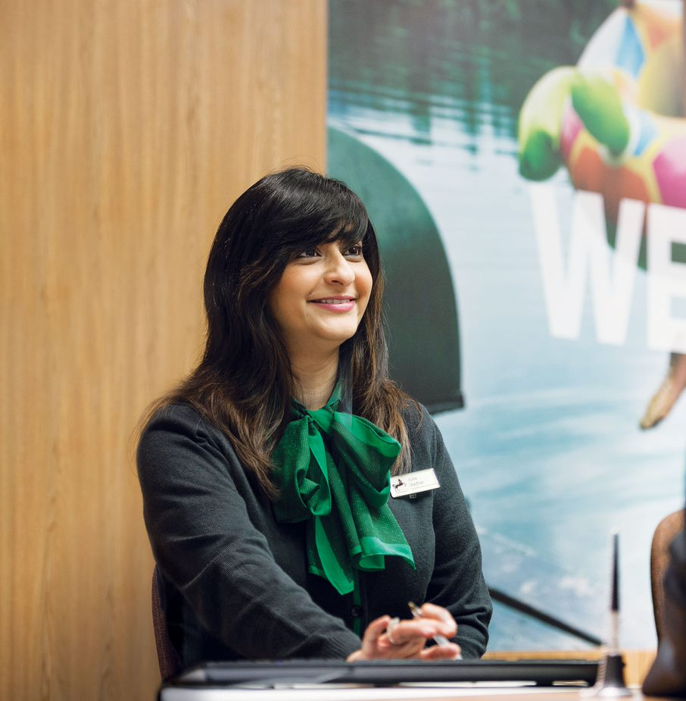
Cash
Do you know how to get cash from your bank account?
Have you used a cash machine before?
Notes:
*** NOTE: SLIDE IS ANIMATED – CLICK TO SHOW EACH QUESTION ***
Ask: You want to get some cash from your bank account to pay for car parking and some treats when you next go out. So how do you get cash from your bank account?
Pause: For any suggestions.
Explain: You can get cash from a bank branch using your bank card or a cheque, or you can use a cash machine.
Ask: Have you used a cash machine before to get cash out of your bank account?
Pause: For responses
Explain: You can do this with your bank card and PIN. The amount of cash you can withdraw depends on the amount available in your bank account and any limit imposed by your bank. For example, you may have £300 in your bank account, but your bank card will only let you take out £100 per day in cash.
You can also use these machines to see your account balance, change your PIN and order a bank statement.

Slide 35
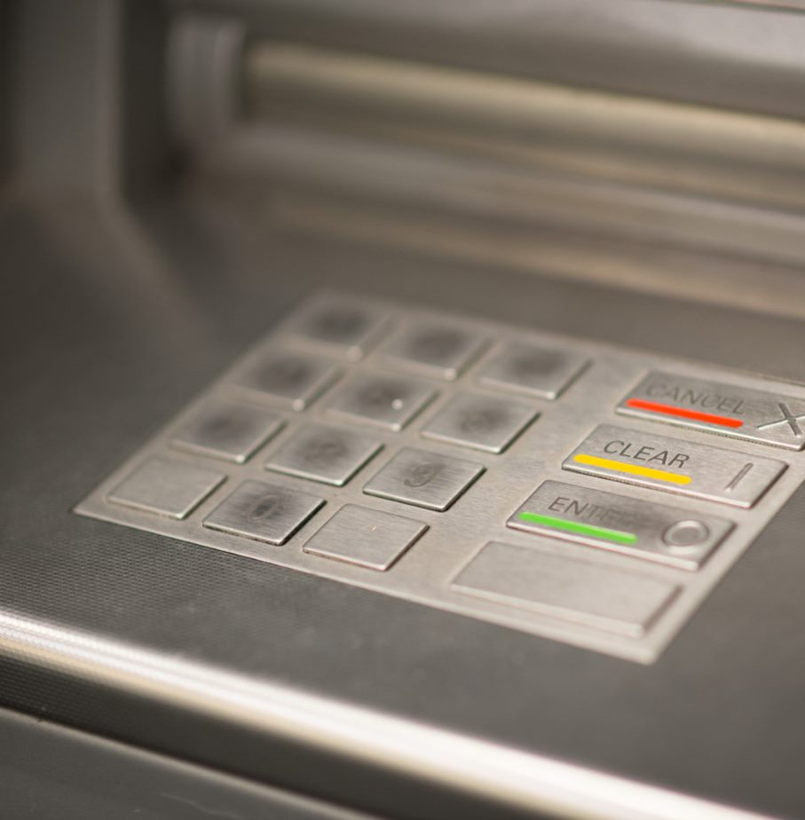
How to use a cash machine
Find a cash machine
Make sure you are safe
Insert your bank card into the slot with the card’s chip facing forward
Select the language to use
Type in your PIN when prompted
Select the service you want
For cash, select the amount
Remove your card when prompted
Select if you want a receipt
Take your cash and receipt
Notes:
*** ANIMATED SLIDE – CLICK TO REVEAL EACH STEP IN TURN ***
Explain: These are the common steps when using a cash machine:
Find your local bank’s nearest cash machine. You can also use your card in another bank’s cash machine
Check your surrounding area to make you are safe to use the cash machine. Is it daylight hours with plenty of people about or is dark with very few people about? Will you be alone or will someone else be with you?
When you’ve found a cash machine to use, insert your card face up with the card’s chip facing forward. Some cards may have arrow or a ‘thumb notch’ cut out to help you insert it the right way round
Some cash machines may ask what language you want to use, particularly when you are using your bank’s cash machine for the first time
When the cash machine has read your card, it will ask you enter your 4 digit PIN using the keypad
The cash machine offers other services, so select cash if you want that option. They might have different options like ‘cash with receipt’ or ‘cash and show balance’ so pick the one you want
Select the amount you want from the options on the screen. There will be a button alongside each to help you select the one you want. If the amount you’re after isn’t shown, there’s usually an ‘other amount’ option where you can type in the amount
Once completed, the cash machine will tell you to remove your card from the machine and you then wait for the cash to be dispensed.
The cash machine will then ask you if you need a receipt - pick ‘yes’ or ‘no’
Remember to take your cash when it has been dispensed by the cash machine.

Slide 36
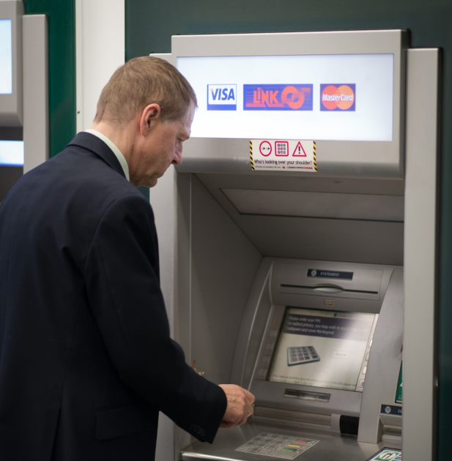
Top tips for using cash machines
First time? Ask a member of staff to help
Keep your PIN safe and away from your bank card
Be aware of your surroundings
Look for the ‘Link’ sign for free use
Keep your distance
Make sure you take your cash
Keep your receipts
Check you’ve got everything before you move away
Notes:
*** ANIMATED SLIDE – CLICK TO REVEAL EACH TIP IN TURN ***
Explain: Here are some tips to using a cash machine:
If you’re using a cash machine for the first time, ask a member of staff to show you how it works. They’re always willing to help their customers
Always keep your PIN safe and never tell anyone the number
Your bank will send you the PIN separately to your bank card, for security reasons. Never keep them together. If they get lost or stolen, you could be liable!
Be aware of your cash machine’s location. Is it somewhere with lots of people passing by or is it more out-of-the way?
Some cash machines may charge a fee for using their machine and they are not generally as safe to use as the ones outside banks
Keep your distance to other cash machine users or others nearby, and cover your hand as you enter your PIN to make sure no one else can see what it is
When you take your card from the machine, remember to wait for your cash. Don’t leave the machine until you have received your cash.
Always keep your receipts so that you can check them against your bank statement.
When you have finished, check you have everything before you leave the machine.

Slide 37
Cash machine services
Cash
Check your balance
Change PIN number
Order a statement
Receive account updates
Notes:
Explain: The basic services offered by most cash machines are cash, checking your balance, changing your PIN, order a statement or mini statement and receive account updates. The more complex cash machines may offer cheque deposits and bill payments.

Slide 38
Debit cards
Notes:
OK, let’s take a look at debit cards now. When you get a bank account, you might get one of these, so it’s good to know about them, and how you can use them.
Read session objective:
So by the end of this section, you should be able to:
discuss the use of debit cards.

Slide 39

Debit Cards
Debit card
UK: 0345 123 4567
Overseas: +44 1234 567 890
Customer Name
0123 4567 8901 2345
Sort code
01-23-45
Account number
12345678
Bank Name
Expires end
01/23
CVV2
123
Notes:
Explain:
Sam was given a debit card once he was accepted for a bank account.
And if you have a current account, you’re likely to get one too. But some of the basic bank accounts don’t give these out – they only give you a cashpoint card.
This is what they look like – yours may look a bit different but it will have the same information on it (TRAINER NOTE: IF LEARNERS HAVE ANY OLDER-STYLE CARDS, THESE ARE LIKELY TO HAVE MOST OF THIS INFO EMBOSSED, ON THE FRONT – POINT OUT THAT WHEN THESE CARDS ARE RENEWED, THIS IS WHAT THEY’LL LOOK LIKE – BANKS CHANGED TO PUT MORE INFO ON THE BACK, TO MAKE THEM SAFER)
Your bank will tell you what your spending limits are for your card, including how much cash you can withdraw each day
Ask:
So Sam decides to use his debit card to pay for the weekly shopping in the local supermarket. What are the different ways could he use the debit card to pay at the checkout?
If necessary, prompt: have you seen anyone use one of these cards? What do they actually do with them, to make the payment?
Look for:
Sam has seen other people use their cards to pay for shopping and they either insert their card into the machine – this is called chip and pin - or tap the card on the machine – this is called contactless.
Explain:
Let's look at those two options in more detail … (leads into next slide)

Slide 40
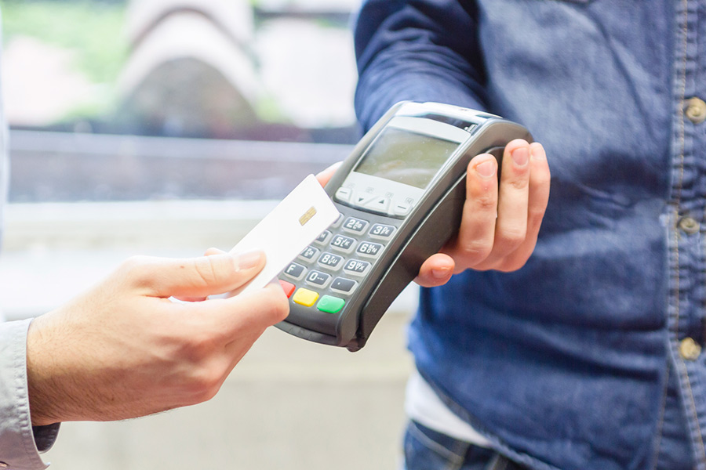
Chip and pin vs contactless
Notes:
Explain:
When you use the chip and PIN method to pay for something, you will need to insert your card into the machine and type in the PIN number. Only you will know this PIN, so remember not to share it with anyone as this would mean they could make payments using your card.
Once the transaction is approved, you can remove the card. The bank will take the cost of whatever you are paying for, out of your bank account.
If you don't have enough money in your account to pay for it, the transaction will fail.
If what you’re buying is under a certain amount – and most banks let you set your own limit here - you can pay using the contactless method. To do this, you just tap your card against the machine.
You might find that sometimes you are still asked to pay using chip and PIN; this is to prevent fraud, especially if this is the first time you've used your card.
Once the machine beeps it will process the transaction – again if you don't have enough money in your account the transaction will fail.
Discuss:
Ask the group to discuss this method of paying for items and how safe they feel it is. Reassure them where appropriate.
PREPARE FOR NEXT SLIDE - Ask:
Where else can Sam use his card to pay for items or services?
Look for:
Online using the internet.

Slide 41
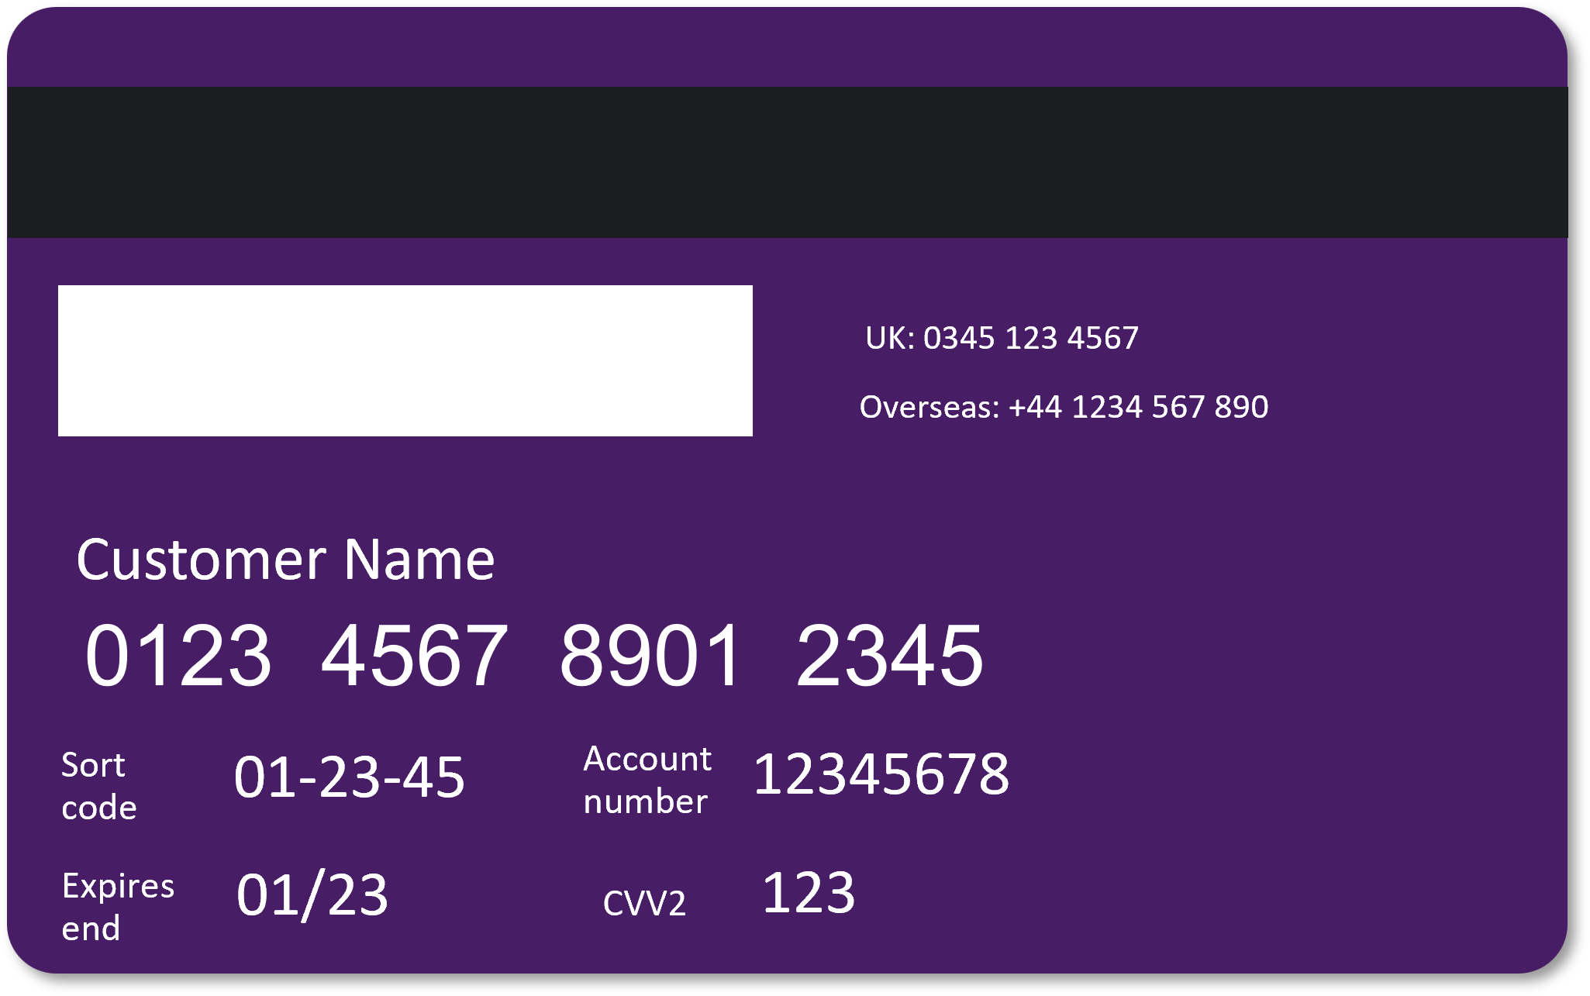
Online payments
What information does the online shop need?
Notes:
Ask:
What information will Sam need to give the website so they can process the payment?
Look for
The type of card they are using
The 16-digit long card number
The expiry date
The 3-digit code / CVV code
ALL THESE ARE HIGHLIGHTED ON THE NEXT SLIDE, FOR YOU TO TALK THROUGH / POINT OUT

Slide 42
Online payments continued
They will ask for:
Card number
Expiry date
CVV/CVV2 code
1
2
3
Notes:
THE ANSWERS!
Talk through with them, once they have come up with ideas:
The type of card they are using – in this case, it’s a 'debit card'. On some websites, it may say 'visa' or 'pay by card'.
The 16-digit long card number from the debit card (this is usually on the front of the card but may appear on the back of newer cards).
The expiry date – this is shown on the card.
The 3-digit code (sometimes called a CVV code or CVV2). Those three numbers verify the transaction.

Slide 43

Staying safe online
Research companies online to make sure they’re trustworthy
The bank may do extra checks when you buy online
Notes:
Explain:
Sam asks his friend how he can be safe when using his card to pay online. His friend tells him to research companies online to make sure they're trustworthy.
His friend also explains that most banks use security checks when you're paying online, to help keep you safe – for example, they might send you a text message or ask you to approve the payment through your banking app.

Slide 44

Keeping your card safe
Keep it in a safe place
Keep it separate from your PIN
Don’t share your card with others
Contact your bank if it’s lost or stolen
Notes:
Explain:
There are plenty of things you can do to keep your card safe when you’re out and about, too.
First, keep it in a safe place. If you get into the habit of always keeping it in a purse or wallet, for instance, you’ll always know where it is, and you’re less likely to lose it than if it’s just put loose into a bag or backpack as you go out the door
We’ve talked about keeping it away from your PIN, too. This means if your card does get stolen, at least the thief hasn’t also got the PIN as well
Don’t be tempted to share your card – or its details – with anyone else. If you need someone to help with shopping or paying bills, think about getting them a trusted person’s card. This will have its own card number and PIN, different to yours
If the worst happens and you do find that it’s been lost or stolen, get in touch with your bank straight away. They can help you cancel the card and order a new one. Most banks also let you freeze the card using their banking apps. This is really useful if you think it’s lost, then find it later on. You can freeze it using the app, then un-freeze it when you find it.

Slide 45

Essential banking skills review
You should now be able to:
Explain the difference between a basic bank account and a current account
Know how to open a bank account
Name parts of a bank statement
Manage a bank account
Use your bank card safely
Notes:
Review the workshop with the learners by running back through the objectives and reminding them about what they wanted to get from this session
You should now be able to:
explain the difference between a basic bank account and a current account
plan how to open a bank account
identify the different parts of a bank statement
manage a bank account
And talk about how to use debit cards.

Slide 46
Any questions?
Notes:
Ask the learners if they have any questions about what's been covered.
Encourage learners to help and support each other.

Slide 47
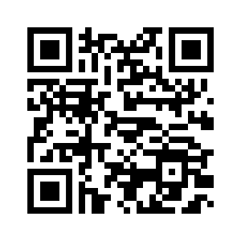
Post-session survey
Notes:
Encourage learners to scan the QR code here and complete our short post-session survey around levels of confidence now they have completed the training, plus any other comments or feedback about the session

Slide 48
Lloyds Bank Academy *Ends*
Notes:
Explain:
This is the end of this workshop. Thank you for attending, we hope it's been useful.
Please keep your workbooks so that you can refer back to your notes.
The workbook also has some helpful links to information on the internet, and a Jargon Buster to help you understand the words and phrases we use.

