Slide 1
Banking Online Workshop
Presentation

Slide 2
Welcome

Slide 3

Introductions
Your trainer today is:
Please introduce yourself
What do you do online?
Notes:
Introduce yourself – state your role today and how you plan to help them​
Let them know this is a safe space to ask questions about money
Encourage them to ask about terms or practices they are unclear on
Learner intros - if it’s a large group, ask them to introduce themselves to the person on their right ​
In their intros, ask them what kind of things they already do online. This will give you an idea of their online experience and preferences

Slide 4

Aims
By the end of this workshop, you should be able to:
List the benefits of banking online
Set up an online account
Feel confident about managing your account online
Notes:
Talk through the slide:
This workshop aims to help you to manage your bank accounts online.
By the end of this workshop, you should be able to:
list the benefits of banking online
set up an online account
and feel confident about managing your account online

Slide 5

Today’s session
What are the benefits?
How to set up online banking
How to use online banking
Disclaimer: Everything that is discussed today is for guidance and is not financial advice. Any websites, tools etc. are examples of what's available.
Notes:
Run through basic health and safety (fire exits, trip hazards etc) if appropriate ​
Run through the agenda. ​
Read out the disclaimer: ​
Everything that is discussed today is for guidance and is not financial advice. Any websites, tools etc. are examples of what's available ​
Hand out the workbook and explain it's for the learners to make notes as we go through the workshop and has some useful links to further information. ​
​

Slide 6
What are the benefits?
Notes:
First, we’re going to take a look at the benefits of banking online
Explain:
And by the end of this section, you should be able to:
list the benefits of banking online.

Slide 7

Mary’s story
This is Mary. She’s thinking about setting up online banking
What do you think she’ll be able to do with it?
Notes:
Ask:
Mary has been thinking about setting up online banking after a friend suggested she gave it a try. What do you think the benefits will be? What will she be able to do / get out of it?
Look for:
Bank from anywhere
Checking balance
Moving money
Statements
View and make and change payments
Manage direct debits
Updating your personal information
Access to safety features such as freezing your card
Explain:
Most large banks now offer really secure, sophisticated online banking
You can still go to your bank branch as normal, but internet banking makes it easy to access your account and move money around with it, whenever you like and wherever you are
If you are asked about branches closing, empathise with the learner and say something like:
The way people are choosing to bank is constantly changing and evolving and as a result, sometimes decisions are made to close branches. This can be unsettling and upsetting but unfortunately, it’s not something that is in my hands. There is an extensive process in place before the decision is made and alternative means of support are offered when a branch does close.

Slide 8





Benefits of online banking
Bank from anywhere
Check your balance
Pay people at any time
See your statement
Freeze your card
Notes:
ANIMATED SLIDE – CLICK TO REVEAL EACH ITEM
Some of the benefits you get from online banking are:
Bank from anywhere (and any time) – whether you’re at home or out and about
Checking balance – you can check any time to see how much money you have in your account
Moving money - you can use online banking to pay people and companies at any time – not just when your local bank branch is open
Statements - you don’t have to wait for a paper bill to be sent to you – you can see everything that’s gone on in your bank account over the last week, month or longer
Access to safety features like freezing your card - so if you lose your card, you can freeze it straight away. If you find it again, you can go back in and un-freeze it. Simple!
There are other benefits, including:
View and make and change payments
Manage direct debits
Updating your personal information

Slide 9

Mary’s concerns
What do you think
Mary may be worried about?
Notes:
Ask:
What types of worries or concerns might Mary have about setting up and using online banking?
Look for:
Remembering passwords
Other people hacking into the account
General ‘keeping money safe’ concerns
Explain:
It's understandable to have concerns, but the banks have strong protection in place to help stop this.
Banks see how you use your account normally. They’ll let you know if they see anything unusual, for example, an unusually large payment or your card being used in a different country.
Banks react quickly in these situations and will help you set things right. This does mean that occasionally they may ask about one of your transactions to check if it's really you. Once you confirm this, they will let that transaction go through.
Remember, your online bank details – things like passwords and PINs - are for your eyes only. Never share these details with anyone or write them down in a note or email.
If anyone is concerned about fraud point them to the Stop Fraud website (the link is in the workbook, page 5) which can help you to understand how to be aware of fraud.

Slide 10
Setting up online banking
Notes:
Now we’re going to look at how you go about setting up online banking.
Explain:
So by the end of this section, you should be able to:
Set up an online account

Slide 11
Getting online
Mary wants to access the internet
Where could she get online?
What devices could she use?
Notes:
ANIMATED SLIDE – CLICK TO SHOW SECOND QUESTION
Ask:
Mary is wondering about the best way to access the internet, what would you advise her to do?
THEY CAN WRITE A FEW NOTES IN THEIR WORKBOOK HERE (PAGE 6) – OR CALL OUT / USE FLIPCHART
If required, prompt: what could Mary use, if she wants to use the internet?
Explain:
To use online banking, Mary will need to have access to the internet.
She might use her mobile phone, a computer or a laptop linked to her home internet, or she may have someone she visits – maybe her daughter - who would let her use their internet access.
There are also lots of ways to access the internet in public too, Mary could try her local library or businesses such as local pubs, cafés and restaurants.

Slide 12

Apps and browsers
Both let you:
Check your balance
Pay bills and send money
Manage regular payments
Transfer money between accounts
Report a missing card and order a new one
Update your details and preferences
With the app, you can also:
Freeze your card
Pay in a cheque
Notes:
ANIMATED SLIDE – CLICK FOR ‘BOTH LET YOU’ THEN CLICK AGAIN FOR ‘WITH THE APP …’ LISTS
Explain:
Now Mary has access to a device such as a mobile phone or computer, and she’s connected this to the internet. So she’s all ready to set up her online account.
Ask:
Before she goes ahead, her friend explains that she can access online banking through a browser, or she can download an app onto her mobile phone. Mary asks her friend what the difference is.
Explain:
Mary’s friend explains that a banking app is something you can download onto your phone. You can use it for most banking activities. Using your internet browser to connect to the online banking website can give you access to more information and features.
Pause here, and prompt them to jot down these differences in their workbook (page 6), if this helps them
You can see here the main features that you can access from both the website and the app. Bear in mind that if you want to pay in a cheque online, you’ll need a device with a camera for this.

Slide 13



Getting started
Go online
Visit a branch
Phone your bank
Notes:
ANIMATED SLIDE – CLICK TO REVEAL EACH ITEM
Ask:
Mary is wondering how she can set up an online account. Where and how would you advise Mary to set up an online account?
Look for:
You can go online.
You can go into a branch.
You can phone your bank.
Explain:
You can go online – if you feel comfortable, you can use a web browser to visit your bank's website. From there you can find out how to register for online banking. Some will let you do it online, others may ask you to go into a branch or phone them.
You can go into a branch – they can help you understand how to get started with their online banking services.
Or you can phone your bank – from there, they should be able to help you get started.

Slide 14
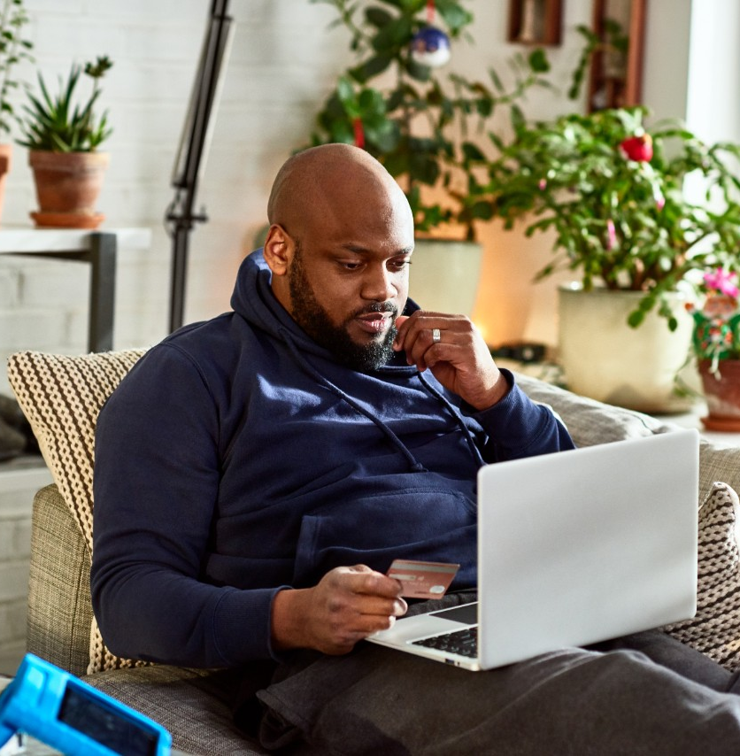
Account setup - what to expect
Personal details
Login details
Terms and conditions
Security checks
Notes:
Ask:
What type of information do you think you’ll need, and what will you need to do, to set up an online account?
Look for:
Personal details
Log in details
Confirm she's read the terms and conditions
Undergo some security checks
If face-to-face training and you have a whiteboard or flipchart, use these to note their suggestions
Explain:
To find your account, the bank will ask for some personal details, like name, date of birth, postcode and account details.
You’ll be given a customer number to help you to log on to online banking. You’ll also be asked to fill out some other details. These details are how you, and only you, will be able to unlock your account.
Some banks do this by asking the person to create a username and password. Others will ask you to set up other types of protection like a PIN, or some memorable information.
Others may also ask you to set up a different kind of authentication, like a fingerprint or face identification. These all act as an extra layer of protection, to make sure you’re the only one who can use the account.
You’ll also be asked to read and agree to some terms and conditions. When setting up your account, you should read these and make sure you're comfortable with what you're signing up to.
Some banks will add extra security checks into the process. This is just to make sure it really is you who is setting up online banking. This can sometimes be a phone call with the bank, or you may need to record a short video of youself so the bank can check you are who you say you are. Because most banks will require you to do a security check via call or message, you will need some kind of phone number.

Slide 15
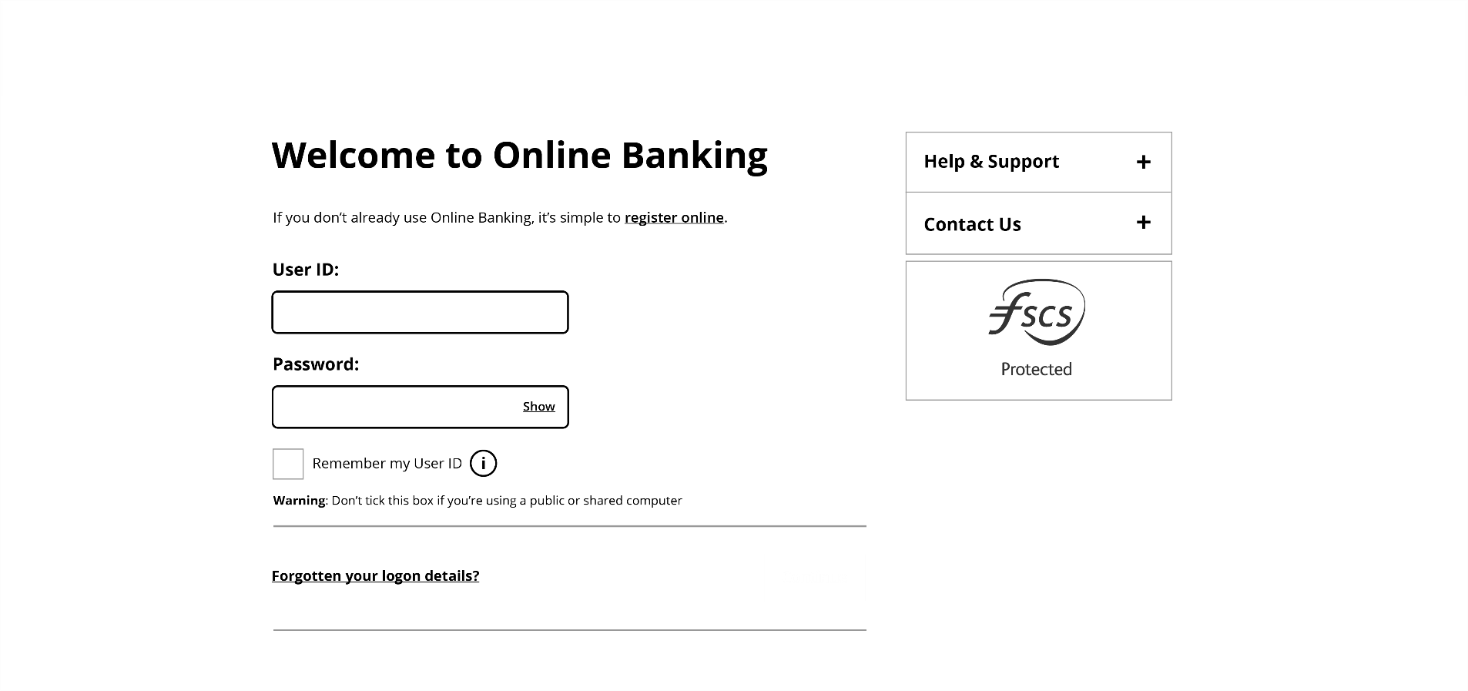
Browser log in
Notes:
Explain:
Once you’re registered for online banking, you can go to your bank's website and click where it says 'log in’
You’ll need to enter your unique details, given to you when you registered

Slide 16
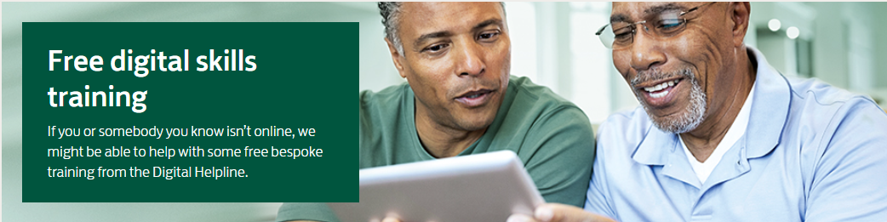
Help downloading the app
0345 222 0333
Notes:
Explain:
Mary wants to set up the app on her phone for quick, easy access to her online account.
First, she'll need to download her bank's app from Google Play or the Apple App Store
Mary isn’t sure how to do this, so she calls the Digital Helpline on 0345 222 0333.
This is a free service - you don’t need to be a customer.
It is open Monday to Friday, 9am – 5pm.
These details are in your workbook. The Lloyds Bank Digital Helpline can give free one-to-one support with digital skills to anyone over 18.
Or of course, Mary could contact her bank for support
Mary finds she can also get a link to download the mobile banking app through the bank's website.
Once she has downloaded and opened the app, she can log in using the details given to her when she registered.
PAUSE HERE AND CHECK HOW THE LEARNERS ARE FEELING – SO YOU CAN ADJUST THE TRAINING AS NEEDED

Slide 17
Using online banking
Notes:
So now Mary has got into her bank account online, let’s explore the kind of things she can do with it.
Explain:
And by the end of this section, you should be able to:
Set up an online account

Slide 18





Logging in online
****
Passwords
PINs
Biometrics
Memorable information
Multi-factor
Notes:
ANIMATED SLIDE – CLICK TO REVEAL EACH ITEM
First, let's chat a bit more about logging into online banking.
Ask:
What types of information might Mary's bank ask her for in order to access her new online account?
Look for:
Passwords
Multi-factor identification
PINs
Memorable information
Face scan
Fingerprint
If training face-to-face and you have access to a whiteboard or flipchart, use this to note their suggestions (and add any that they don’t get, as you talk through them).
Facilitator note:
Explain the different options and what they mean
Passwords – this is where you choose a set of letters, numbers and symbols which you will enter when you log in
Multi-factor authentication – this is a type of security used to lock and keep your accounts safe. It means using two or more types of lock. So, if someone gets your password, for example, they will still need to get through a different kind of lock.
PINs – you would select four or more numbers. You mainly use this with a password as a second type of lock in case someone gets through the first.
Memorable information – this is usually the answer to a question, it should be something meaningful to you. It is often used with a password as an extra lock. It is also sometimes used to help unlock your account, if you forget your password.
Face scan – a type of security where you use your device's camera to scan your face.
Fingerprint – another type of security lock, but this time using your fingerprint to unlock your account. You will need to have a fingerprint scanner on your device. Most modern smartphones will have this built-in.
PAUSE THE SLIDES HERE, FOR THE CARDS-BASED ACTIVITY

Slide 19
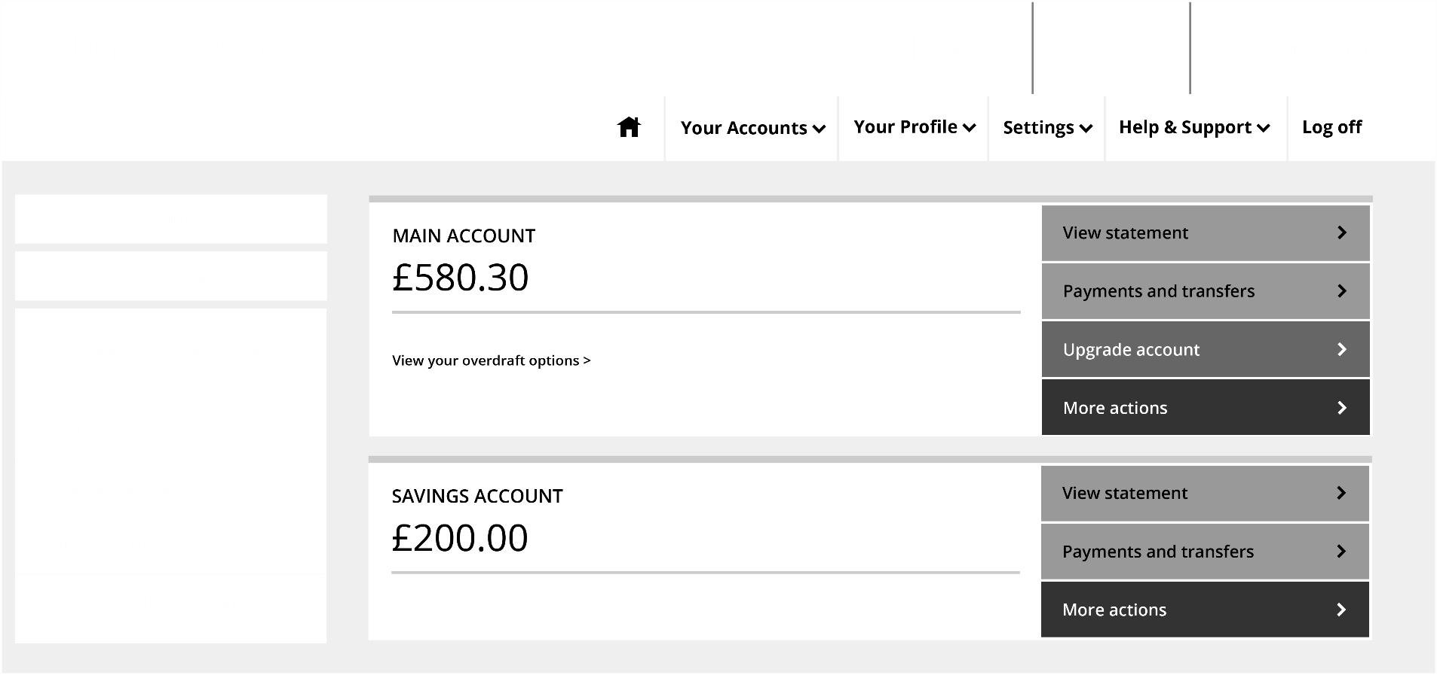
Example of what you might see
CARD MANAGEMENT
Notes:
Check everyone can see the details here – if not, point them to the image in the workbook.
Exercise:
Point out the image of a generic internet banking screen on the screen / in the workbook and discuss with the learners what features they can see. Discuss each of these areas and their functionality with the learners.
top area:
Search – you will usually see some kind of search bar. This will allow you to look for help or find something in your accounts.
Your accounts – you will be able to see a tile or list of all the accounts you have with the bank. You can see in the main part of the screen that Mary has two accounts – a main account and a savings account.
Settings – you will usually see a link to manage your account settings. This might look like a cog or gear symbol.
Support – there will usually be some kind of help or support button or section. You can use this to get help with your banking or how to bank online.
On the left:
Spending – you will find some kind of representation of your spending or a link to see this information.
Card management – there will often be some kind of card management section, especially on apps. These allow actions like seeing your card details, cancelling and ordering new cards, reporting a card lost or freezing/unfreezing a card.
Our products and services – there will usually be some way to apply for new products, so you can set up new accounts. With most banks, you won't be able to set up all of their products online, so you might be referred to speak to someone via phone or branch
On the right:
Pay and transfer – you will usually have some kind of pay or transfer button or tab. This lets you see accounts you have paid previously or set up new payees and make a payment. It will also usually include your list of direct debits and standing orders.

Slide 20

Online activities
What do you think you can do online to help manage your money?
Notes:
What do you think you can do with online banking to help you manage your money?
Idea for exercise:
Split the class into groups.
Ask each group to list the types of actions they expect to be able to do online to help them manage their money.
Once the groups have come up with their lists ask them to share their findings with the rest of the class.
Walk them through each answer as follows:
Look for:
Check your statements – you can see these as soon as they are created, so you don't need to wait for them in the post.
Download your statements for your records. You can also send them to, for example, a landlord to prove your income etc.
Search for specific payments and learn more about them. You can also see all your spending within a certain date range.
See the details of purchases – it can be easy to forget you bought something, so you might be worried when you see something on your account you don't recognise. With online banking, you can see the details of your spending so you can find out when you spent the money and where. This can help reassure you that all the money from your account was spent by you.
With everything you need online, at your fingertips, you can go paperless and receive all your letters from the bank online. This can save paper and time waiting for messages in the post.
Change your personal details like your address and mobile number in your account settings in an instant. This helps to make sure changes happen quickly.
(CONTINUED ON NEXT SLIDE)

Slide 21



Using your account online
Payees
Transfer money
Regular payments
Check future payents
Pay in a cheque
Notes:
ANIMATED SLIDE – CLICK TO REVEAL EACH ITEM
Explain:
There are lots of ways you can use online banking to make payments and send money.
She can pay new and existing payees. (this is a good point to check if they recall / understand the term ‘payee’)
She can also move money between her accounts. This means she can pay and move money from anywhere.
Online, Mary can manage direct debits and standing orders. She can cancel them and review upcoming payments.
Mary may even be able to send money outside the UK. Who she can pay and how she can pay will depend on the bank; if Mary needs any help with this she can speak to the bank or look in the help section online.

Slide 22
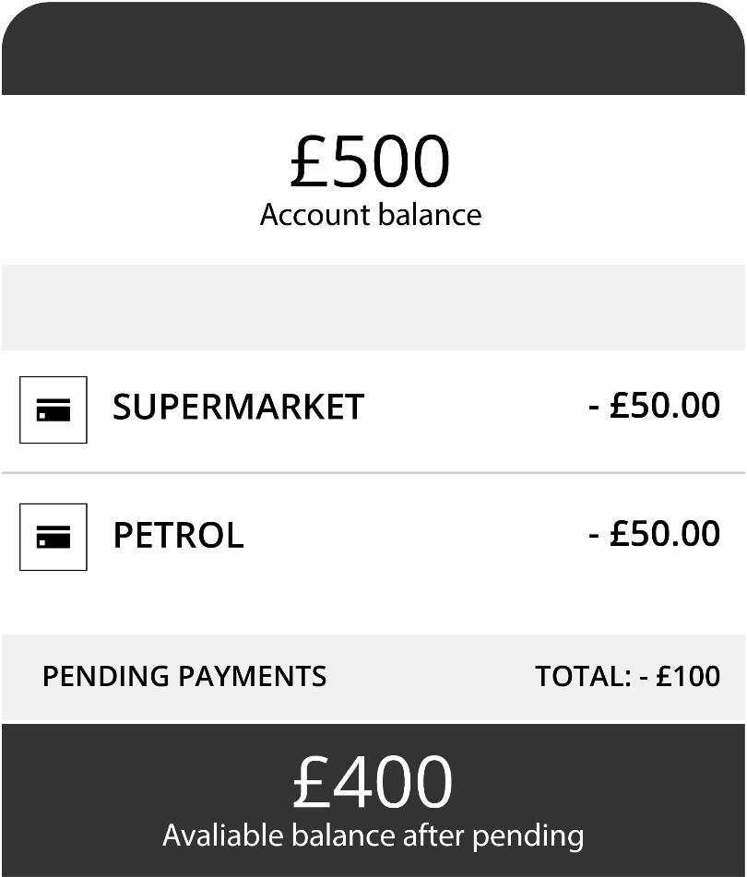
Pending payments
Notes:
See your pending payments – when you make a card payment, they don't automatically go out of your account. This can make it hard to know how much you have left to spend. This is why online banking usually shows you your 'available funds' which is the amount you will have to spend once your pending payments have left your account. They're a better indication of how much money you currently have.

Slide 23
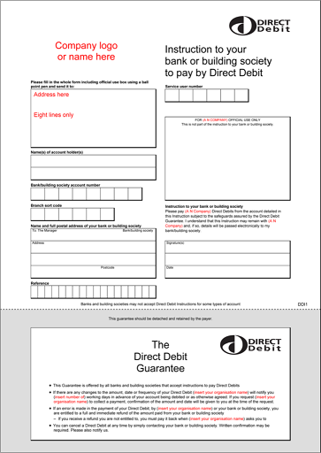
Direct debits – how do they work?
Set up by the company
Make sure you have enough money in your account
You can cancel using online banking
Notes:
Explain:
Direct debits automatically pay a company once a month from the money in your account. Lots of companies like you to use this payment method, as you don't have to remember to pay your bill – the bank will automatically do it for you each month.
Ask:
Who is responsible for setting up a direct debit?
Explain:
Direct debits are set up by the company you are paying.
It's still important that you check your direct debits, to make sure they're set up right.
It's also important you make sure you have enough money in your account to pay your direct debits, or you may be charged a fee for missing a payment.

Slide 24
Standing orders
Mary wants to send a regular monthly payment to a family member
Who is responsible for setting up the standing order?
Notes:
Standing Orders
Ask:
Mary wants to send a monthly payment to a family member she supports. Who would be responsible for setting up the standing order?
Explain:
Mary, because standing orders are set up by the account holder
The first thing Mary will need to do is set up the person/organisation she wants to pay as a 'payee'. To do this, Mary will need to know their name, bank account number and sort code.
Once she has these details, she is ready to start.
Most banking services will have a 'pay and transfer' section. It might not be called this, but it will be something similar.
In this menu, there is usually a button or link that will say 'Add new person' or 'Create new payee'.
After clicking on this, Mary will be able to fill in the details of her family member.
Mary can review and manage her payments online at any time, giving her control over her spending.

Slide 25
Standing orders – how do they work?
Set up by you
Make sure you have entered the correct details
Set the frequency and amount of the payments
Enter the reference details
Review, change and cancel online
Notes:
Ask:
Why should you always double-check the details of the person or company you are paying?
Explain:
Always double-check that the details you enter are correct - or you could end up sending the payment to the wrong account.
Some banks will now have a step where they will check with you whether the details you have entered match what they have on file. So, for example, if you want to pay John Smith with the account details 01234567, sort code 00-00-00, but the bank has a record that shows that this bank account belongs to James Wright, then they may encourage you to check.
You will also need to set an amount and the date you want the payment to go out on – for example, the first day of the month. You will also need to say how regularly the payment needs to be made – weekly, once a month and so on. You will also need to add a reference. The reference shows how it will appear on your statement and the statement of the payee, so it might be something like 'holiday deposit'. Some companies will ask you to put something specific as the reference to help identify the payment when it comes into their account.
Once you’re sure all these details are correct, you can confirm and finish setting up the standing order. Some banks will ask you to re-enter your password at this point, or go through an extra layer of security to make sure it's you.

Slide 26
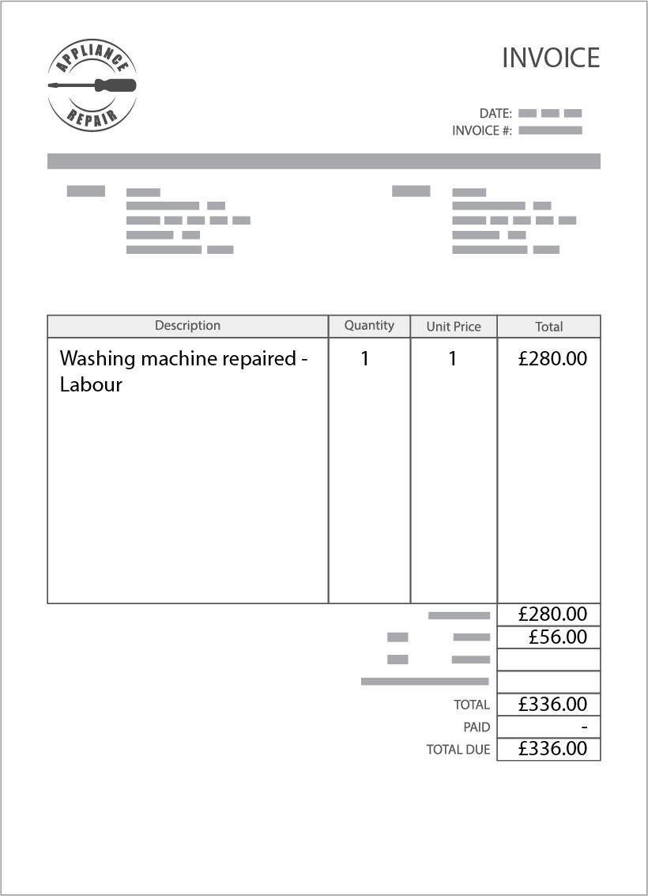
One-time payments
Mary's washing machine broke down
A repair man came and fixed it and asked Mary to send the payment through to his bank account
He gives Mary an invoice with the payment details
Notes:
Talk through:
Mary's washing machine broke down. A repairman came and fixed it and asked Mary to send the payment through to his bank account. He gives Mary an invoice with the payment details.
Explain:
The way you set up a one-time payment is similar to setting up a standing order, except you need fewer details and the payment is usually made there and then.
Once you set up or find the payee in your list of payees, you can enter how much you want to pay and add a reference. Some banks will also allow you to schedule the payment for a later date.
Bear in mind that all banks will have some kind of limit on the amount you can pay in a one-time payment or in a period of time. For example, they may say no more than £10,000 in one payment, or no more than £10,000 in one day.

Slide 27
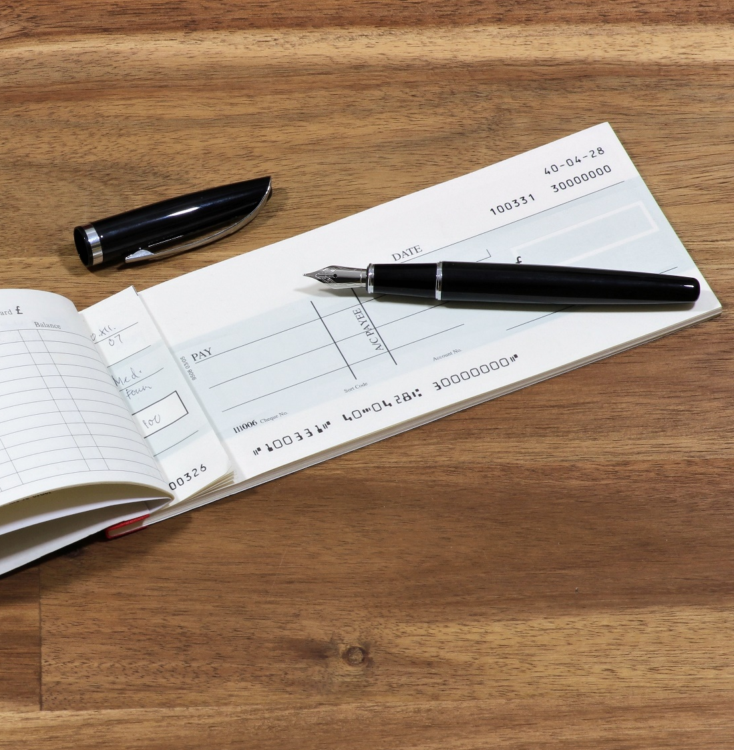
Paying in a cheque
Select ‘cheque deposit’
Enter the amount
Let the app use your camera
Take photos of the cheque (front and back)
Review and confirm
Notes:
NOTE – THIS SLIDE IS ANIMATED TO SHOW EACH STEP IN TURN
Ask: does anyone receive cheques?
This is how you pay a cheque in, using the app. Most banking apps will guide you through these steps to help you.
(THIS IS THE START OF THE ANIMATION – CLICK AND TALK THROUGH EACH STEP IN TURN)
In your app, select the Cheque deposit option.
Now enter the amount shown on the cheque.
You may be prompted to give the app permission to use your phone camera.
Then places the cheque on a dark, flat surface. Hold the camera over the cheque until the green box is shown around the cheque. The app then scans the cheque.
Next, turn the cheque over and repeat the process.
Finally, you’ll be prompted to Review your deposit and check that the details are correct. If everything is correct, go ahead and confirm the deposit.

Slide 28

The lost card
Mary lost her card yesterday morning
She used her app to freeze the card whilst she looked for it
She found the card later that day and used her app to unfreeze the card
Notes:
Talk through the slide text
Ask:
What other services relating to your bank card do you think you can do online?
Explain:
You can usually use online banking to manage your card and card's PIN.
You can order new cards.
You can report cards lost or stolen or you may be able to freeze your card while you try to find it to stop it from being used.
You can also sometimes see your details like your card details, your PIN and your card's contactless limit.
PAUSE SLIDES HERE, FOR THE SAFETY AROUND ONLINE BANKING (MULTI-CHOICE) EXERCISE

Slide 29
Quiz time!
Notes:
Quiz
EITHER:
Use the cards in the Facilitator guide for the ‘Safety in online banking’ multiple choice activity
OR:
Show the next six slides which cover three questions (1 slide with options + 1 ‘correct answer’ slide per question). Use this option if your group would benefit from seeing the questions on the screen, you don’t have the cards or you’re short on time.

Slide 30
Your bank texts you. They want you to log in using a link in the text
What do you do?
Delete the text and report it
Click the link and give your details
A
B
Notes:
Ask: ​
Your bank sends a text to you, they ask you to click on a link and enter your login and
password to help fix a security issue. What do you do?
Delete the text and report it(correct) ​
Click the link and enter your details.
Exercise: ​
If you think the answer is a, stand on the left side of the room ​
If you think the answer is b, stand on the right side of the room ​
If you have a small group, or learners with accessibility issues, you could ask them to hold their hands up instead ​
For online sessions, ask learners to type their answer (A or B) into the chat box​
​

Slide 31
Your bank texts you. They want you to log in using a link in the text
What do you do?
Delete the text and report it
Click the link and give your details
A
B
Notes:
Answer revealed
Explain: your bank will never text, call or email you asking for your details.

Slide 32
You struggle to remember your password
What do you do?
Use the same password for everything
Use your pet’s name
Make it unique and keep it safe
A
B
C
Notes:
Ask: ​
If you have trouble remembering your password, what action should you take?​
Use the same password for everything so you only have to remember the one
Keep your password simple, for example, use your pet's name. ​
Use a unique password and keep it safe ​(correct) ​
Exercise: ​
If you think the answer is a, stand on the left side of the room ​
If you think the answer is b, stand on the right side of the room ​
If you think the answer is c, stand at the back of the room ​
If you have a small group, or learners with accessibility issues, you could ask them to hold their hands up instead ​
For online sessions, ask learners to type their answer (A, B or C) into the chat box​
​

Slide 33
You struggle to remember your password
What do you do?
Use the same password for everything
Use your pet’s name
Make it unique and keep it safe
A
B
C
Notes:
Answer revealed
Explain:
Your password helps to keep your money safe. So don’t be tempted to use the same one as you use for other apps or accounts. And make sure it’s something unique, that no one else can guess.
There are online tools to keep your passwords safe.
Some people write their passwords down. If you need to do this, make sure where you write it down is far away from any device you use.

Slide 34
You use a computer at your local library to log into your bank account.
It asks if you want this device to remember your details.
Do you tick that box?
Yes
No
A
B
Notes:
Ask: ​
You're at the local library using one of their computers when you decide to check your online
account. You go to the website and select 'Log In'. After entering your login details there is a
box that asks if you'd like the browser to remember your login details. Should you tick this
box?
Yes, it'll be quicker to log in next time
No, you don't want it to remember your details. (correct) ​
Exercise: ​
If you think the answer is a, stand on the left side of the room ​
If you think the answer is b, stand on the right side of the room ​
If you have a small group, or learners with accessibility issues, you could ask them to hold their hands up instead ​
For online sessions, ask learners to type their answer (A or B) into the chat box​
​

Slide 35
You use a computer at your local library to log into your bank account.
It asks if you want this device to remember your details.
Do you tick that box?
Yes
No
A
B
Notes:
Answer revealed
Explain that as this is a public computer that other people use, you don’t want it to remember your details in case someone else is able to access your online account.

Slide 36

Banking online recap
This is what you’ve done today:
Listed the benefits of banking online
Learnt how to set up an online account
Explored ways to manage your account online
Notes:
Review the workshop with the delegates by running back through what has been covered

Slide 37
Any questions?
Notes:
Ask the learners if they have any questions about what's been covered. Encourage learners to help and support each other.

Slide 38
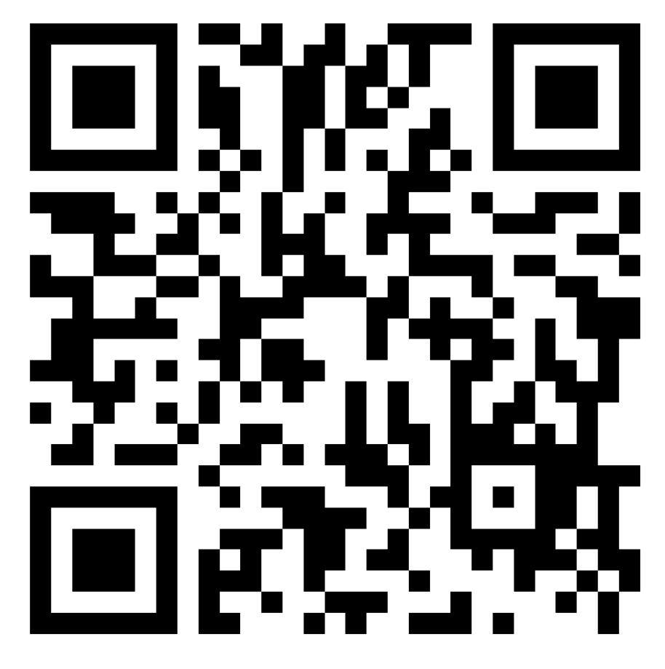
Thank you!
Let us know what you think
Notes:
Encourage learners to scan the QR code here and complete our short post-session survey around levels of confidence now they have completed the training, plus any other comments or feedback about the session

Slide 39
Lloyds Bank Academy *Ends*
Notes:
Explain:
This is the end of this workshop. Thank you for attending – we hope it's been useful.
Please keep your workbooks so that you can refer back to your notes.
The workbook also contains helpful links to information on the internet as well as an explanation of financial terms to help you understand the terminology of banking.

