Slide 1

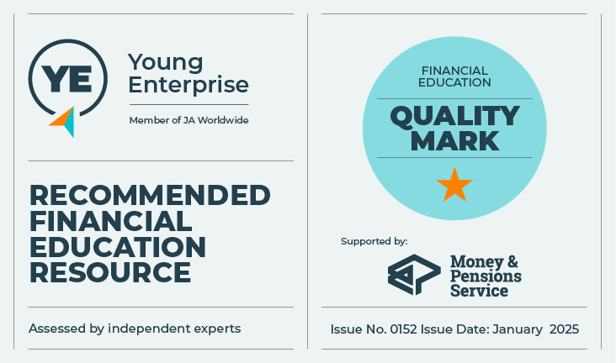
Borrowing Money
Exploring borrowing and credit
Let’s talk about money
This material is intended for information purposes only and does not constitute advice or a recommendation.

Slide 2

Introduction
Today you will be learning about:
Types of borrowing and credit.
Borrowing terminology.
Why you might borrow money.
The alternatives to borrowing.
The benefits of borrowing.
Factors to consider when choosing products.
Risks of borrowing, and ways to avoid those risks.

Slide 3


Activity A
Why borrow
True or
False
Borrowers in the UK paid £220 million a day in
interest on average, as of August 2024.
As of August 2024, the average credit card debt for
an adult in the UK was £1,324.
A credit card on the average interest rate would take
25 years and 8 months to repay if you only
paid the legal minimum repayments (interest plus 1%
of the outstanding balance) each month.
The current average total debt per household, including mortgages was £65,665.
£220
MILLION
DEBT
Source: The Money Charity

Slide 4
Activity A – Why borrow?
Why might people want to borrow money
?

Slide 5

Activity A – round up
Why borrow?
Key learning:
It is important to understand why you may want to borrow.
Sometimes, it might be better to find another way, for example, to save money first.
You should be clear about your reasons for borrowing.
Always think about whether your borrowing is manageable and if you can afford to pay it back.
Having debt can impact your mental health.

Slide 6

Activity B – round up
Understanding borrowing
Key learning:
It is important to know the types of borrowing for each situation that may arise at different stages of your life.
It is important to know where to get advice – and not to be afraid to ask.
There are many reputable money advice services and websites that can provide guidance to help you with borrowing decisions.
It is important to keep safe and to understand the risks when borrowing or using credit.

Slide 7

Activity C – Borrowing decisions
Ethan
Ethan’s friends have asked him to go on holiday to Ibiza.
He can’t afford it and still owes his Dad money from his holiday last year.
He’s just opened a new credit card account, and so he says yes and buys his flight on the card.
Six months later, he’s struggling to make even the minimum payment each month.
Why did he borrow?
What kind of borrowing was it?
Was it a good or bad decision?
What could he have done?
What should he do now?

Slide 8

Activity C – Borrowing decisions
Jasmine
Jasmine as just got her first job and wants to move out of her parent's home but renting is expensive.
She has some savings and has applied for a loan that helps younger buyers purchase their first home.
The payments are fixed for five years so she knows how much she will pay each month.
She wants to travel in the future, and if she owns her home, then she may be able to rent it out when she is away. She needs to do more research into this.
Why did Jasmine borrow?
What kind of borrowing was it?
Was it a good or bad decision?
What could she do differently?

Slide 9
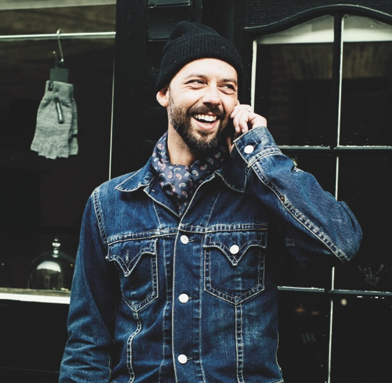
Activity C – Borrowing decisions
Rob
Rob just got his first job - he doesn't earn a lot.
He applied for a credit card, but was rejected.
He went clothes shopping and was offered 10% off his purchase if he signed up for a store card. In the same day, he signed up for two.
Three months later, he has spent all of the credit available to him.
The interest payments are really high, and he’s worried as he doesn't know how he is going to pay off the debts.
Why did Rob borrow?
What kind of borrowing was it?
Was it a good borrowing decision?
How is it affecting him?
What should he do now?
What could he have done to avoid it?

Slide 10

Activity C – Borrowing decisions
Malik
Malik is studying at university. He has taken out a loan to pay for his fees.
He didn’t want to borrow any more, so he has decided to live at home with his parents.
He works part time and hopes that by the time he finishes university, he will only have his fees to repay.
He doesn’t have to repay the loan until he starts earning a set amount in a job, so he may take a gap year first.
Why did Malik borrow?
What kind of borrowing was it?
Was it a good decision?
Could he have done anything differently?

Slide 11
Activity C – Round up
Borrowing decisions
Key learning:
It is important to understand our motivations for borrowing.
Always ask yourself if you can afford it and if you need it?
We should consider alternatives first, such as saving.
It is important to know where to go for advice when making borrowing decisions.
Borrowing can help us to manage our finances.
It is also important to ask for advice if we run into problems with borrowing.
We need to understand the risks that can come with borrowing, and that there could be a negative impact our credit score and credit history if we cannot afford to pay back borrowed money.

Slide 12

Thank you!

