Slide 1

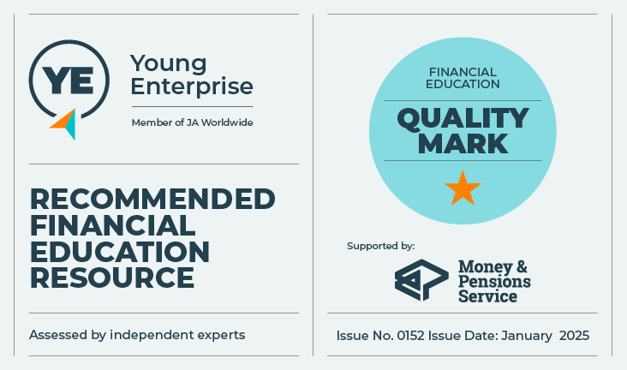
Financial independence comes from earning your own money
Let’s talk about money
This material is intended for information purposes only and does not constitute advice or a recommendation.

Slide 2

Introduction
Today you will be learning about:
Next steps in life for financial independence.
How to read the financial information in your payslips.
Working patterns within a changing economy, and their impact on the way you work and the jobs you might do.

Slide 3

Activity A
What’s next for me?
Mariam is 19, taking her A-levels at college.
She's exploring her options but can’t decide between them.
Should Mariam:
Go to university.
Get an apprenticeship.
Get a job.
Start her own business.
What does she need to know to help make her decision?

Slide 4
Activity A
The options – know or want to know?
Draw a chart like this one on a piece of paper. Allow plenty of space to write about the different options.
 | Know | Want to know
University
Apprenticeship
Working
Starting a business
Think about each of the options on the cards and use the questions on the next slide to:
Discuss what you already know about each ‘what next opportunity’. Write down what you know in the ‘Know’ column.
Discuss what you want to know more about and write down any specific questions you
have about it in the ‘Want to know’ column.

Slide 5
Activity A
Is this an option for me?
University
Apprenticeships
Why go?
How do I apply?
How much does University cost?
What is a Student Loan and how do
I apply?
What does it involve and how do
I apply?
How much will I get paid?
How will it impact on my finances?
How long does an apprenticeship last?
Working
Starting a business
What sort of job do I want?
How do I write a CV?
Where might I look for work?
How far will I have to travel?
What is the National Minimum Wage?
What is a business plan and what does it include?
What do I need to know about set0ting up a business?
When will the business start to make a profit?
Will I be able to pay myself a salary?

Slide 6

Activity A – round up
University… Apprenticeship… Work…
Key learning:
Financial independence comes from earning our own money.
Making choices about next steps in life can be challenging.
The choices you make about education, training and employment will impact on the income you may have, both now and in the future.
Find out as much as you can about the different choices available to you.
If you’re unsure, talk to others - friends, family and supporting adults.

Slide 7

Activity B
Payslip challenge
Kobe has been working for the last 9 months.
He receives his payslip monthly by email, but doesn't really understand them.
He thinks he has been underpaid, so he wants to check his payslips.
He must search his emails to find them, as he may have deleted some.

Slide 8
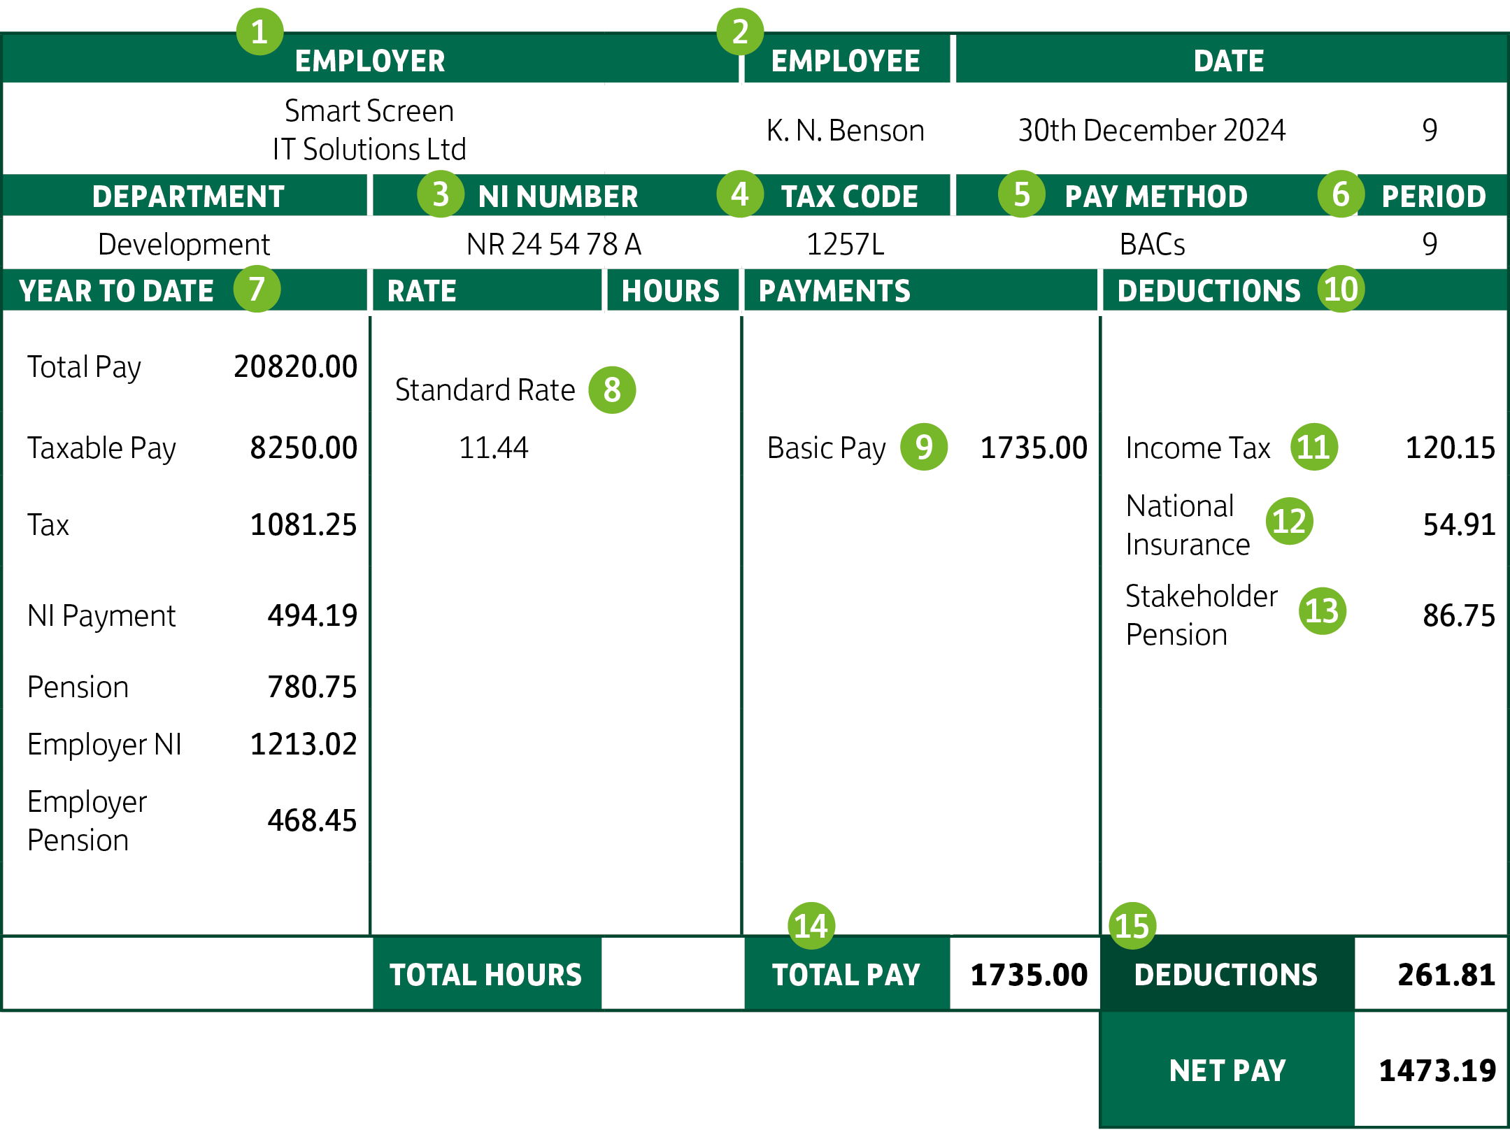
Activity B
What’s on my payslip?

Slide 9
Activity B – round up
Payslip challenge
Key learning:
Payslips are a record of how much you’ve earned and how much has been deducted from your earnings.
You should check each payslip to make sure it’s accurate.
If you think your pay is incorrect, you should speak to your employer immediately.
Payslips are an important form of financial information.
Keep all financial information safe – file or save it electronically.
National Insurance and Income Tax are deductions taken directly from your earnings.

Slide 10

Activity C
What’s my gig?
“The way we are working is changing fast and traditional career paths look less and
less relevant.”
These are some different styles of working:
Employed
Self-employed
Casual worker
Zero-hours contract
Gig contractor/contract worker
Entrepreneur
Volunteer worker

Slide 11

Activity C
What’s my gig?
Which types of working style would provide:
The greatest flexibility.
Better job security.
The most financial security.
The opportunity to work from home.
Ease of managing money from one
week to the next.
Better benefits e.g. holiday and sick pay.
Use the information sheet to support you.

Slide 12
Activity C
Agree/disagree?
If you have a permanent job, you might still only work part-time.
Running your own company means you make lots of money.
When you work for yourself, you are responsible for paying your tax and National Insurance.
Technology enables people to work from anywhere at any time.
The way you are paid will impact on how you manage your money.
A good work/life balance is important.
Only employed people get to have a pension.
A good work/life balance is important.
If you have a permanent job, you might still only work part-time.
Running your own company means you make lots of money.
It is better to be employed than
self-employed.
Working short term contracts makes it more difficult to manage your money.
The gig economy allows greater working flexibility.
Everyone is entitled to holiday pay and sick pay.
The gig economy allows greater working When you work for yourself, you are responsible for paying your tax and National Insurance.
The way you are paid will impact on how you manage your money.
Technology enables people to work from anywhere at any time.
Only employed people get to have a pension.

Slide 13
Activity C – round up
What’s my gig?
Key learning:
There are different pathways to earning money.
The way you work may change in the future.
Some working styles can require more thought and forward-planning to manage your finances.
Employee benefits such as holiday and sick pay may not be available if you work for yourself.
Self-employment and short-term contracts may allow for greater working flexibility.
Knowing what you get paid and how often is important and key to financial planning.
Making sure you have enough to live on from month to month is good financial planning.
If you earn, you must pay tax and National Insurance.
If you work for yourself, you may want to set aside an amount to fund your pension in later life.

Slide 14

Thank you!

