Slide 1

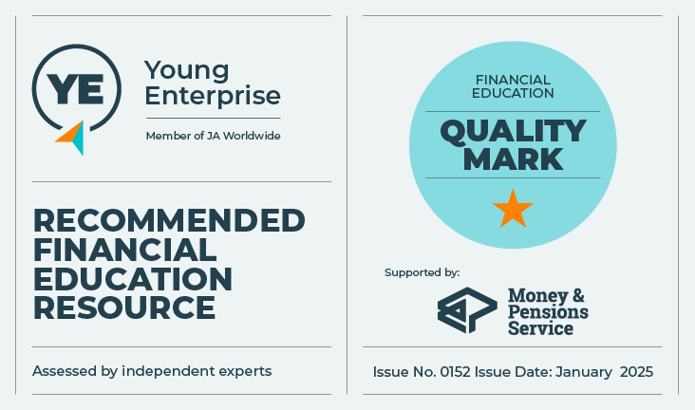
Risking money
Staying safe and in control
Let’s talk about money
This material is intended for information purposes only and does not constitute advice or a recommendation.

Slide 2

Introduction
Today you will be learning about:
The importance of insurance.
Adapting our behaviour with money to reduce risk.
How to stay in control
of your money.

Slide 3

Activity A
Why have insurance?
How many different types of insurance can you name in 30 seconds?
Buildings insurance.
Home content insurance.
Pet insurance.
Travel/holiday insurance.
Car insurance.
Life assurance.
Income protection/critical illness insurance.
Mobile phone insurance.
Extended warranty insurance for domestic/electrical appliances.
Medical insurance (health/dental plans).

Slide 4




Activity A
It all adds up
In 2024, travel insurers paid claims worth a total of £352m to travellers who needed help whilst they were abroad.
In 2024 pet insurers paid out a record-breaking 1.1 million claims worth £1.2 billion. The equivalent of £3.2m worth of pet insurance claims were processed every day.
Motor Insurance - Insurers processed the equivalent of £34m of claims per day in motor claims in 2024.
Property Insurance - Insurers processed
£3.5 billion in property claims in 2024. The highest type of claim is for Fire and Explosion which is equivalent to 17% of all claims followed closely by Theft at 14%.
https://www.abi.org.uk/globalassets/files/publications/public/key-facts/abi_key_facts_2021.pdf

Slide 5

Is insurance important?
In 2024, a holiday insurance claim paid out £78,000 to a traveller. They had spent 23 days in hospital recovering from injuries and trauma following a road crash in Spain.
Activity A
Worth the risk?
www.abi.org.uk

Slide 6

Activity A
Who really pays?
Over £1.3bn of general insurance claims fraud was detected/suspected in 2024.
Fraudulent motor claims were the most common, valued at over £600m.
www.abi.org.uk
What do you think about the moral/ethical issues of this statistic?
Who really pays for insurance fraud?
How might insurance fraud impact on individuals and society as a whole?

Slide 7

Activity A – round up
Why have insurance?
Key learning:
Insurance is a way of protecting yourself against financial loss.
Car insurance is compulsory. Other types
of insurance may be relevant depending
on circumstances.
Shop around for insurance products.
If you don’t understand a financial product, seek independent financial advice
before you buy.
If you are unsure what to do talk to others – friends, family and supportive adults.

Slide 8
Activity B
Adapting behaviour with money to reduce risk.
Excessive debt
Not being able to make ends meet
Money problems can make life difficult in many ways.
Here are some of the most common problems people experience with money:
Loss of earnings
Gambling
A spending addiction
Borrowing from an unlicensed lender

Slide 9

Activity B – round up
Adapting behaviour with money to reduce risk.
Key learning:
Behaviour and choices related to money may impact on your financial security.
Addictive behaviour may mean you spend money you can’t afford.
Don’t borrow money from someone you don’t know. They may be a loan shark.
If you need to, seek help and advice.
Try talking to others – friends, family or supportive adults.

Slide 10

Activity C
Who’s got my money?
Being in control of our money is important. It includes:
Knowing how much we have.
What we are spending it on.
Being able to make our own decisions about it and keeping it safe.

Slide 11


Activity C
Who’s got my money?
CASH STRAPPED STUDENTS TARGETED AS MONEY MULES.
Financial abuse is a form of domestic abuse.
Online banking warning: Victim loses £33k after scam text.

Slide 12



Activity C
Who’s got my money?
Explain:
The situation behind the headline.
What the consequences might be.
How to avoid/resolve the situation.
Where to go to seek advice or help.
Decide on:
One key thing you’ve learnt.

Slide 13

Activity C – Round up
Who’s got my money?
Key learning:
Stay in control of your own money.
Know where your money comes from and who you are giving it to.
Be vigilant. Your bank will never ask you to transfer money into another account.
If you are unhappy and feel someone has control of your money, talk to your bank.
If someone takes your money, report it immediately.
If you have a money problem, seek help and advice quickly.
Talk to others – your friends, family or supportive adults.

Slide 14

Thank you!

