Slide 1
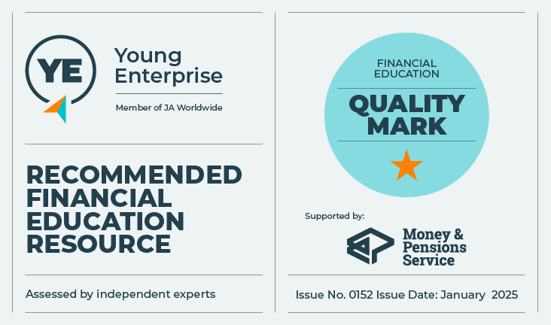

Banking on it!
Let’s Talk About Money
This material is intended for information purposes only and does not constitute advice or a recommendation.

Slide 2

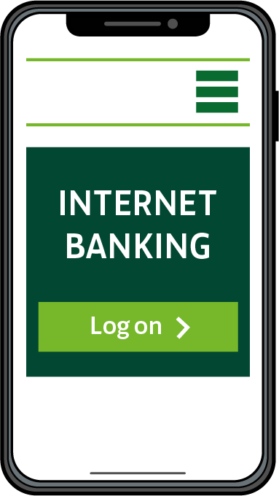
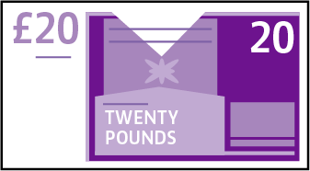
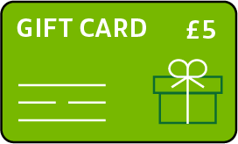

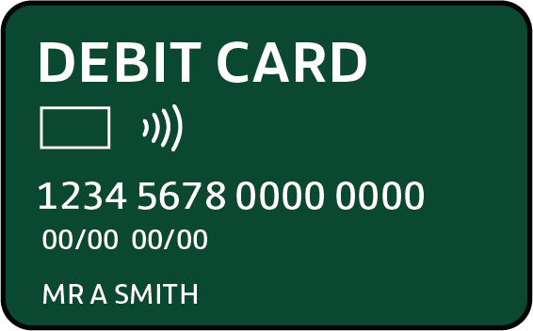
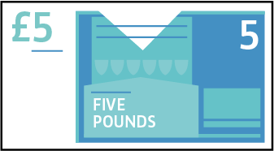
Introduction
During this session, we will be talking about:
  The difference between goods and services.
  What it means to be a critical consumer.
  Banking and the digital world of money.

Slide 3

Shopper, customer, consumer…
Consumer
‘A person who buys and uses products or services.’

Slide 4
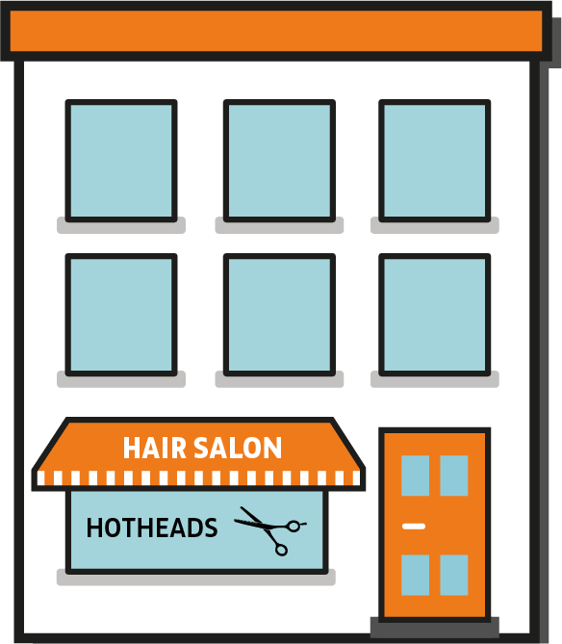


Services
Service
‘Helping or doing work for someone.’

Slide 5
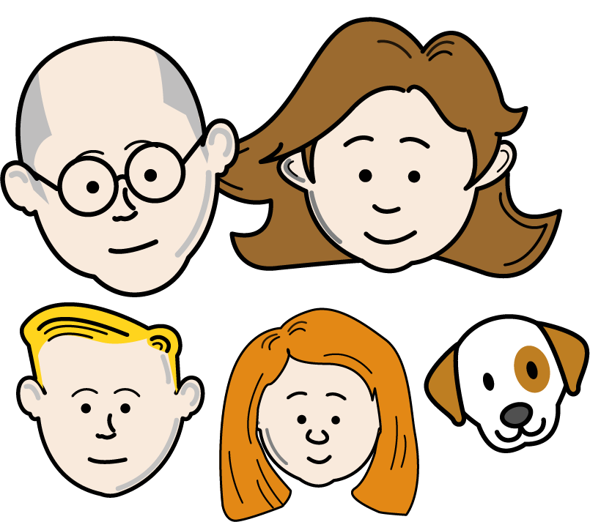
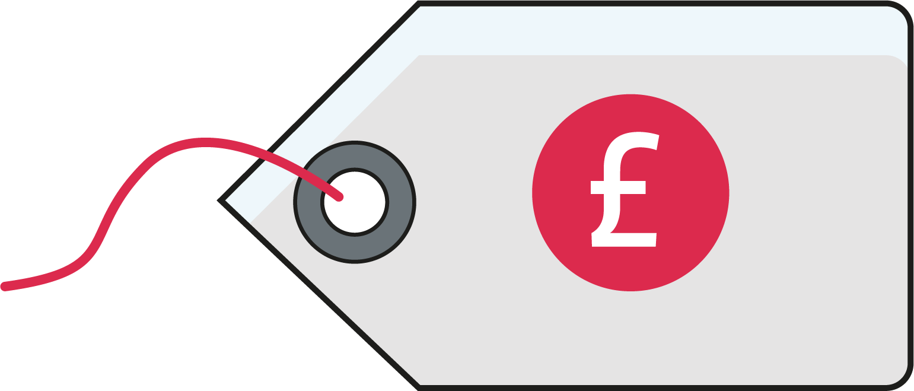

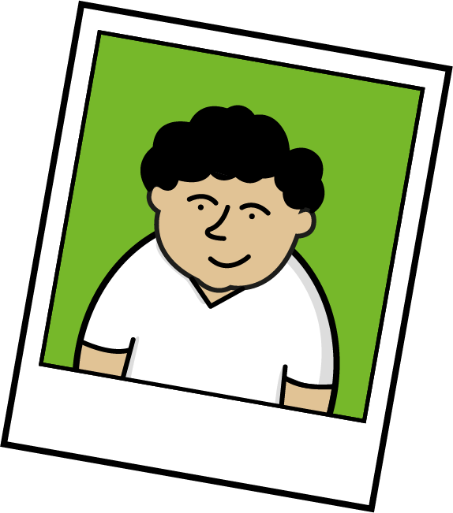

What influences our choice?
Lots of things can influence what
we choose to do with our money.
Price
Brand
Friends and family
Advertising
Salesperson
Social media influencers
Latest trends and ‘must have’ products
Functionality
Reliability
Ethical or climate issues
Dietary or health requirements

Slide 6

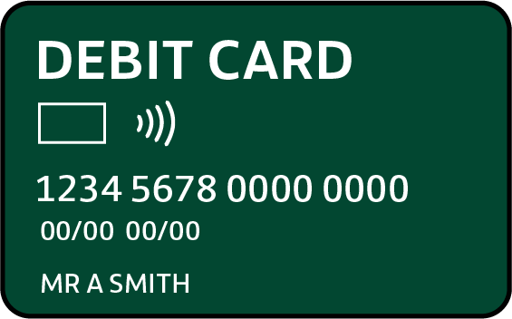
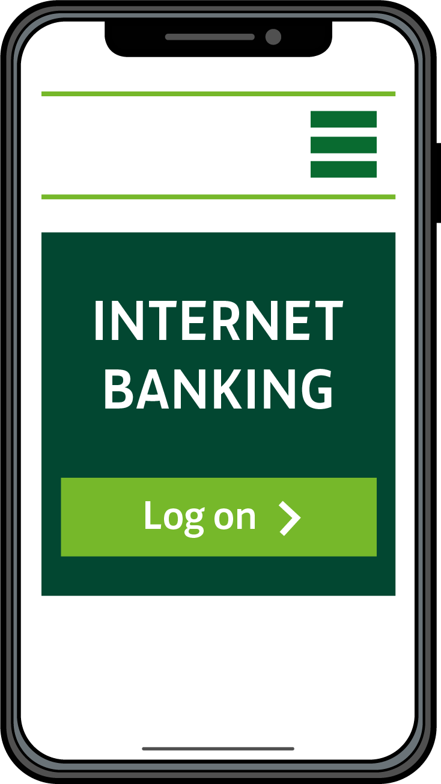

Bank services
What do you know about banks?
What services do banks offer to their customers?
What services would you want from a bank?

Slide 7
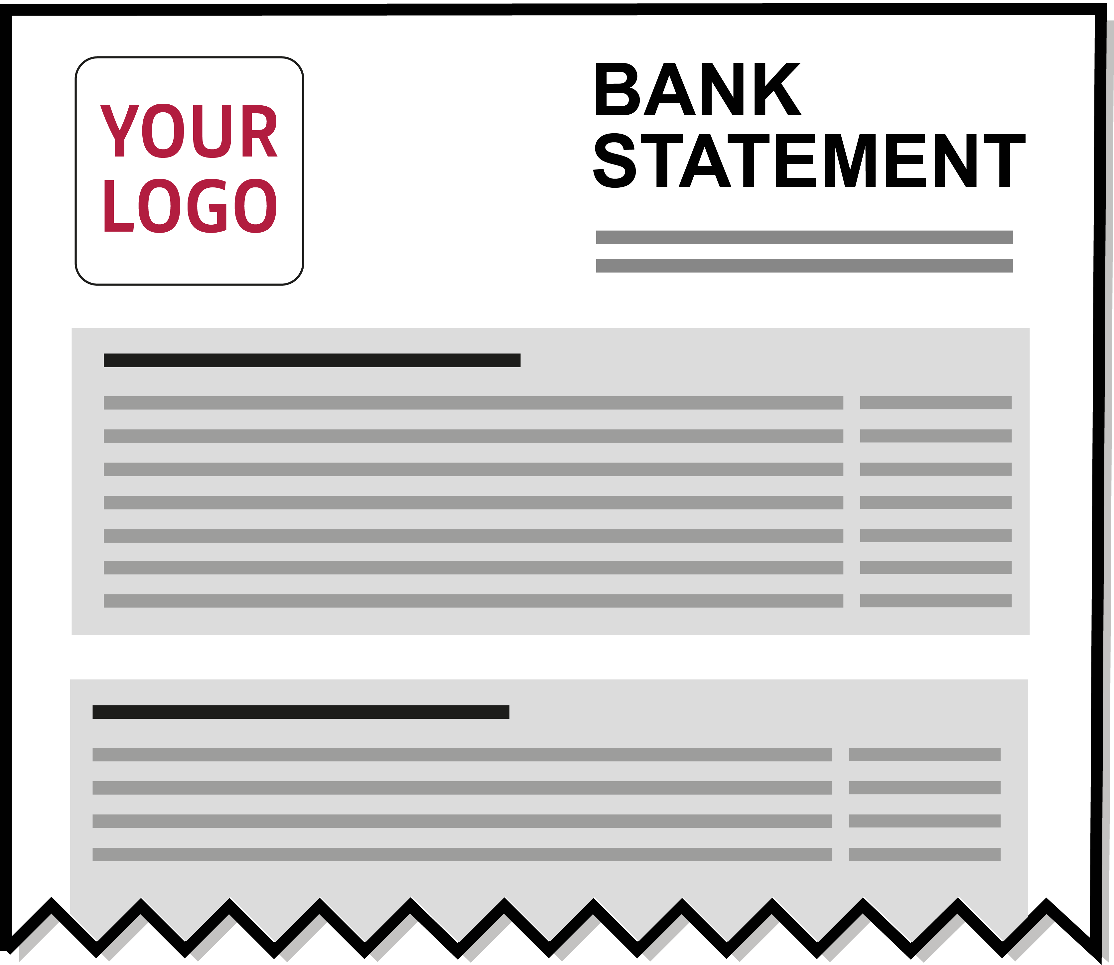
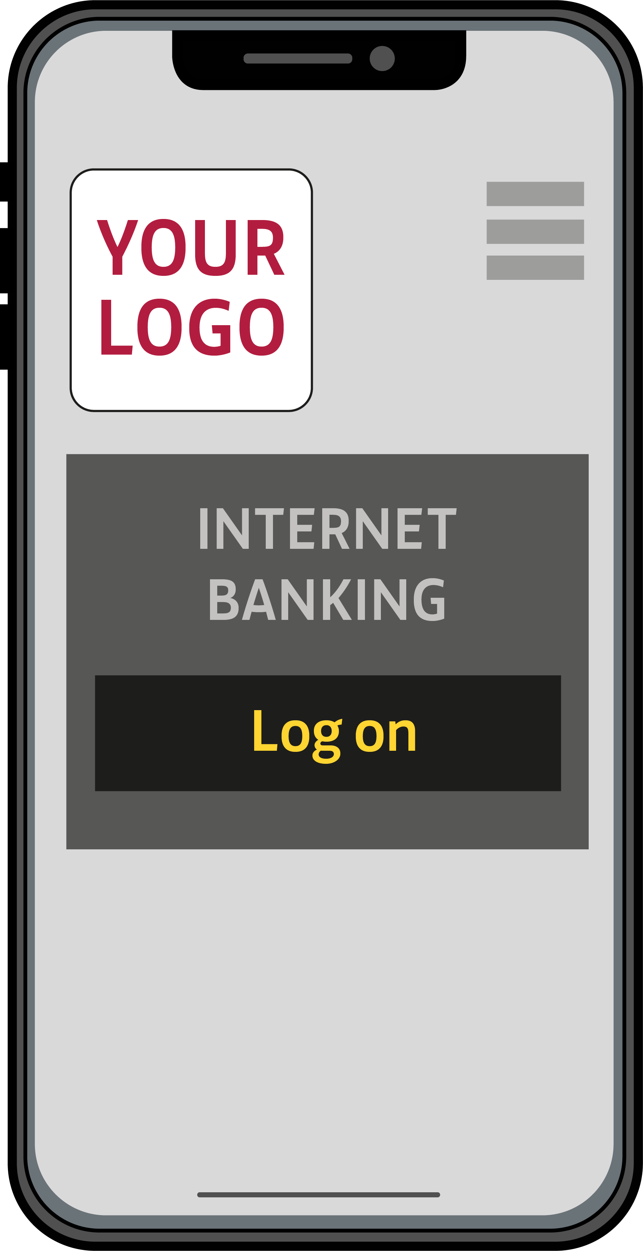
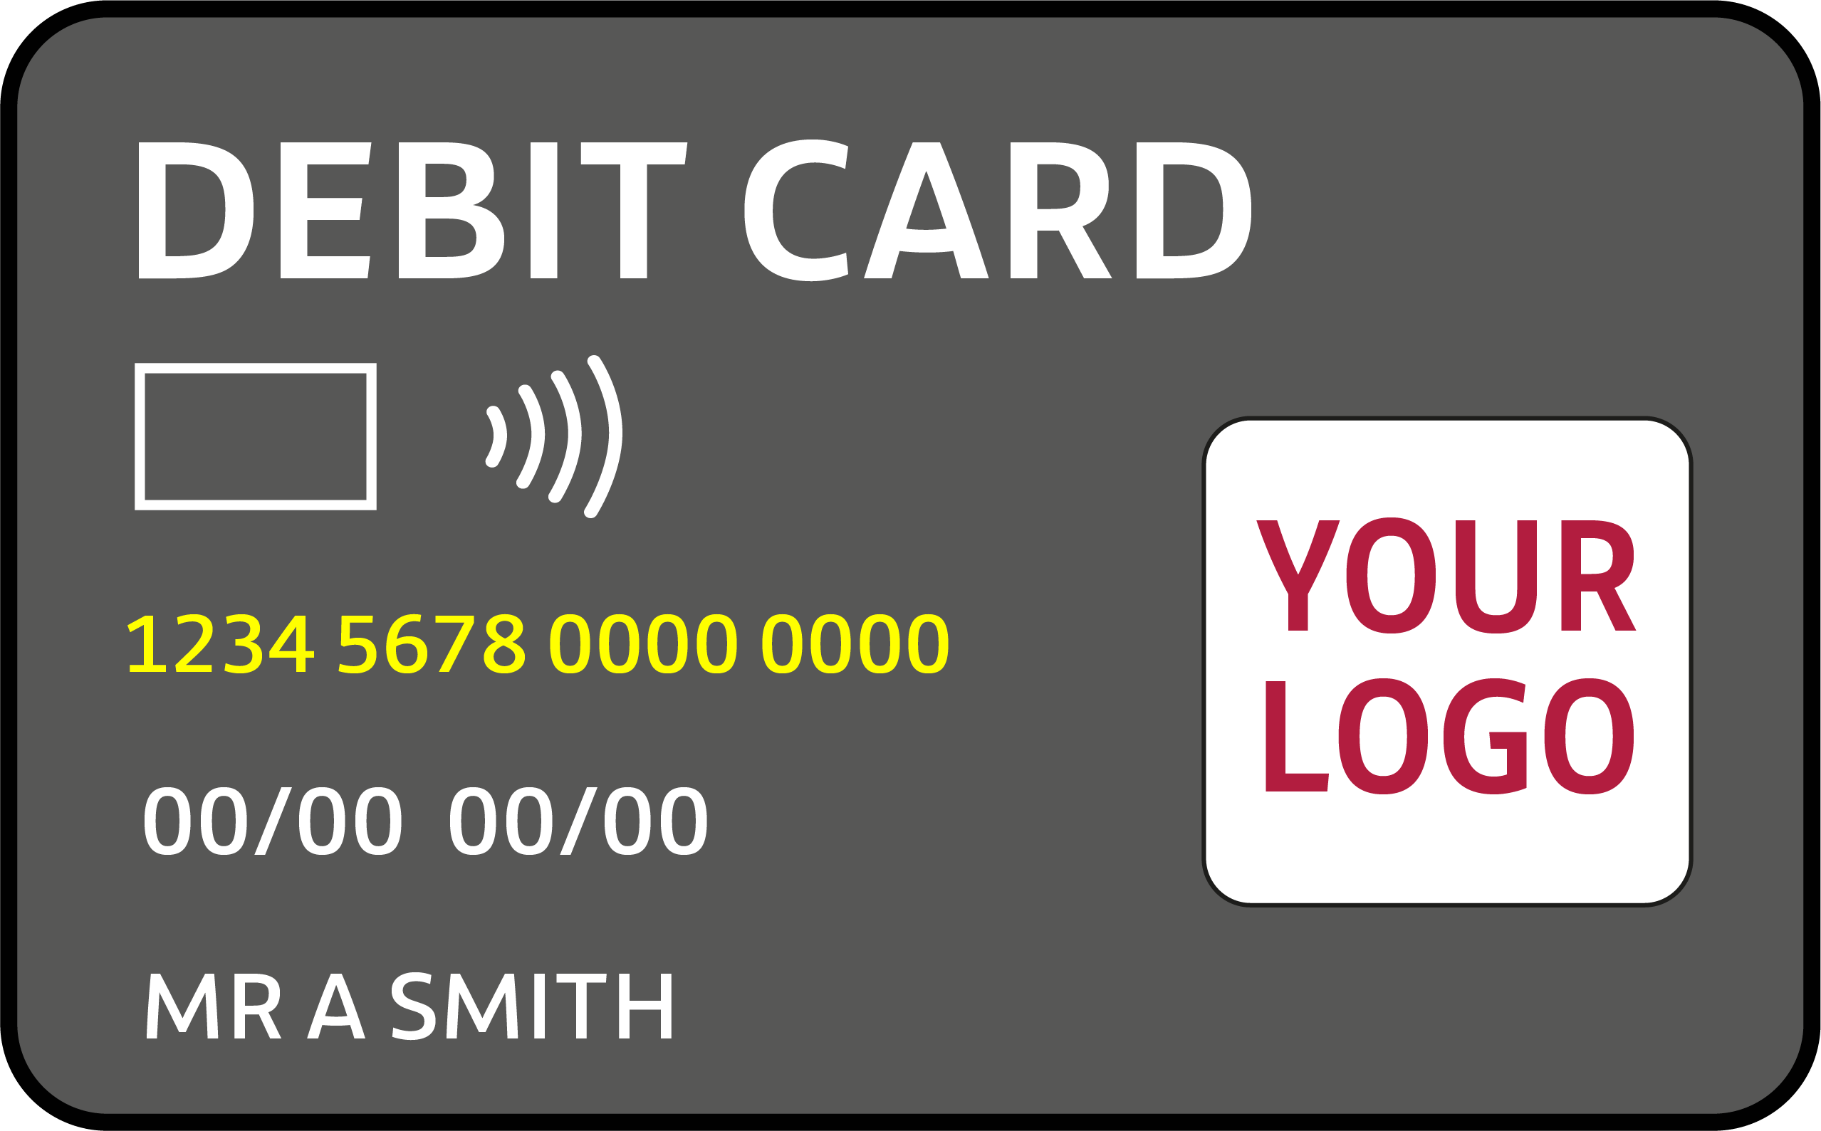
Design a bank account
You are going to design your own bank account.
1
Give your bank a name and create a logo.
2
Select 4 services your bank account is going to offer. Use the ideas you’ve shared as a class and the information sheet to decide.
3
Create at least one new extra of your own. It could be anything you want e.g. a discount card to use at certain shops or free music on your phone. Your extra service can be fun, silly or sensible!
4
Create a promotion slogan to tell customers why your bank is the best there is!

Slide 8
It doesn’t just have to be a bank!
Banks are just one way of managing our money. There are other alternatives to banks:
Credit Unions:
let people in a shared local community save and borrow money with each other
offer a range of savings accounts, current accounts and loans to their members
are owned by their members and not-for profit.
Friendly Societies:
are based in a very local area
allow members to save and borrow money
offer a range of products including savings accounts and insurance.
Building Societies:
owned by their members
offer a range of savings accounts, current accounts and loans
are sometimes bigger national organisations.

Slide 9
It’s my choice!
3
Why might your choices change over time?
Why is it important to be
a critical consumer?
1
Did you all make the same
choices of services to offer?
Does everyone have the same
reason for their choices?
4
2

Slide 10

A big thank you!

