Slide 1


Decisions, decisions!
Let’s Talk About Money
This material is intended for information purposes only and does not constitute advice or a recommendation.

Slide 2

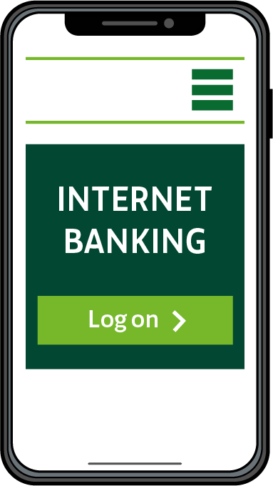
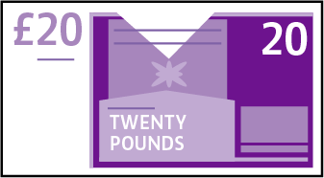
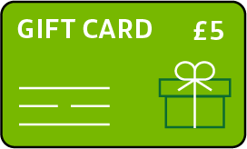

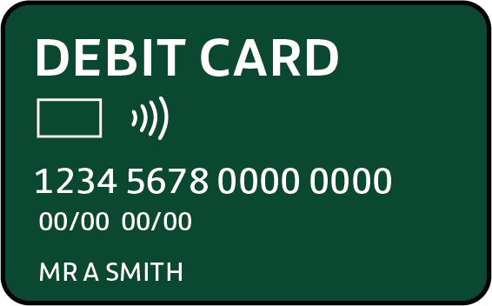
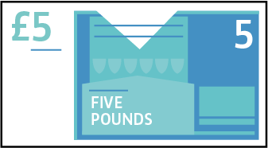
Introduction
During this session, we will be talking about money:
  What are needs and wants?
  Managing money
  Making money decisions

Slide 3


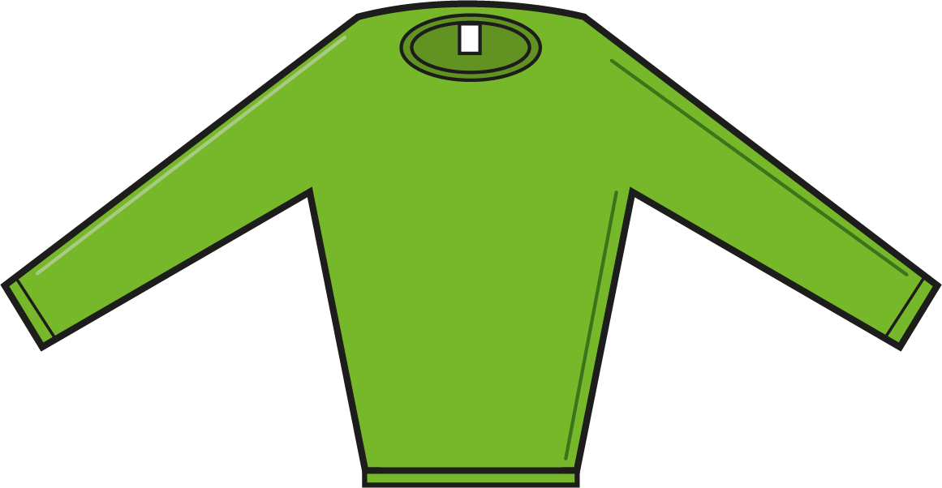


My needs, your needs
Think of something you need – share your idea with your partner.
Are your ideas the same or different?

Slide 4





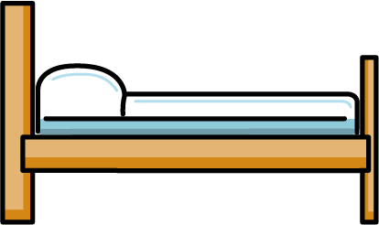







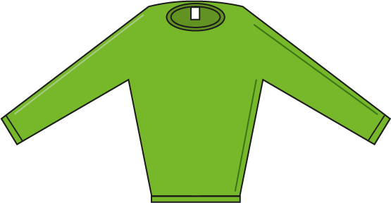

Needs and wants

Slide 5
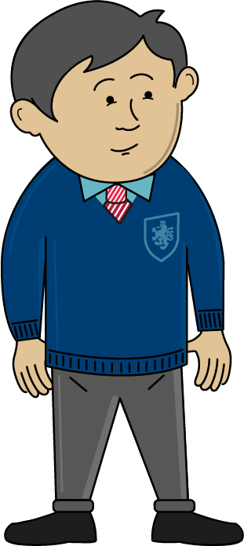

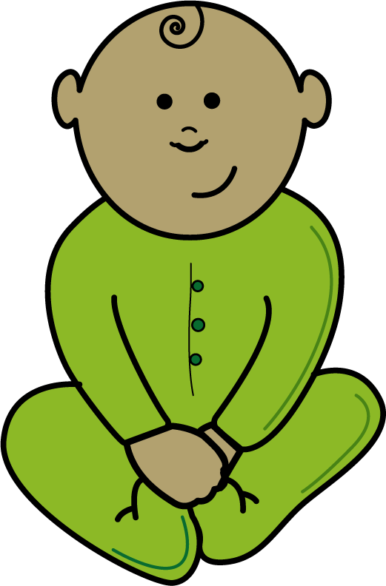
Do we all have the same needs and wants?
What might these young people need which is different to you?

Slide 6
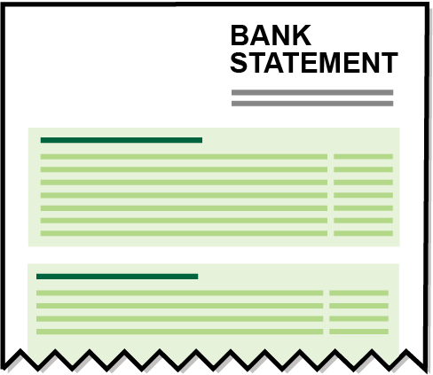
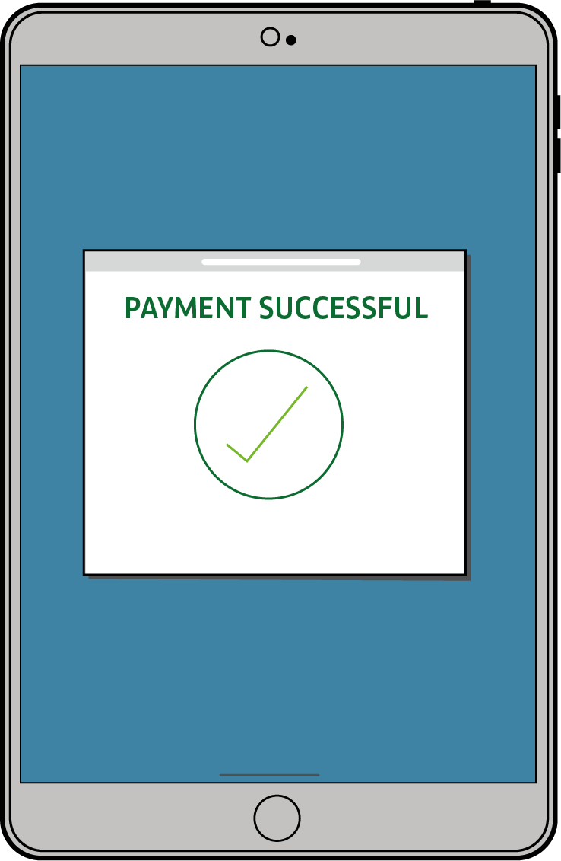
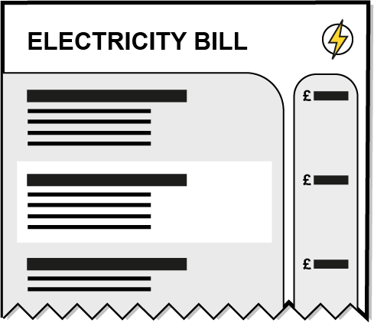





Managing the budget
Budget
A financial plan to manage the money you have and the amount you spend

Slide 7


The Green household
£400
The Green’s have
to spend each week
Decide on the needs of the household.
What wants or luxuries will they have?
There are two adults, two children and a dog living in the house.

Slide 8
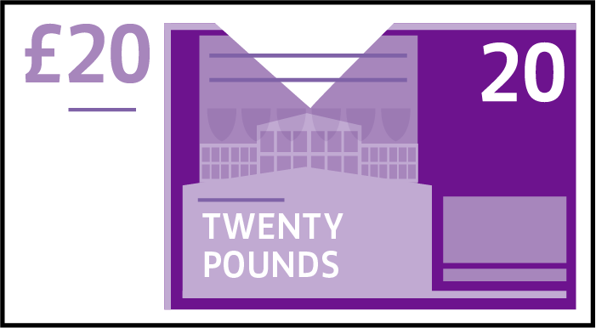
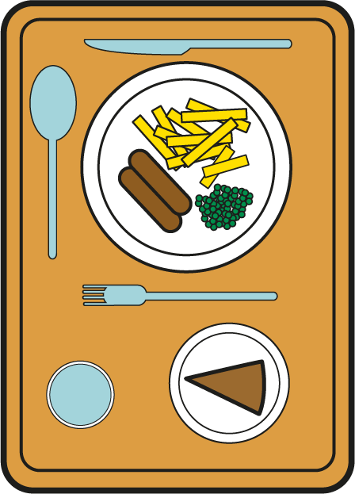

What does the Green household need each week?
Food £100
Ice skating £25
Transport £40
School lunches £20
Housing costs £120
Trip to the swimming pool £15
TV Licence £3
Trip to the cinema £20
Clothes £15
Treats for Saturday night £10
Savings £15
Netflix/TV package £5
Telephone £15
Heating and light £25
Takeaway meal £30
House Insurance £10
Holiday fund £30
Your task:
Sort the items into needs and wants.
Decide which items you want the household to have.
Write the items inside the house outline you have drawn.
1
4
Add up how much has been spent.
Remember you only have £400.
2
5
3

Slide 9



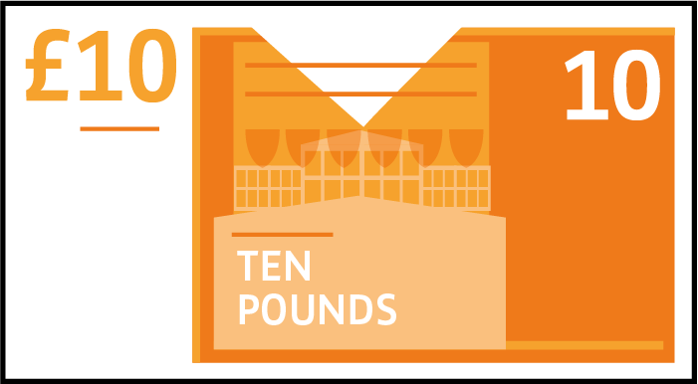
What happens when things change?
The Greens need to pay for all these extra items this week. Decide on what changes they will need to make to their weekly budget in order to afford these extra things.
£30
£15
£10
Trip to the vet
Birthday present
Extra spend on the telephone bill

Slide 10
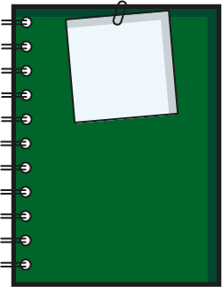
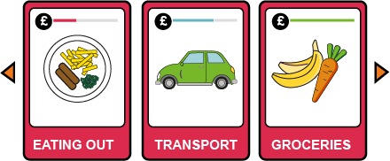
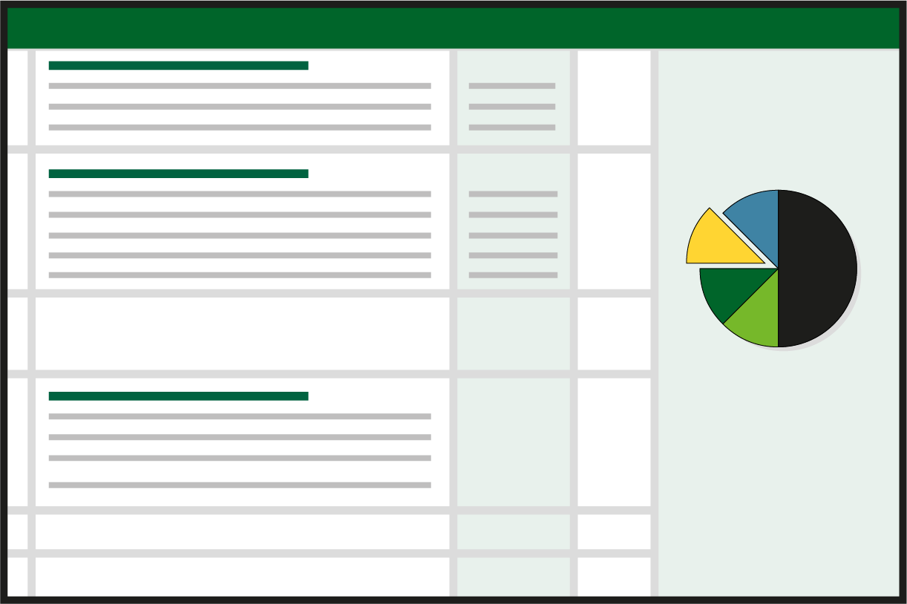
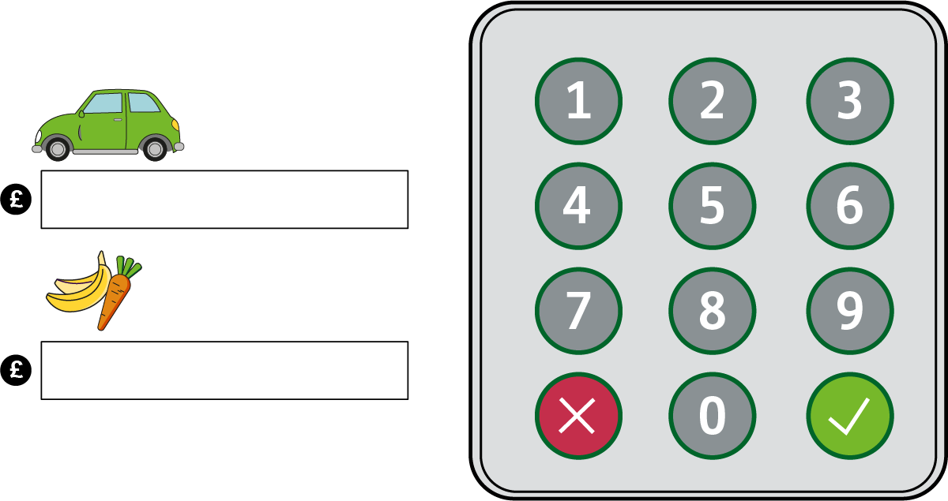
Tools to help you budget
Managing our money and working out a budget can be tricky. Here are some budgeting tools to help:
Shopping list
Budget sheet
Jam Jar accounts
Spreadsheets
On-line calculators
Writing a list before you go shopping helps you only buy what you need.
Making a list of all the things you need to spend money on and how much it will cost will help you make sure you have enough money to cover the essentials before you spend on the wants.
They can help you save for different
items e.g. rent,
bills etc. You can use different jam jars at home to save for different purposes.
They can be used to add up all the things you need to spend money on and how much money you have each week/or month. You can keep a paper record of what you spend.
These help you to work out how much you need to set aside each week for items which you have to pay for monthly or yearly. You can also use them to work out how much you need to save each week or month to be able to buy a more expensive item.
Need to be able to stick to what is on the list and not buy extras.
Need an account that allows you to set up these different ‘jars’.
Need access to a computer and spreadsheet app.
Only helpful if you stick to it.
Need access
to the internet.

Slide 11
Making money decisions
Use the questions to report back as a team on the decisions you made with your budget.
2
3
Did you all agree
on which items were needs and which items to have as wants?
How did it make you feel when you had to adapt your budget in order
to have enough money
to cover the extra items?
1
Which were the
hard decisions?

Slide 12

A big thank you!

