Slide 1

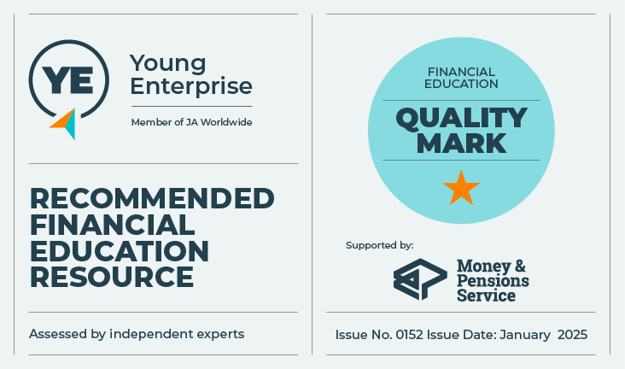
It’s my choice
Let’s talk about money
This material is intended for information purposes only and does not constitute advice or a recommendation.

Slide 2
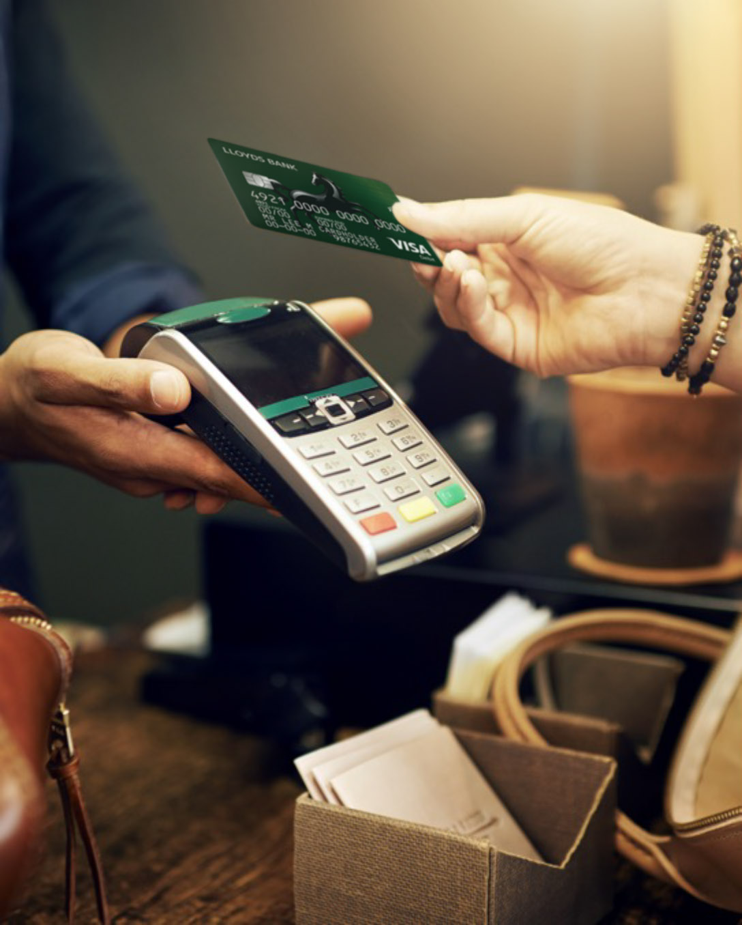
Introduction
During this session, we will be learning about:
What you can do with money and how it makes us feel.
Different financial products – pros and cons.
Different ways to protect your money and identity in a digital world.

Slide 3
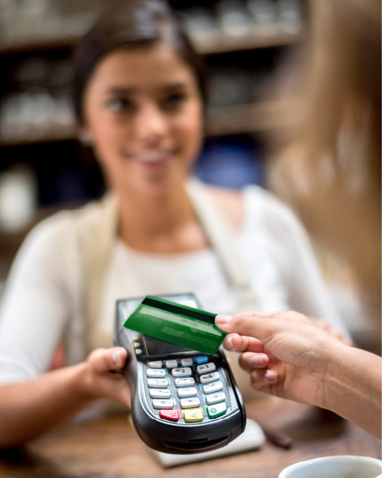
My Money
What would you like to spend your money on?
What would you not like having to spend money on?
How might spending make someone feel?

Slide 4


Spending and using our money
What else might we do with our money?
Save it
Give it to charity
Lose it

Slide 5
Money Choice Bingo

Slide 6
Money Choice Bingo
Select 5 of the terms below and write them onto the white boxes on your grid.
Current account
Savings account
Phone Insurance
Digital wallet
Overdraft
Unsecured Personal Loan
Direct Debit
Credit Card
Mortgage
Standing Order
Debit Card
Mobile banking
Online banking
Add-on Warranty

Slide 7
Staying safe with money in a digital world
This activity is about deciding what’s SAFE or UNSAFE in the digital world.
UNSAFE
SAFE
Imagine a line going from one side of the classroom to the other.
The right-hand side of the line is SAFE and to the left is UNSAFE.
You are going to hear six students read out a statement.
As a class you need to decide how safe or unsafe each statement is.
You then need to help position the student on the line. Do this by telling them ‘safer’ – student should move towards the right, or less safe – student should move towards the left.

Slide 8

Two, four, six!
Working in pairs:
Two things that you have learned today that you didn’t know before.
Two rules for helping to protect your money or identity online.

Slide 9

A big thank you!

