Slide 1

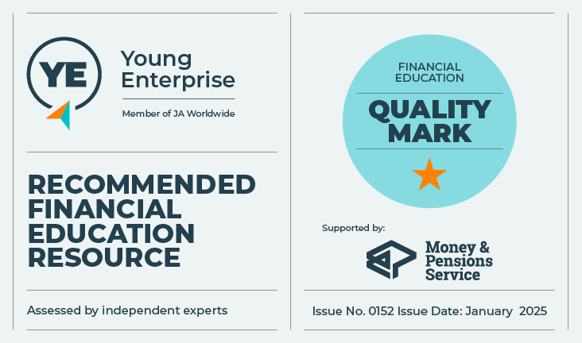
Life, work, money…
How do I stay in control?
Let’s talk about money
This material is intended for information purposes only and does not constitute advice or a recommendation.

Slide 2

Introduction
During this session, we will be learning about:
Where money comes from – now and in the future, and how you will plan to spend and save it.
What types of digital tools are available to help to manage money.

Slide 3

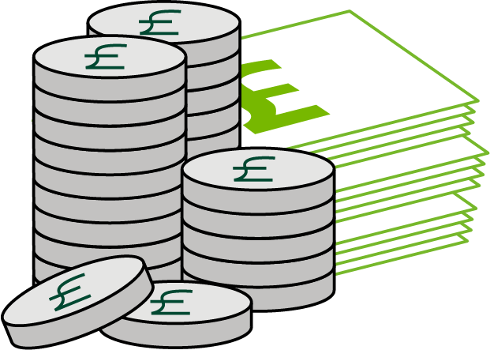
Money and me: agree or disagree?
I will be able to have everything I want in the future.
Good qualifications will help me to earn more money.
Earning money is the only good thing about having a paid job.
Borrowing money is always bad.
You are not spending real money when you pay for things with a smart phone.

Slide 4

Money in? Money out?
What are all of the
possible sources
of income you might
have now?
Where do you get money from now?
Where might you get money in the future?
What do you spend money on now?
What will you spend money on in the future?

Slide 5

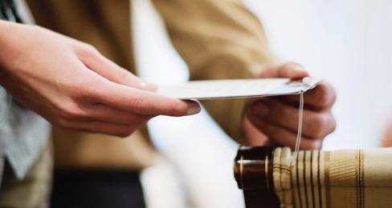
Money in? Money out?
Income
Outgoings
Weekly Allowance
Clothes/
game console
Part time job
Rent

Slide 6
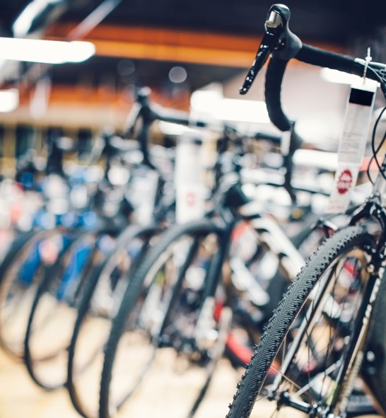
Spend, borrow or save?
1. Jack: Save or spend?
Jack has £200 of birthday money. He wants a new bike and has seen two that he likes. He could buy the cheaper one now for £200, or save another £100 to get the one he really wants.
If he offered to do some extra jobs around the house or saved his allowance, then he could probably save quite quickly.
What should Jack do?
Save? Spend?

Slide 7
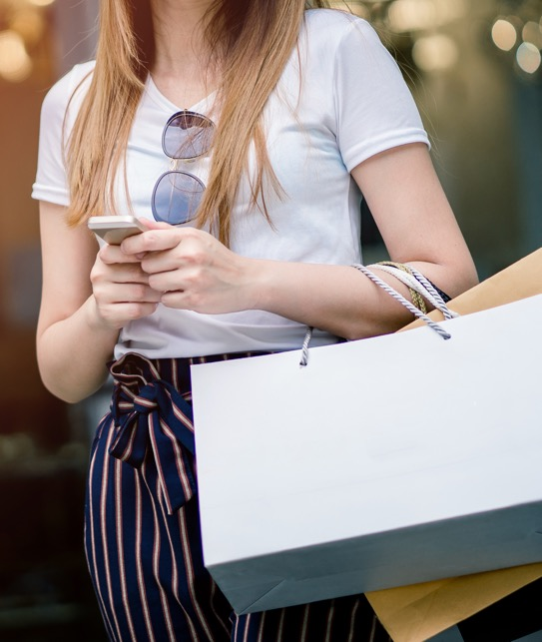
Spend, borrow or save?
2. Lola: Spend, save or borrow?
Lola has saved her £10 per week allowance for over 10 weeks because she is planning a trip into town to buy some new clothes. Her Mum tells her that they are going to London as a treat. She is really excited about the idea of London, but she really did want to get some new clothes.
Her Mum says that she will lend her an extra £50 for their trip to London, and she can pay it back from her weekly allowance when they get back home. If Lola spends all of her own money buying clothes now, and borrows from her Mum, she won't have any money for over a month after the trip while she pays her Mum back.
What should Lola do?
Save? Spend? Borrow?

Slide 8
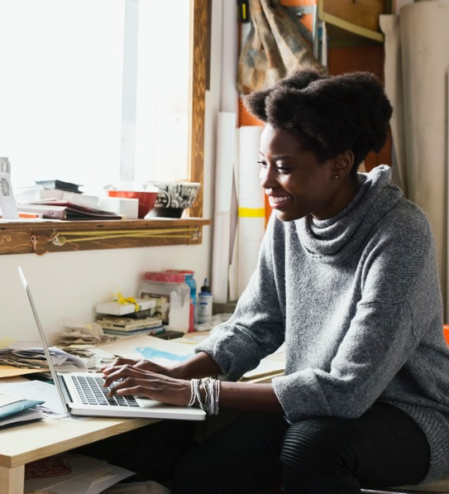
Spend, borrow or save?
3. Aleena. Spend, save or borrow?
Aleena really wants a new laptop to keep up with her online gaming friends. It will help with college work too. She has seen one she wants and it costs £700. She has saved £700, but it will use up all of her savings and she will lose the interest she would earn in her bank account after a year, which is £30.
She has seen an offer at the shop to buy the laptop, on an interest free deal over 12 months. There is a £15 charge for setting up the deal. She could ask her Mum to do the deal at the shop, or pay on her credit card.
What should Aleena do?
Save? Spend? Borrow?

Slide 9






Staying in control
Shopping online
Comparison site
Switching site
Online banking
Banking app
Budgeting app

Slide 10

Me and my money!
Write down…
3 things you have learnt about where you can get money from, now and in the future.
2 things you have learnt about saving
and borrowing.
1 thing you will now do to manage your money in the future.

Slide 11

A big thank you!

