Slide 1


Making the most of what I have
Let’s talk about money
This material is intended for information purposes only and does not constitute advice or a recommendation.

Slide 2

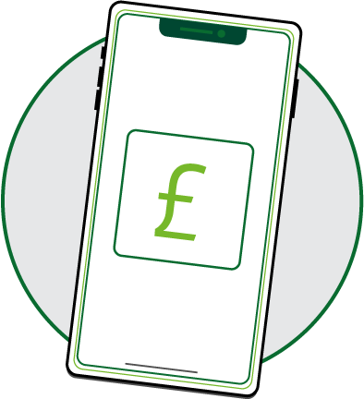
Introduction
Today you will be learning about earnings and pay.
We will also be looking at ways to manage money.

Slide 3

What’s my pay?
Hairdresser/barber
Chef
Nurse
Teacher
Web designer
Fitness instructor
Waiter
Painter and decorator
Shelf filler
Office Manager
Building Engineer
Bar staff
£19,889
£22,080
£37,402
£31,650
£28,116
£35,869
£29,587
£35,242
£26,024
£30,737
£39,319
£22,408
(Annual average earnings: Office of National Statistics, ONS 2024)

Slide 4
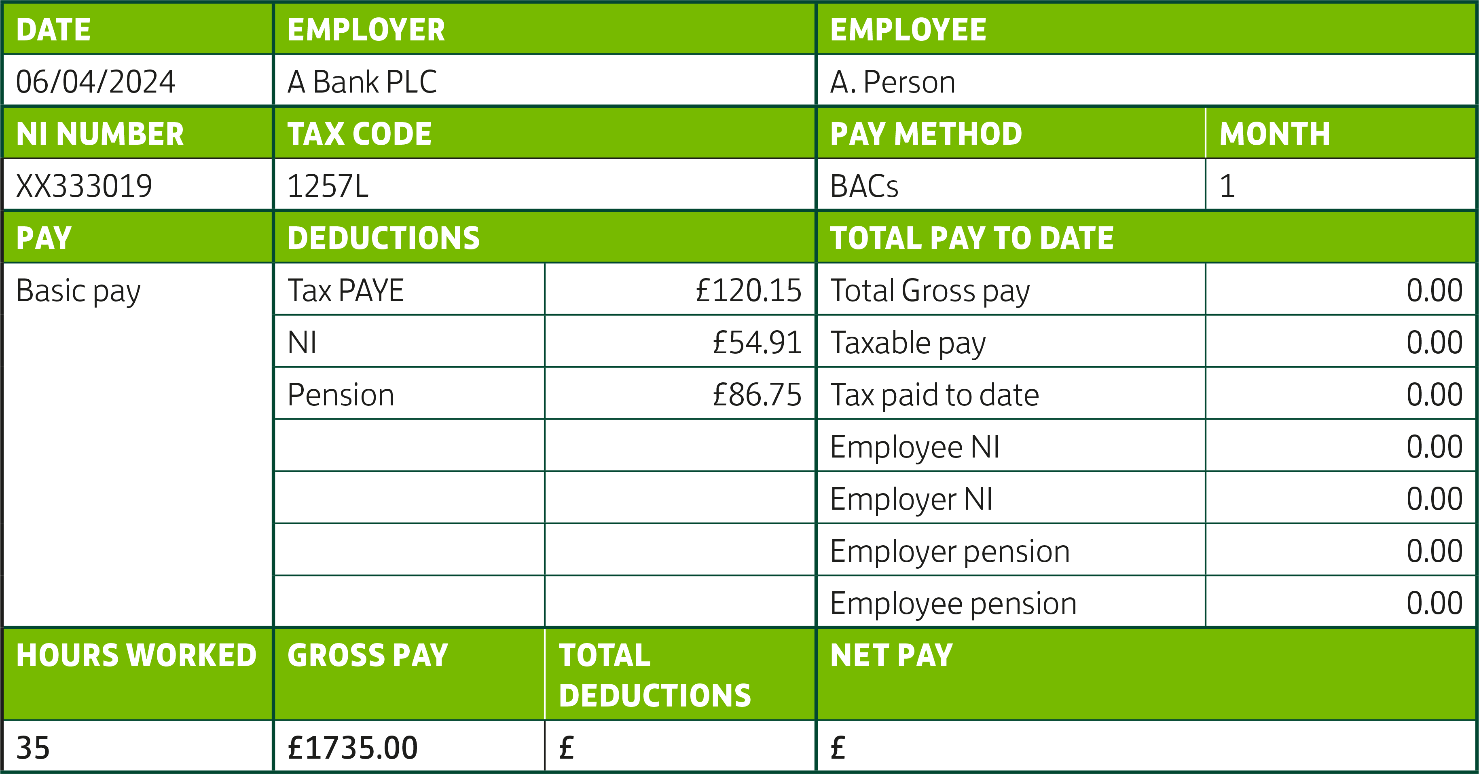
Pay day challenge

Slide 5




Keeping track of what we spend
Write down 2 ways that you keep track of what you spend.
Write down 3 things you or people you know bought last week. Were these things essential or non essential purchases?
Let’s share our ideas…

Slide 6




Making the most of it
Jay’s weekly budget
Jay gets an allowance of £30 each week. He also gets £20 for school lunches. He has just received £30 from his Nan for his birthday. He is saving up for some new trainers that he has seen for £150.
How soon is he likely to get them?
He spends:
£12
each week on a bus pass for school and going out with friends.
£6
each day
on food
(3 days a week).
£5
a week on data top ups for his mobile phone.
£3
a week on music downloads.

Slide 7


Stop, Start!
Choose one thing
you could START
doing in order to manage your money better in the future.
Choose one thing
that you could STOP doing in order to save money or manage money better.

Slide 8

A big thank you!

