Slide 1
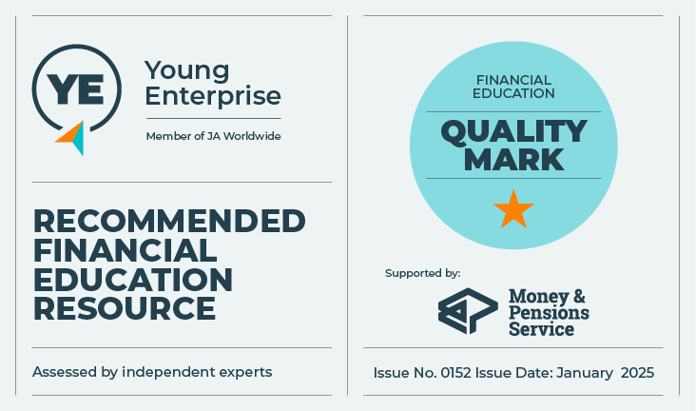

Money box and bank account
Let’s Talk About Money
This material is intended for information purposes only and does not constitute advice or a recommendation.

Slide 2
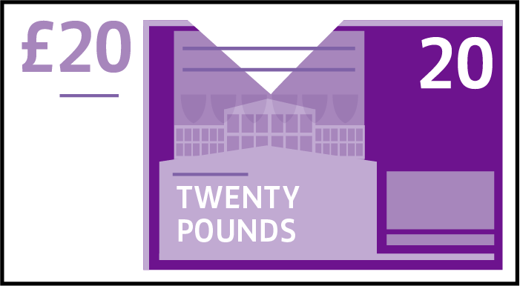
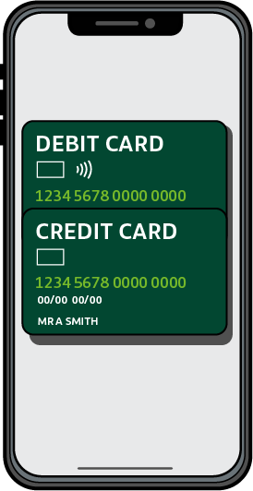
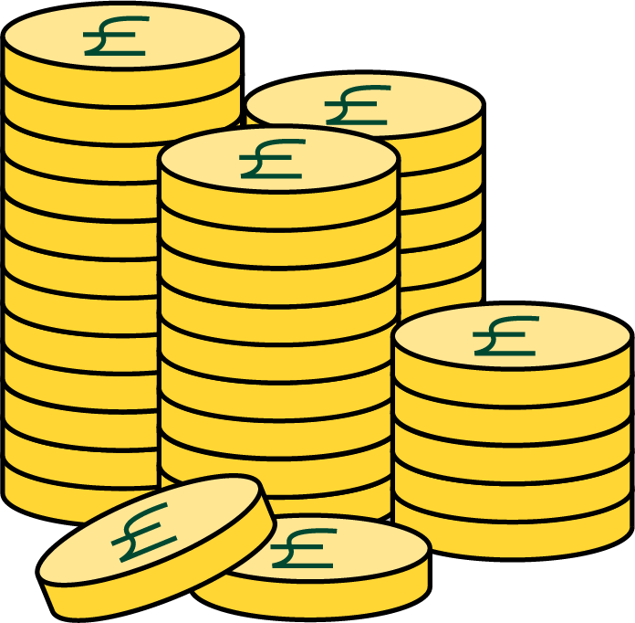
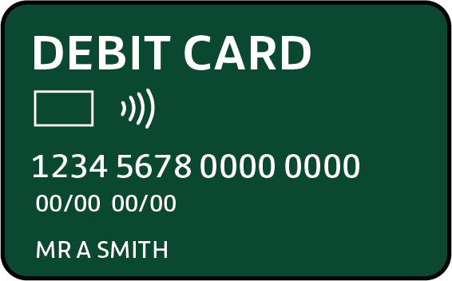
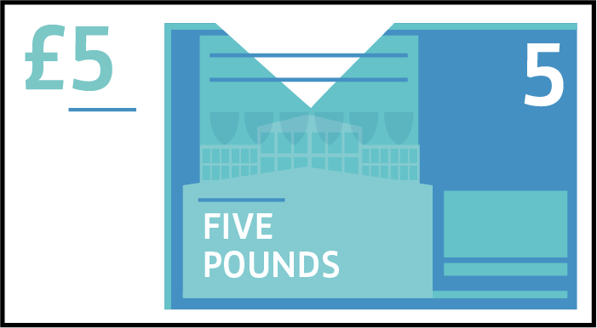
Let’s get started
During this session we will be talking about money:
Ways to keep money safer
The different places to keep money
The different ways to pay for the things

Slide 3
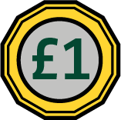
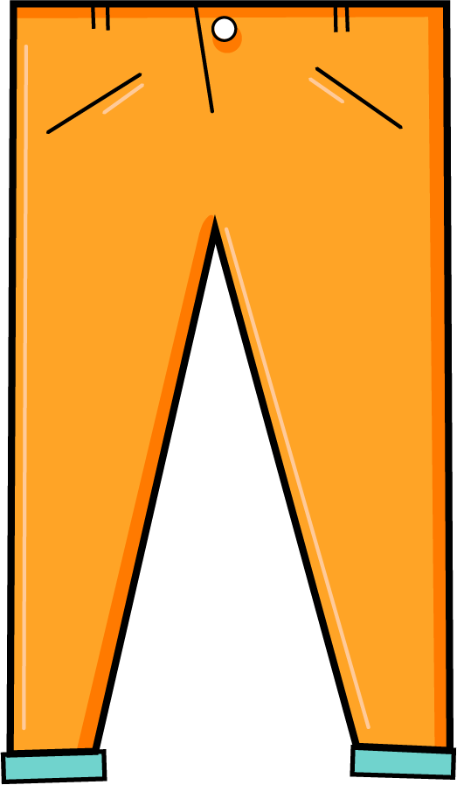

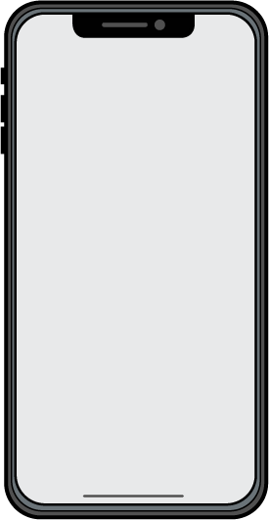
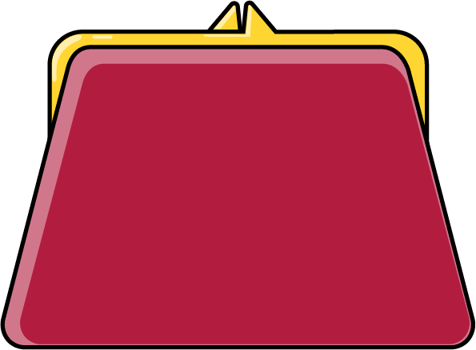
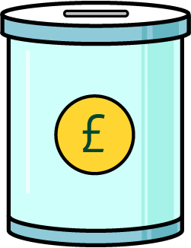
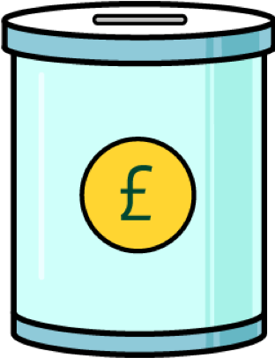
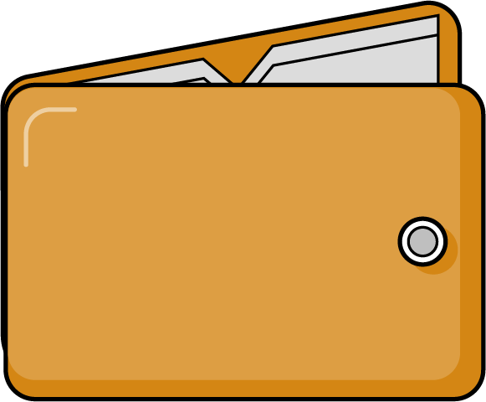
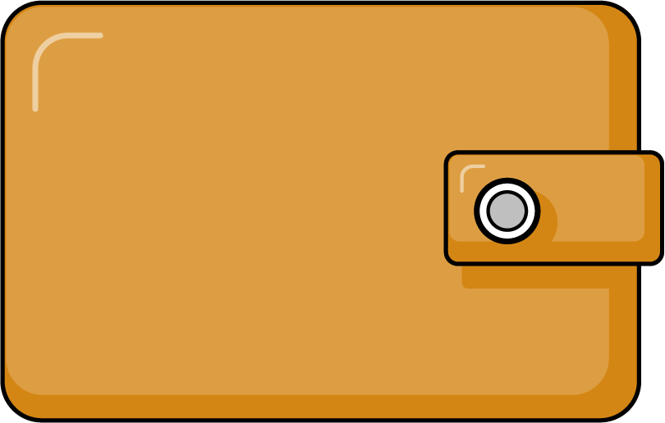
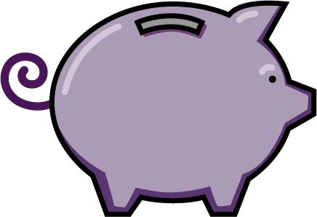
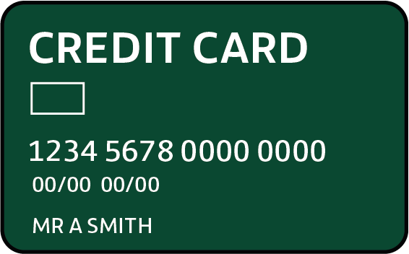
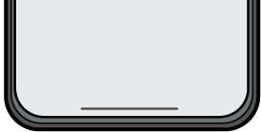
Where can people keep their money?

Slide 4
Keeping money safe
How safe are these places?
Have you changed your mind about
where to keep your money and why?

Slide 5


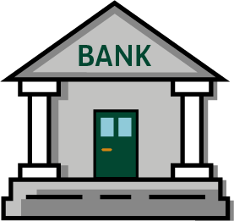
Banks and bank accounts
A bank is one example of a place you can keep your money
You have your own bank or savings account
You can put your money into your account
when you want
You can take your money out when you want to use it
A bank can help you to keep your money safe
A bank can help you to save
A bank account can help you to keep track of your money
A bank account can enable you to pay for things without using cash
You need to have your own account to be able to make use of a bank
If you need cash quickly you need to find a cash machine
You might have your bank card stolen or lose it

Slide 6
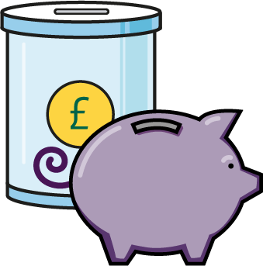
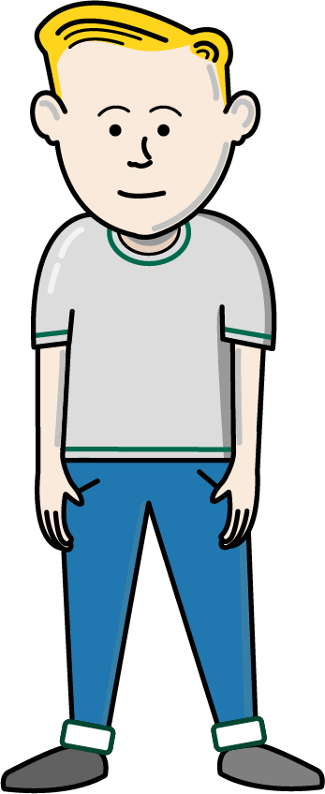
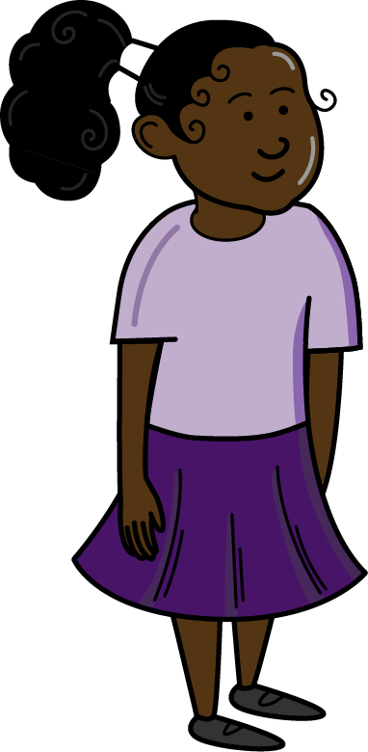
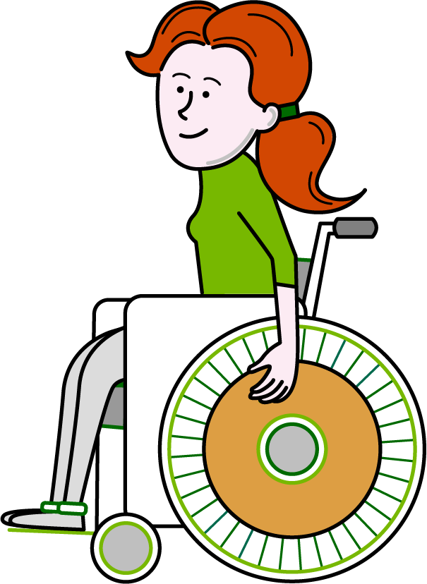
Where should they keep their money?
Working in pairs, decide which is the best place for Tami, Will and Daisy to keep their money
Tami
Will
Daisy
Tami gets £2 pocket money each week. At the weekend she likes to go shopping.
She spends her money on stickers and comics.
Will has just received £15 for his birthday.
He is saving up to
buy a games console.
He doesn't want to be tempted to spend his money before he has enough for the game.
Daisy earns money from a part-time job at the local cinema.
She is saving to
go on holiday, and
she needs money
to get to college
each day.

Slide 7
Making choices about where to keep money
You can pay for things without having cash.
You can use your account to
save money.
An account may help you to keep track
of your money.
Easy to carry around.
Can count the money you have in it.
Can keep quite a lot of money in it.
Can carry cash and other payment types in it.
Can keep receipts in it so you can track what you have spent.
You need to have your own account to be able to make use of a bank.
If you need cash quickly you need to find a cash machine.
You might have your bank card stolen or lose it.
A thief might steal it.
You might lose it when out and about.
Need to remember to take it with you.
Easy to use.
Convenient.
Cash is easy to get to when you want it.
Can regularly count your money to keep track of it.
Easy to use – so long as you have a pocket!
Cash is ready when you need it.
You know how much money you have available to spend.
Heavy to take out shopping with you.
Very tempting to take money from it too often.
A burglar might steal it.
Not very safe unless you have a zip on your pocket.
Money can easily drop out of a pocket.
You can’t keep lots of money in a pocket unless it is a very big pocket!
A thief could steal the money from
your pocket.

Slide 8
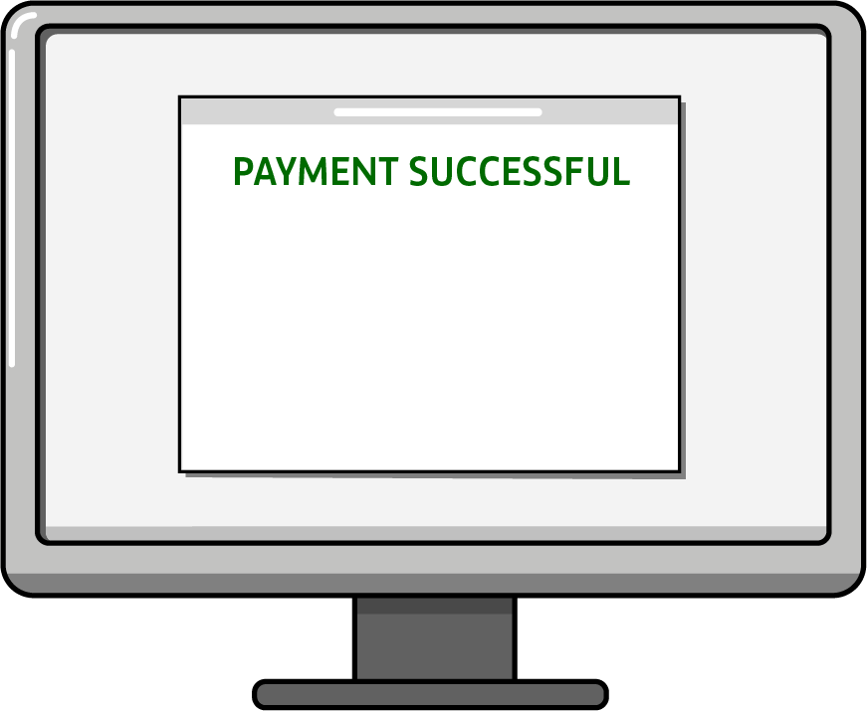
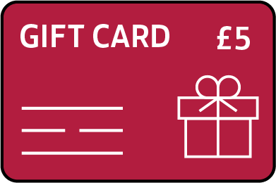
Other ways to pay
Debit
Card
Online Payments
Smart Phone payments
Gift cards
or Vouchers

Slide 9
What have you learnt today?
Talk with a partner about where you will choose to keep your money and why?
What advice would you give a friend
about where and how they might keep
their money safe.

Slide 10
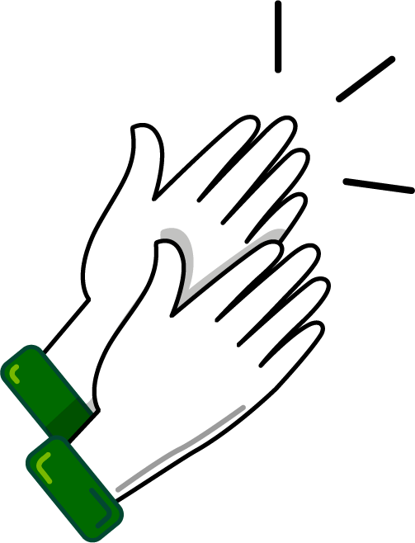
A big thank you!

