Slide 1


Risking it, is it worth it?
Let’s talk about money
This material is intended for information purposes only and does not constitute advice or a recommendation.

Slide 2

Introduction
Today you will be learning about:
Potential risks to do with money.
How we can protect ourselves against risk.
Fraud and ID theft.

Slide 3

Are you a risk taker?
Have you:
Been on a big roller coaster?
Had a bet with someone?
Run across the road without looking?
Decided something by flipping a coin?
Lent money to someone?
Borrowed money from someone?

Slide 4

Risking it!
How much are you prepared to take a risk?
What might happen if things go wrong?
Is it our responsibility to protect ourselves against risk?
How might we protect ourselves
against risk?

Slide 5


What is insurance?
Insurance is a means of protection from financial loss.
It can be used to protect you from things such as accidental damage, theft, illness, unexpected events, etc.
It costs to insure and may not always be appropriate.

Slide 6
The weird and wonderful world of insurance quiz.
You have a maximum of 5 minutes to read and discuss the statements and decide if they are true or false.
You can buy insurance against accidental moustache removal.¹
There was a successful insurance claim for the paint on a couple’s
car which was damaged by a herd of cows licking it.²
Not liking a holiday has been covered by holiday insurance.
There was a successful insurance claim for a man trapped in a house he was trying to burgle, and forced to survive on dog food and soda.³
David Beckham insures his seat in Old Trafford.
Theft of clothing by monkeys has been covered by holiday insurance.⁴
TRUE
TRUE
FALSE
TRUE
FALSE
TRUE
¹source: https://beardoholic.com/lloyds-insuring-facial-hair
²source: https://medium.com/@KingPriceIns/the-most-bizarre-insurance-claims-to-date-62520dc6ca12
³source: https://www.compare.com/auto-insurance/coverage/top-10-weirdest-insurance-claims
⁴source: https://home.bt.com/lifestyle/money/insurance/10-of-the-most-bizarre-travel-insurance-claims-11363966501713

Slide 7


Risk and insurance
Sally has just bought a mobile phone. The phone shop offers her phone insurance. Should she insure or not?
Is there anything else Sally could do?
Fazal is planning a holiday.
The holiday company offers him holiday insurance. Should he insure or not?
Is there anything else Fazal could do?
Facts:
It will cost an extra £10 per month.
She will have to pay the first £100 of any claim.
Sally’s phone costs £270.
The contract is for 24 months.
Sally has never lost or broken a phone before.
Facts:
Insurance will cost £120 on top of the cost of the holiday.
He will have to pay the first £250 of
any claim.
The holiday costs £1,200.
Fazal’s holiday isn’t for another 10 months.
Fazal has never been ill on holiday before.

Slide 8

To insure or not?
Insurance is a way to protect ourselves from risk.
Insurance might not always be the best solution for everyone.
Always:
Shop around – use comparison sites to help you do this.
Find out what the insurance covers and what it doesn’t.
Weigh up the pros and cons of insurance.
How big is the risk?
Can I afford to take the risk?

Slide 9



Types of financial fraud & scams
ID fraud
Social media scams
Fraudsters take on your identity to take out loans, or use your accounts.
Emails and text scams:
These appear to come from the social media app you use. It tells you there is a problem with your account.
You provide personal details or payment to solve
the problem.
Bait and switch scams:
You are sent a fake link to a viral video. You are then asked to update your app. When you click, it infects your device to steal personal details.
Ticket Scams
You buy tickets but you are either sent fakes or the tickets don’t arrive.

Slide 10

Types of financial fraud & scams
Card not present fraud
Scam calls
Safe account scams:
Someone contacts you pretending to be your bank, the police or other governing bodies. They trick you and ask you to transfer money into a ‘safe’ account, which you do. When in fact, the account is the fraudsters.
Authorised push payments: Scammers can pose as a legitimate business which you might already be dealing with. You then send them money instead of to the
real person.
Computer virus scams: Someone contacts you pretending to be your telephone or internet company. They tell you that there is a problem with your computer. You log in and give them access to solve the issue.
Card not present fraud is a type of third-party fraud in which the physical card or PIN does not have to be present – the card details have been fraudulently used to transact with an online retailer, or over the phone or by mail order.

Slide 11
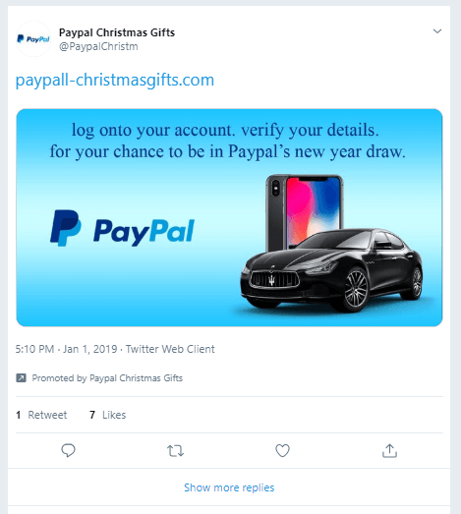
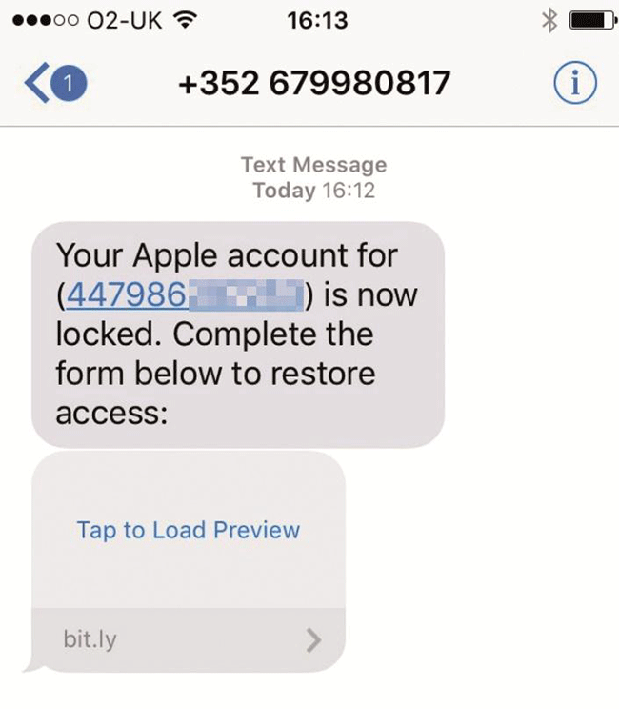
Recognising fraud and scams

Slide 12


Financial fraud – what does it cost?
It’s a big problem:
£1.17 billion was lost to financial fraud in 2023, including:
£104m
Lost and stolen card fraud
£25.6m
Cash machine
fraud
£17.6m
Telephone
banking fraud
£88.7m
Internet
banking fraud
£45.5m
Mobile banking fraud
Figures from UK Finance 2024

Slide 13

What can I do to protect myself?
In 60 seconds …
Write down at least two key things you can or will do to avoid risk.

Slide 14

A big thank you!

