Slide 1


Staying safe with digital money
Let’s Talk About Money
This material is intended for information purposes only and does not constitute advice or a recommendation.

Slide 2
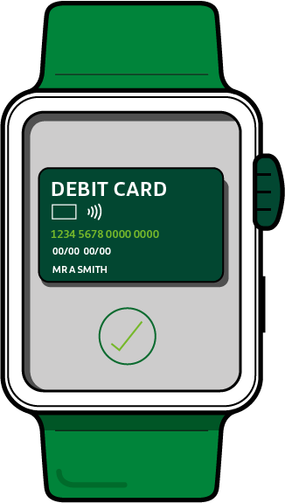
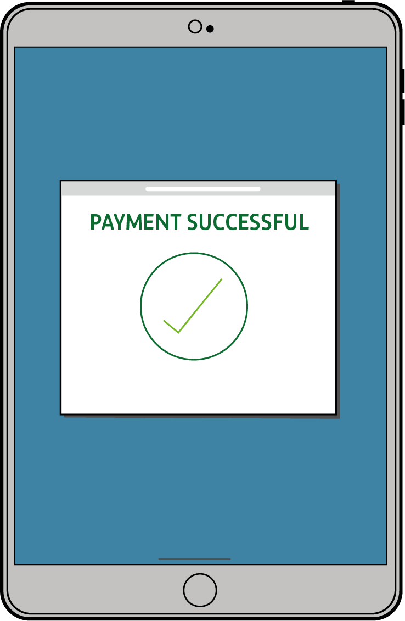
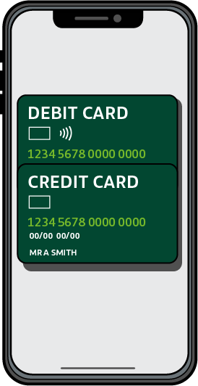


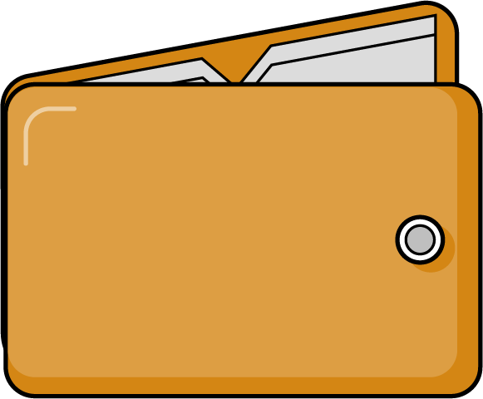

Introduction
During this session we will be talking about digital money:
What is digital money?
Does digital money have a value?
Is digital money safer than cash?
What are online scams?
How can we stay safe online?

Slide 3
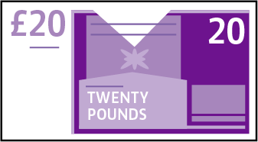

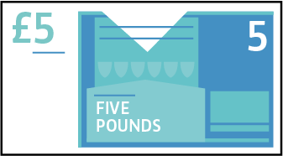
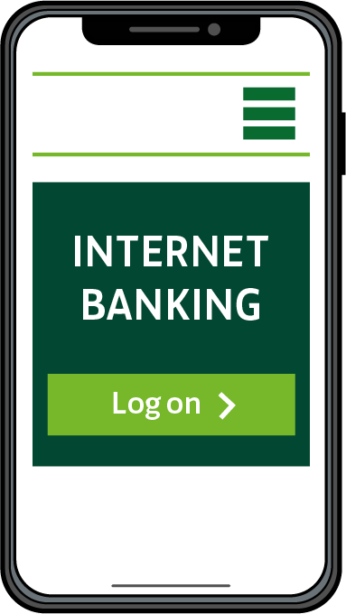
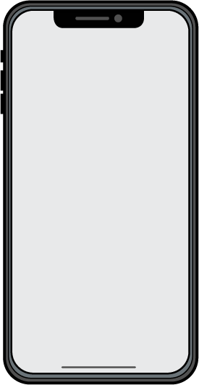
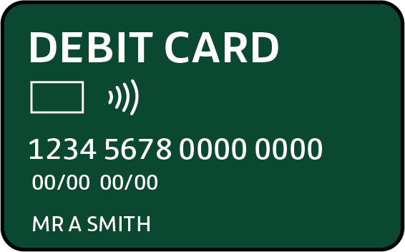
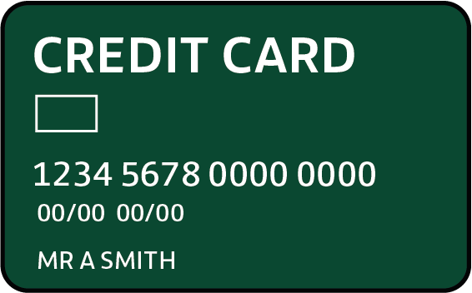

Notes & coins vs. digital money

Slide 4
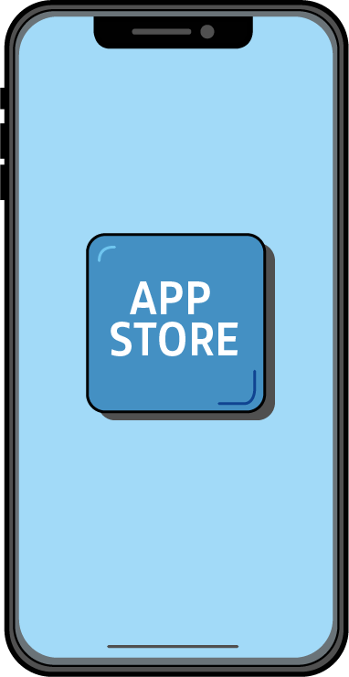

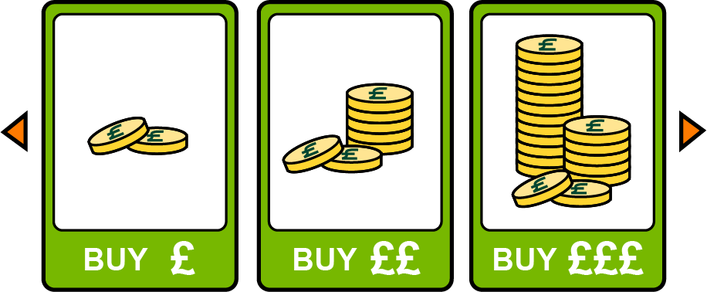
Managing your money online
Apps for phone and tablet
Online
purchases
In-game purchases of coins, stars or tokens
Why do you think people buy things online?

Slide 5

How do you feel?
How would you feel buying things online?
When you buy online are you
spending digital money?
Do you think in-game purchases,
such as buying coins or add-ons
is spending digital money?
What about stars or tokens
you gather during play?
Do these coins, tokens or stars have a value?

Slide 6


Is this safe?
Is it always safe to be online or buy things online?
What do you know about staying safe on the internet?

Slide 7
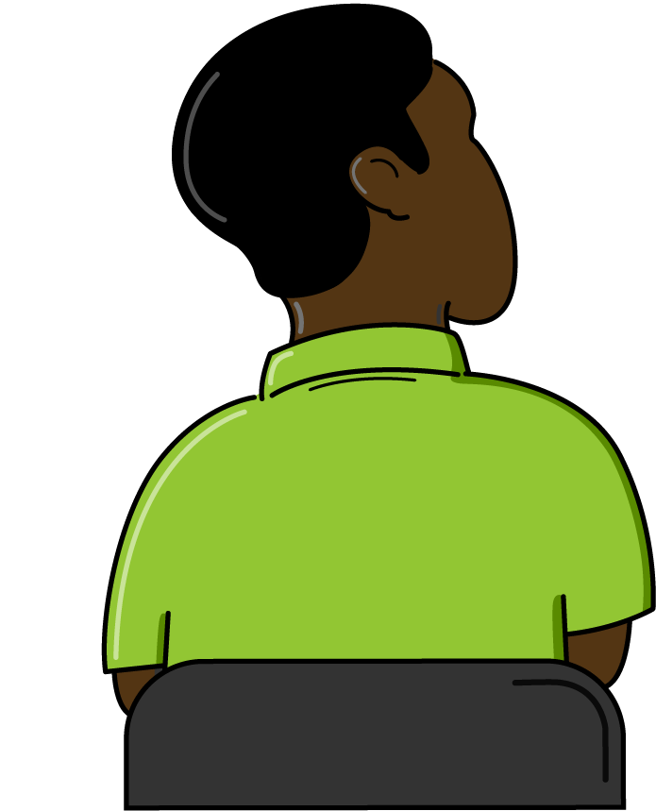
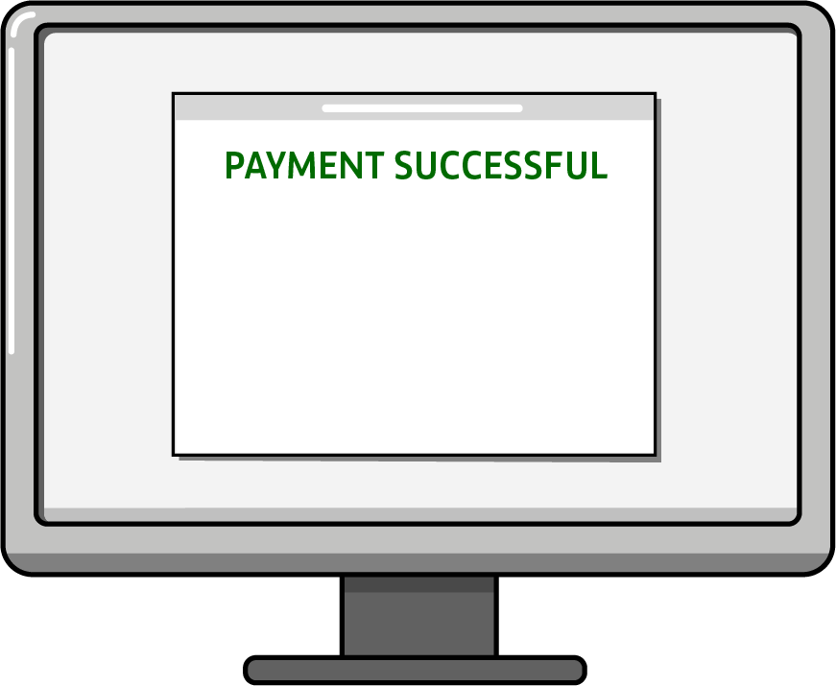


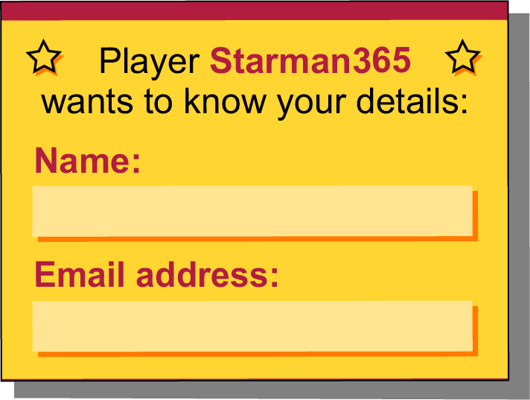

Don’t give too much away!
Ben is at home playing an online game.
What should Ben do?

Slide 8

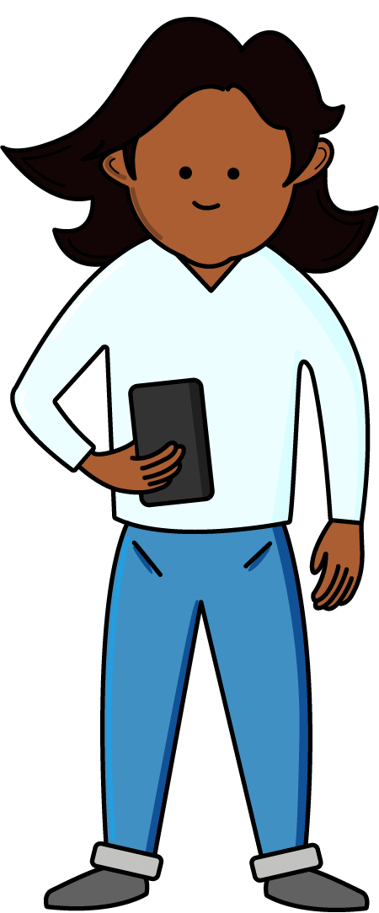
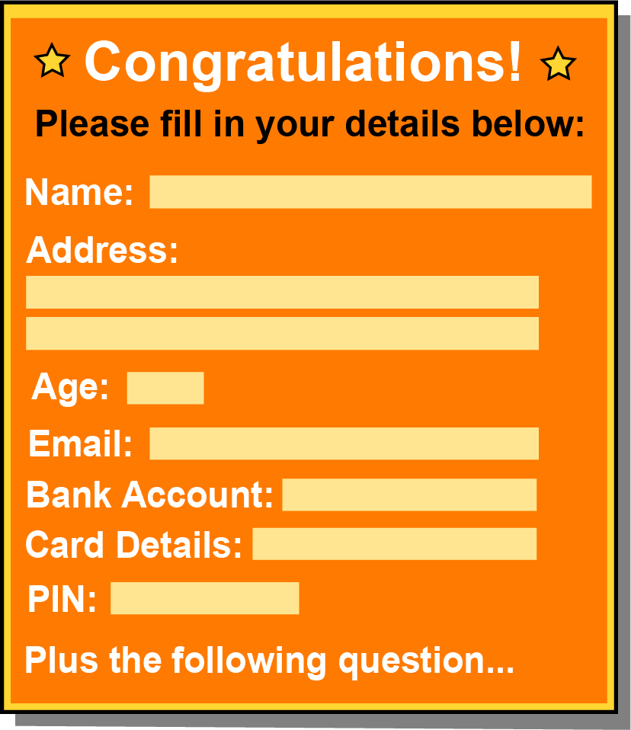

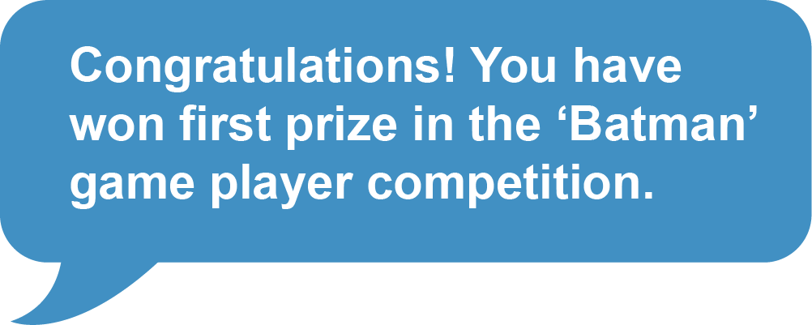

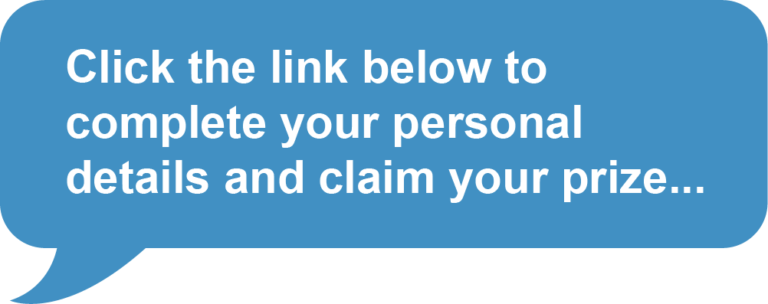

Things may not be what they seem!
Jamilia is checking her messages.
What should Jamilia do?
Do you think she has really won a competition?
Should Jamilia provide all this information?

Slide 9

Scams
A scam involves tricking people.
They are tricked to part with their money
or disclose personal information.
Criminals could use this for other
illegal activities.

Slide 10
Top tips for keeping your money safe online
Keep personal information to yourself when chatting or posting online: Name, address, date of birth, email address, school etc.
Keep passwords (your own secret word) and PINs (Personal Identification Number) private.
Don’t respond to emails asking for your personal information.
Think before you click on links in emails.
Even if it seems a good deal, it may be too good to be true!
If you’re logged into an account always log out when you’ve finished.
Check with an adult before you spend money online.
Tell an adult if you are concerned about anything that
you see or are asked to do online.

Slide 11
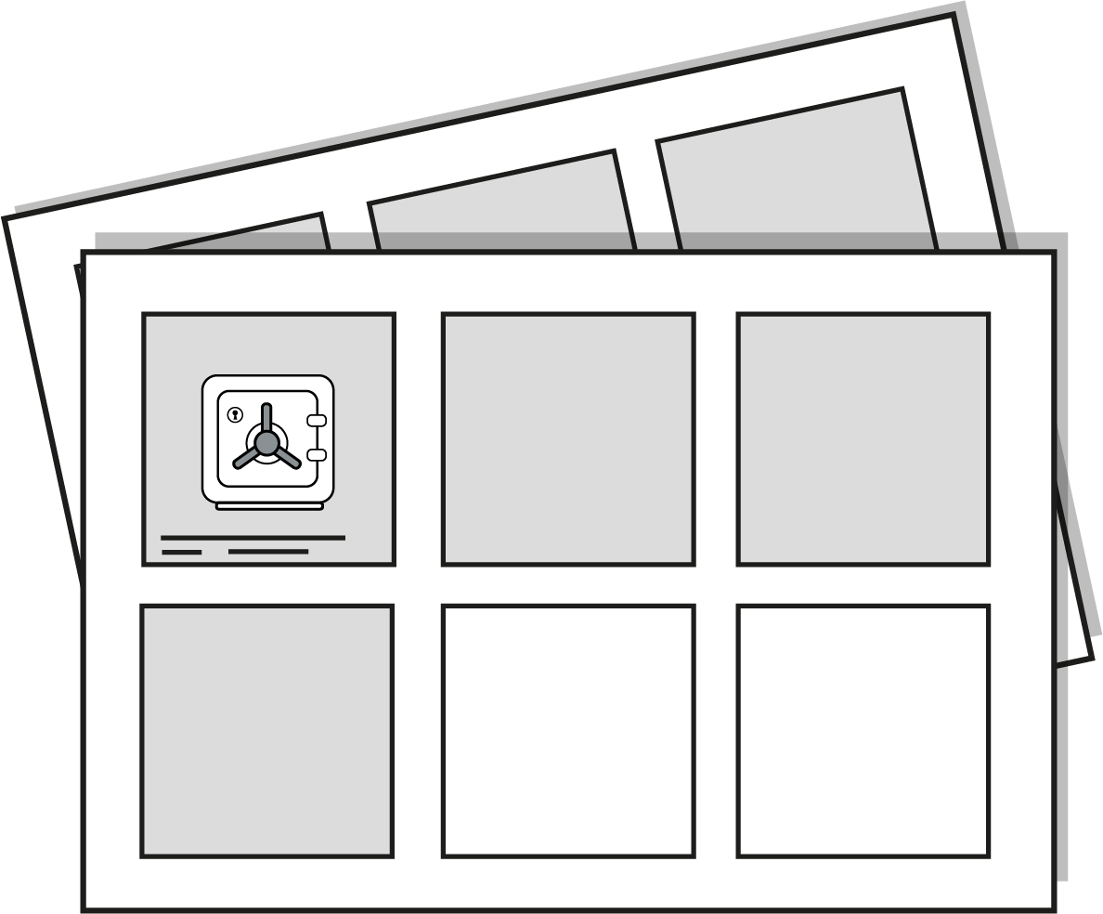
Start Safe, Stay Safe
Create your own storyboard about ‘Money safety in a digital world’. You could imagine you are trying to explain to your friends how to keep their money safe online and why.
Using your piece of paper draw 4 to 6 pictures. Write a short sentence under each picture
which will help to tell your story.

Slide 12
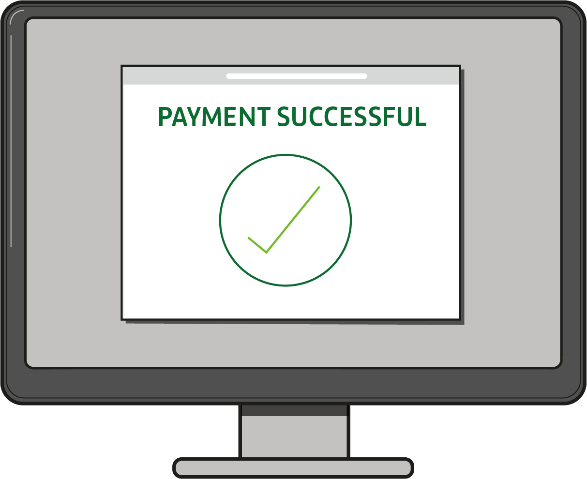
Think before you share
In pairs discuss what we have learnt about today.
List two things you will remember to do in order
to keep your money safe online.

Slide 13

A big thank you!

